Slide 1
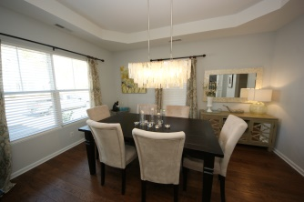
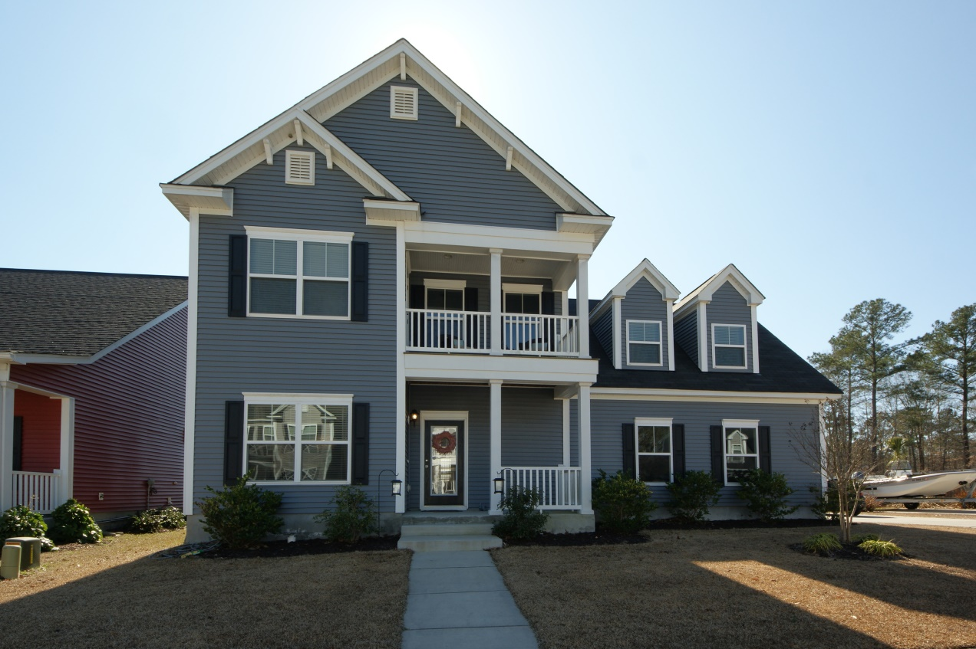
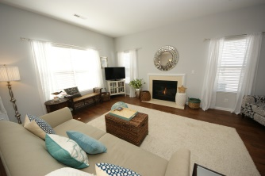
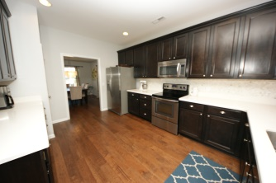
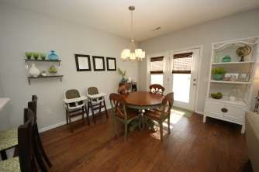
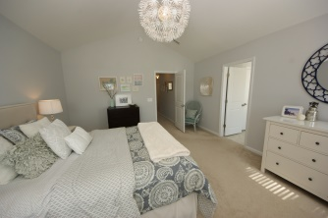
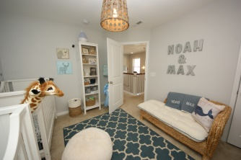
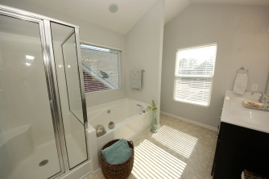
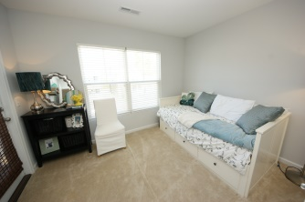
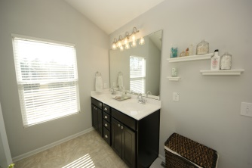
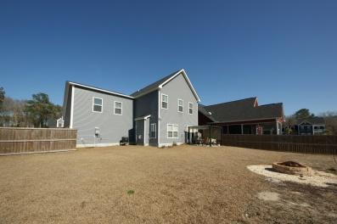
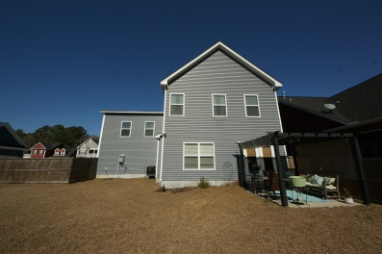
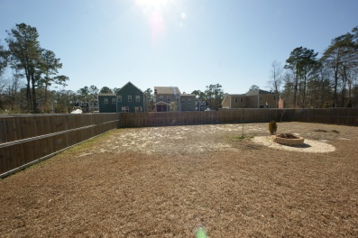
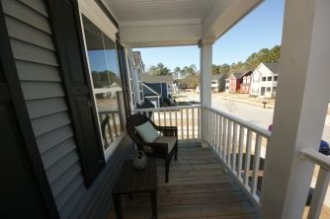



Price Reduced in Swygerts Landing
1306 Segar Street
Johns Island, SC 29455 - MLS# 15007161 - $305,000
Gorgeous lowcountry home on Johns Island in the popular subdivision of Swygerts Landing! Just 15 minutes from MUSC/Downtown and Kiawah and Folly beaches! 5 minutes from some great restaurants, Fat Hen and Wild Olive. Prepared to be wowed by this meticulously cared for home. There are hardwood floors throughout the open floor plan (Wentworth plan) downstairs, which lends itself nicely to entertaining. The kitchen boasts tons of cabinet space, silestone countertops, a beautiful tile back-splash and stainless steel appliances. Upstairs has two secondary bedrooms, the master bedroom and a huge FROG. The details were not overlooked in this home, from the beautiful light fixtures, to the custom faucets in the master bathroom, you won't want to miss out. The home is only 3 years old with many energy efficient features, such as a tankless water heater. Double porches, a two car garage, backyard pergola, fire pit and a large fully fenced yard make this home complete! This one won't last long!
Lara Harpe
Co-Owner
Broker/ Realtor
Mobile 843-298-6669
Lara@thepulsecharleston.com
Stacey Boucher
Co-Owner
Broker/ Realtor
Mobile 843-817-8963
Stacey@thepulsecharleston.com
thepulsecharleston.com

