Slide 1

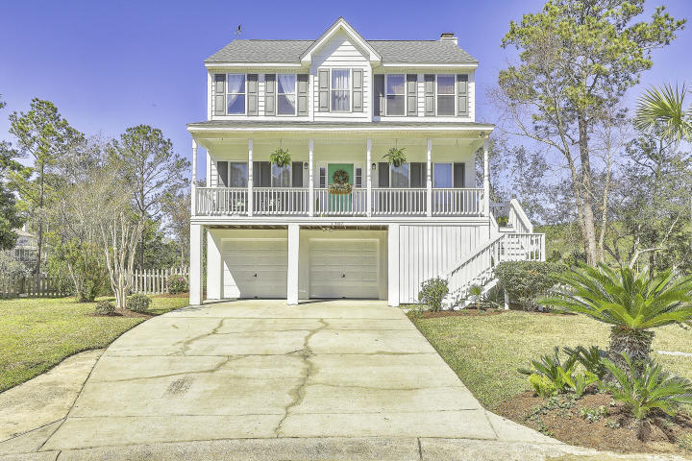
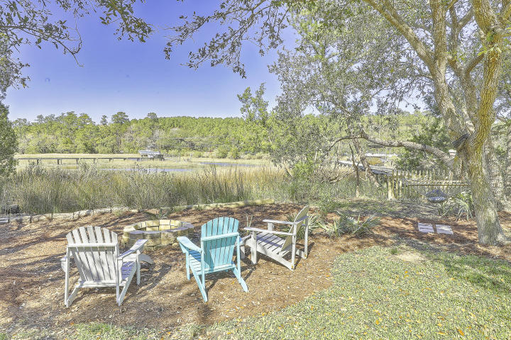
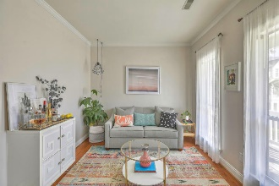
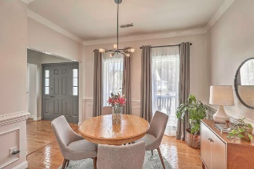
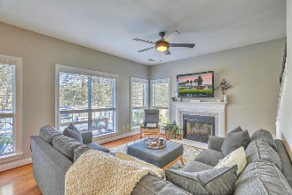
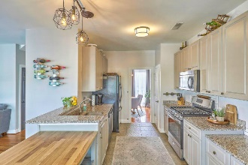
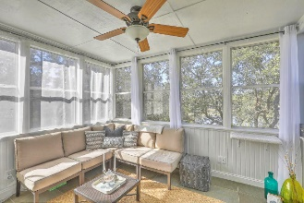
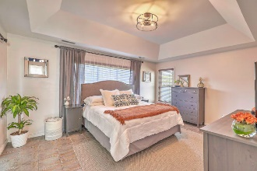
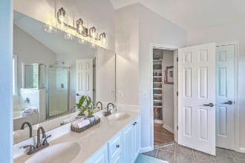
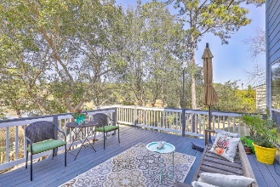
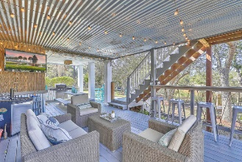
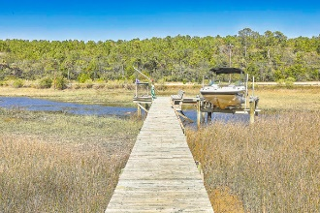


Waterfront Home with Dock! Open House Saturday from 12-2
1307 Rockfish Court
Horlbeck Creek | Mount Pleasant, SC 29466 | MLS# 20006214 | $499,975
Coastal living at its best! Don't miss this immaculately maintained waterfront home with private dock/boat lift on beautiful tidal creek. Loaded with style throughout, you will be greeted by a gracious foyer with separate office/living room and formal dining room on each side. The well-equipped, updated kitchen with breakfast area opens to the Great Room which has a fireplace and wall of windows offering plenty of natural light and sweeping views of the marsh. Enjoy coffee in your cozy sunroom, overlooking the large deck and beautiful back views. Upstairs, is the large Master en suite with tray ceiling and custom shelving in the walk-in closet. Two other bedrooms, sitting room and guest bath round out the interior. Guests will LOVE the exterior space complete with Tiki Bar, firepit and dock out to your own private boat lift and bartop to enjoy a glass of wine as the sun sets over the water. Need a little extra storage space or looking to have your own home gym? Check out the room in the lower level that is not included in the square footage! There is also a neighborhood community dock on deep water where you are welcome to leave your boat overnight. The Wando River is approximately 15 minutes by boat from the house. Easy commuting to the airport via Clements Ferry Rd. and 526. Plentiful shopping and dining nearby and only minutes to Isle of Palms and Sullivans Island beaches. If you have ever wanted a waterfront home, this is definitely one that you don't want to miss!
Desiree Maurer Office - (843) 416-2000
Mobile - (843) 327-9010 desiree.maurer1@gmail.com
www.yourcharlestonhousesearch.com
Keller Williams Realty 496 Bramson Ct Ste 200 Mt. Pleasant, SC 29464

