Slide 1
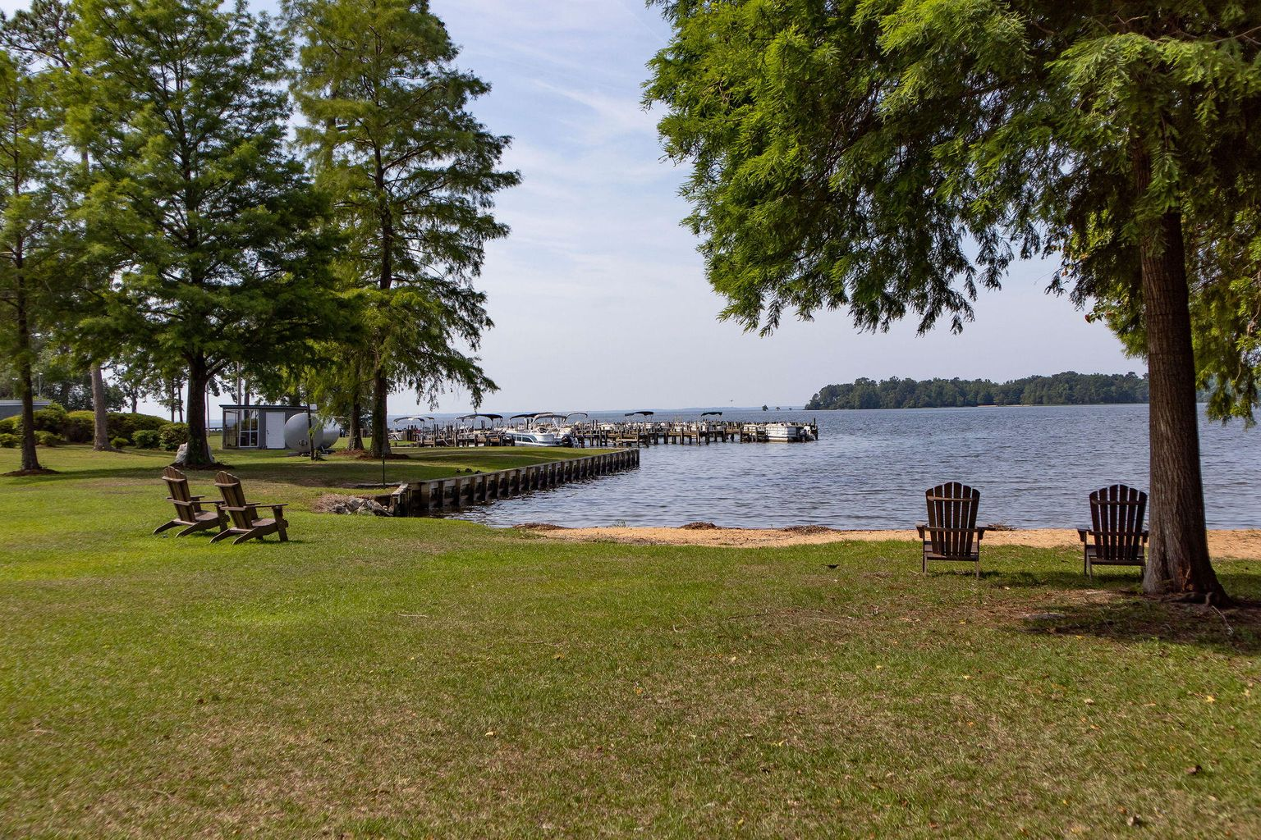

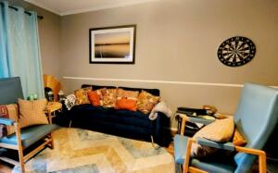
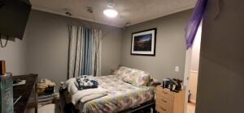
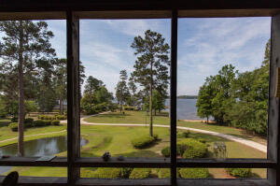
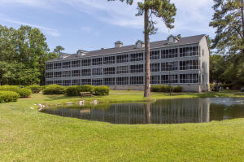
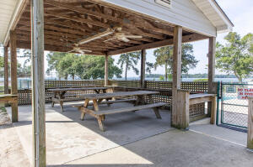
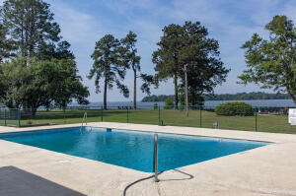


This Condo Wont Last Long
1307 Cypress Pointe Lane A307
Manning, SC 29102 | MLS# 22013355 | $130,000
Countryside, Lakefront living in this one bed and one bath condo that is located on the third floor, so you won't have to worry about any noise from the upstairs neighbors. Inside you'll have a spare bunk bed built into the hallway for a guest. This is a great place for a person that is trying to branch out on their own or a couple that is about to retire and looking for that quiet place to relax. On the grounds, youll have a club house with a two bed/bath apartment to rent for your guests, a fish cleaning station and rentable boat slips with beach access. Next to the property you'll find Lake Vue Marina who is in agreement with your future HOA and allows all of the resident's access to the boat slip. You also have dry storage for your boat and a storage facility across the street. This condo does have a monthly HOA fee of $232.00 but in that fee your cable, Wi-Fi, pest control, water, sewer and ground maintenance and trash pickup is all covered.
Gary Carraway
843-437-8257
garycarraway.realtor@gmail.com
https://garycarraway.truecarolinarealty.com
True Carolina Realty
7410 Northside Drive, Ste 150
N Charleston, SC 29420

