Slide 1
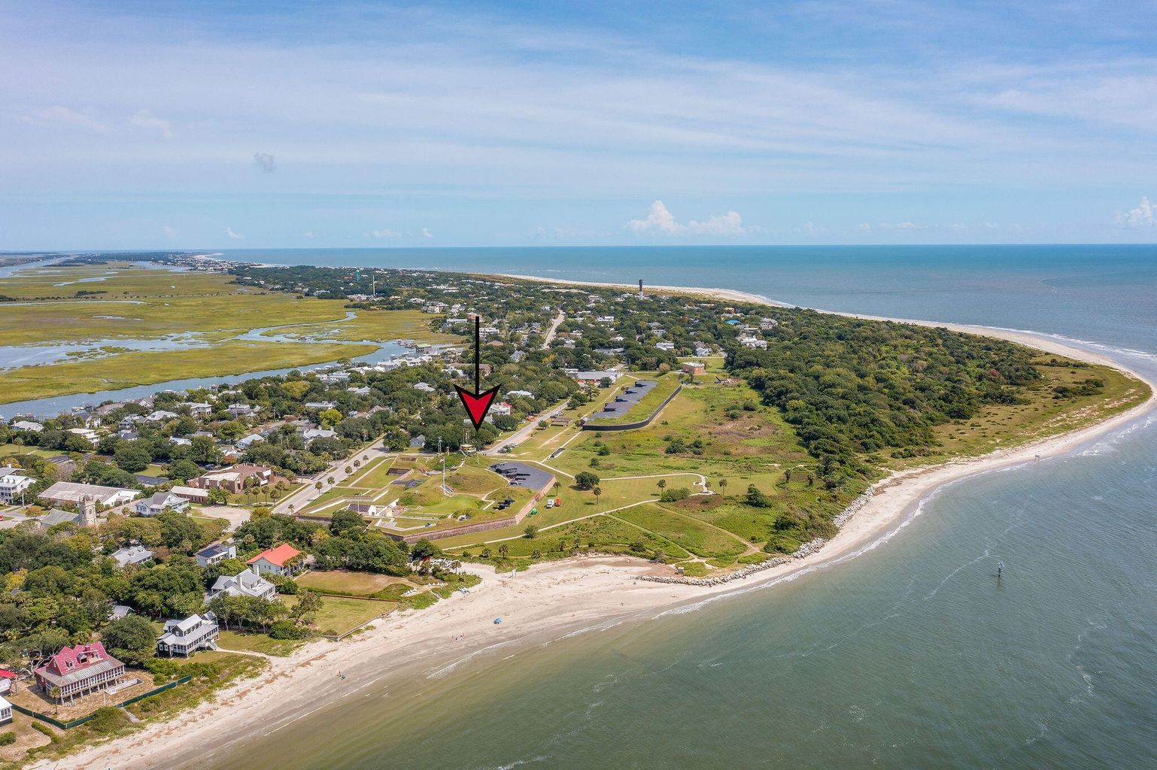
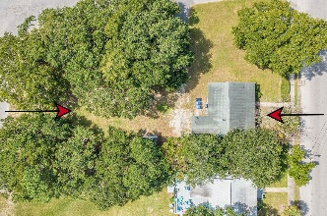
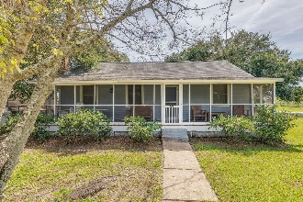
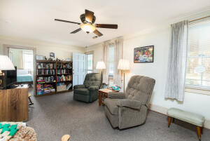
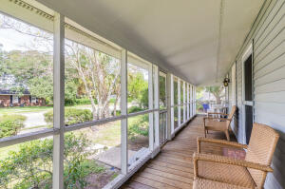
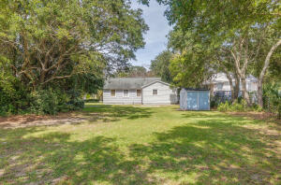
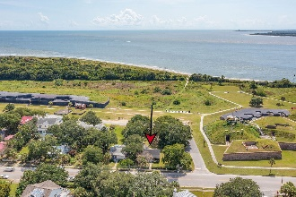
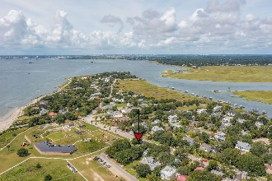
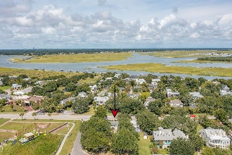

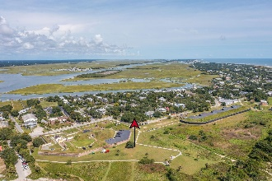

1307 Middle Street
Sullivans Island, SC 29482
MLS# 21027844 | $2,850,000
Wild Dunes Swim & Social
Membership w/ Acceptable Offer
Fabulous Buildable Lot with Early 1900s Cottage
Deep Price Adjustment
GREAT POTENTIAL for an exceptionally nice buildable Lot consisting of .35 acre, located on a street to street corner, at the west end of beautiful Sullivan's Island. At the far end of lot, near Middle St. is a charming early-mid 1900's Beach Cottage, 3 B/R, 2 B/A, L/R, D/R, Kit & Laundry Rm. However, this Cottage can be removed from property or renovated for a Guest House, Pool House, etc. One of the few great locations left on the island, offering unbeatable views along with a convenient beach access path, located just across the street, leading to Sullivan's Island & Ft. Moultrie's beautiful pristine beaches.
Property is accessible from three sides, providing an excellent opportunity for the discerning Buyer to construct a new home facing Poe Ave., overlooking panoramic views of the Atlantic Ocean along with its intriguing and unique Charleston Harbor shipping channel.
Nearby are some of the best known restaurants in the Lowcountry, located on Sullivan's Island and only 20 mins. from downtown Historic Charleston... offering only the best there is to offer!
Also listed as Vacant Land: MLS# 21029074
Linda Laird
REALTOR
M (843) 209-7571 | O (843) 886-8110
linda.laird@carolinaoneplus.com | www.lindalaird.com
Leading Real Estate Companies of the World
Carolina One Real Estate
1503 Palm Blvd
Isle of Palms, SC 29451-2280

