Slide 1
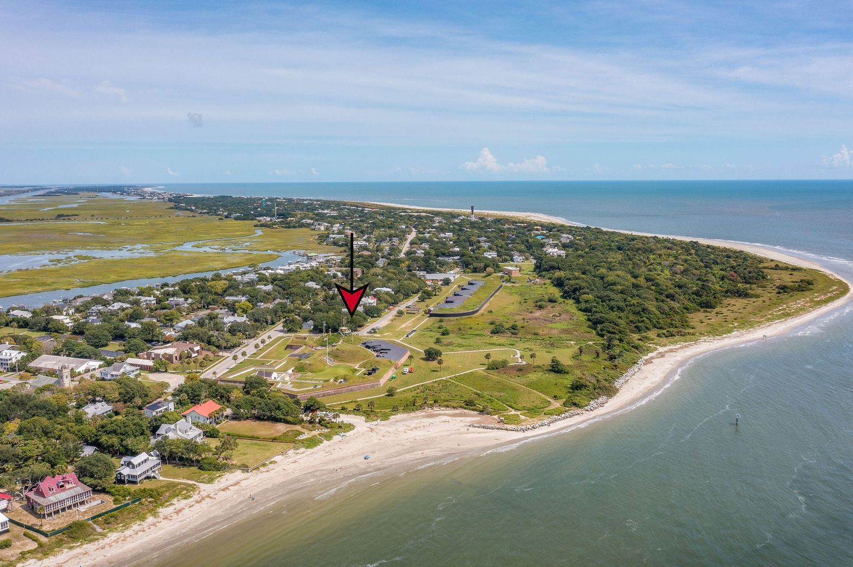
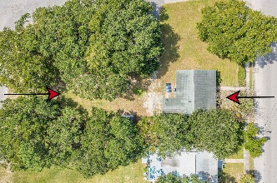
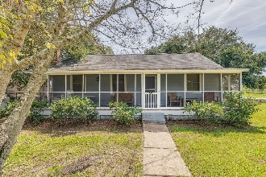
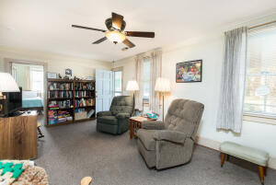
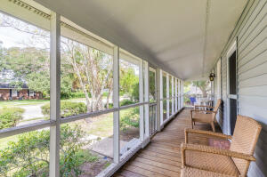
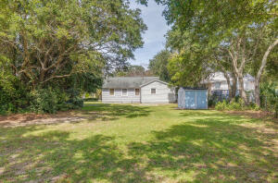
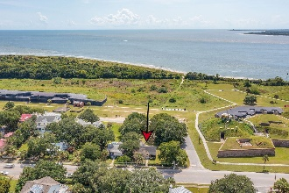
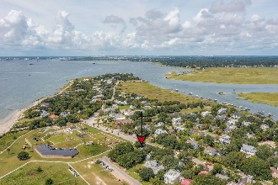
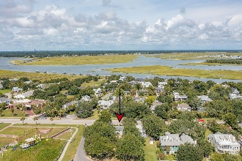

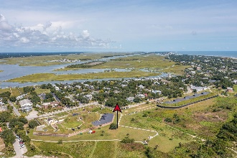

1307 Middle Street Sullivans Island, SC 29482 MLS# 21029074 | MLS# 21027844 | $3,650,000
Wild Dunes Swim & Social
Membership w/ Acceptable Offer
Fabulous Buildable Lot with Early 1900s Cottage
Beautiful parcel of land located on a corner Lot on Sullivan's Island consisting of .35 acre, with road frontage on three sides. Excellent opportunity for construction of a new home facing Poe St., overlooking the Atlantic Ocean, with unobstructed views, & only steps to beach access path, with views to the West, overlooking the Intracoastal Waterway, etc.
A 1920's beach cottage is located on the property and would be ideal for an accessory property and could be used as a Pool House, Guest House, etc. It includes L/R, D/R, Kitchen, One full B/A, Half B/A, 3 B/R's, Laundry area, & Front Screened Porch. House not considered Historic & can be removed or Buyer has the option to have it reconsidered and listed on the Historical Register of Homes as an important Historic Resource.
Linda Laird REALTOR
M (843) 209-7571 | O (843) 886-8110
linda.laird@carolinaoneplus.com | www.lindalaird.com
Leading Real Estate Companies of the World
Carolina One Real Estate
1503 Palm Blvd
Isle of Palms, SC 29451-2280

