Slide 1
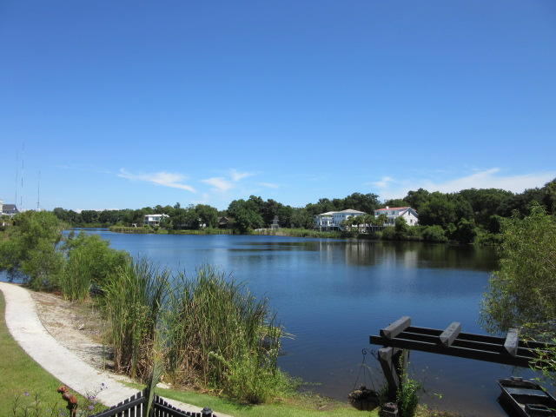
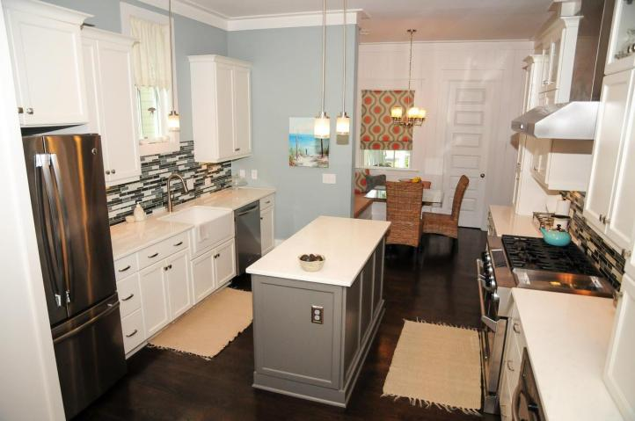
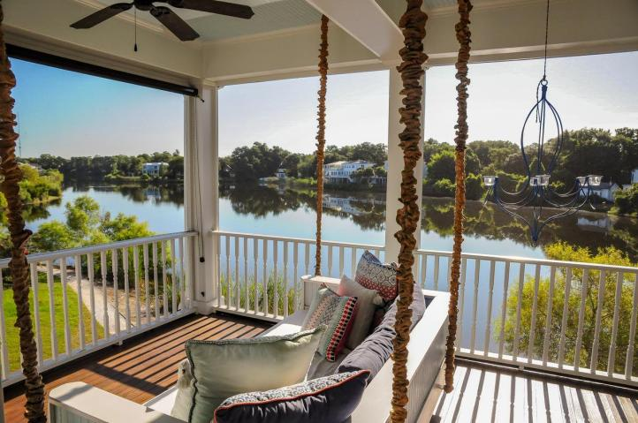
Gorgeous Home For Sale In Watermark It's A Must See!
$40,000
Price Reduction!
1308 Penshell Place
Mount Pleasant, SC 29464
MLS# 18024642 | $829,000
WOW! How about this gorgeous 4 bedroom stunner nestled peacefully on the shores of a large lake in the heart of Mt Pleasant! It doesn't get any more convenient than this; 10 mins to Isle of Palms or Sullivans Island beaches, 5 mins to Town Center, 3 mins to the 526 or Hwy 17, 15 mins to downtown Charleston and the list goes on. The permanent vacation feeling never leaves you in this magnificent home with it's incredible views, 4 beds, 3.5 baths (2 en-suites and one Jack and Jill), beautiful custom shiplap paneling, high ceilings, a gorgeous chefs kitchen (high end gas stove), massive windows, a game room, an office with a view, two screened in porches overlooking the lake, a covered back porch, irrigated garden, flickering gas lanterns front and back, surround sound, fiber optic internet service, a lovely double car garage, community pool and park, a lakeside walking trail and the constant sound of singing birds...WOW! Preferred area schools are all only minutes away. Close to all medical facilities. It's a must see!
Rick Willis
843-327-3017 Rick@RickWillis.com The Group, LLC

