Slide 1
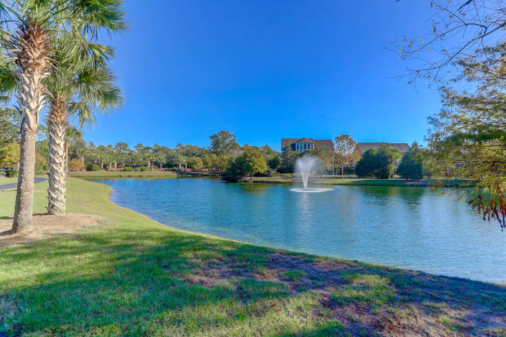
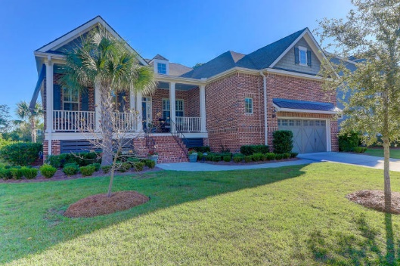
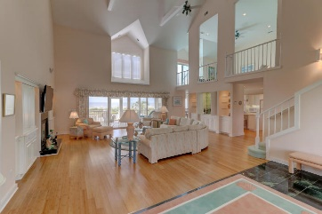
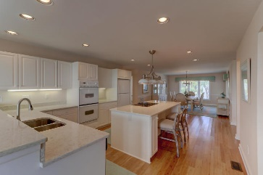
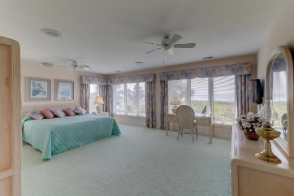
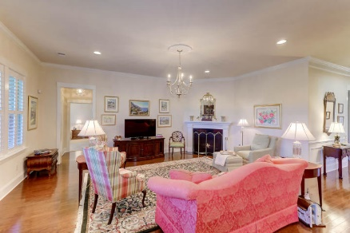
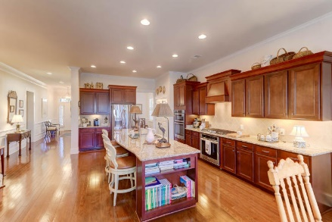
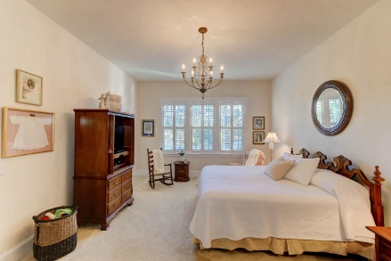
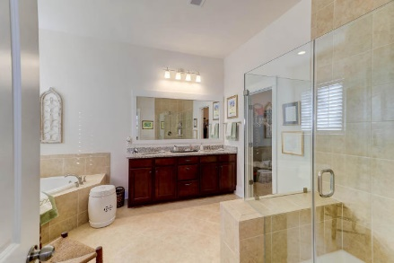
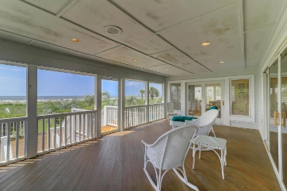


1308 Scotts Creek Circle
Scotts Creek | Mount Pleasant, SC 29464 | MLS# 19030616 | $889,000
Amazing… Like New!
In one of Mt Pleasant’s
most desirable neighborhoods
New Price
Only minutes from anywhere in Mount Pleasant. One story brick home with many wonderful features. Open, Clarendon floor plan, with a gourmet kitchen, large island with lots of cabinetry, all stainless appliances, gas cook top, double ovens, and pantry. Lovely master bedroom with generous closet and luxurious master bath, frame-less glass shower door, tiled upgraded tub. 10 ft ceilings, crown moldings, and many other detailed features. Situated on lovely pond with beautiful landscaping and irrigation. Large covered porch, gas lanterns on front porch. Natural gas community with a seal and conditioned crawl space. Must see this home. Impeccably maintained and the landscaping is truly remarkable.
Gas fireplace with granite surround. Please call for a showing on this truly remarkable home.
Darlene Smith
Office - (843) 886-8110
Mobile - (843) 696-7824
darlenesmith@carolinaone.com
DarleneSmithTeam.com
Carolina One Real Estate
1503 Palm Blvd Ste
Isle of Palms, SC 29451

