Slide 1
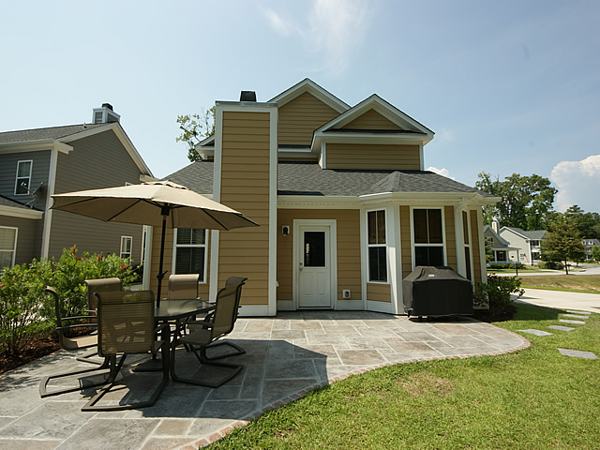
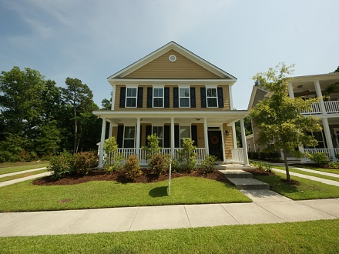
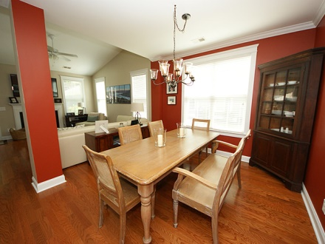
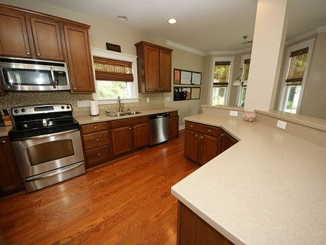
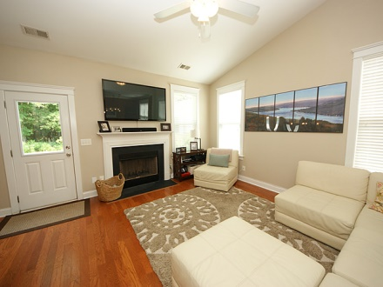
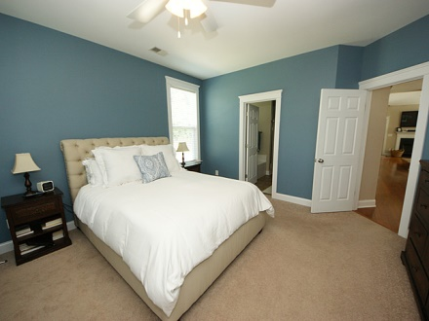
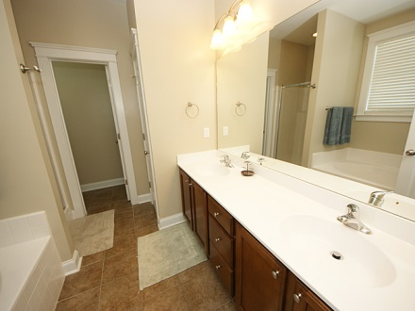
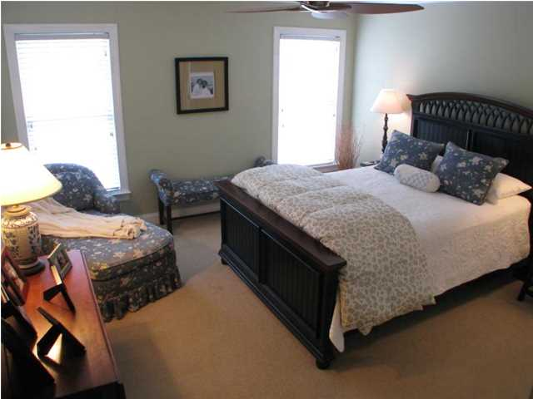
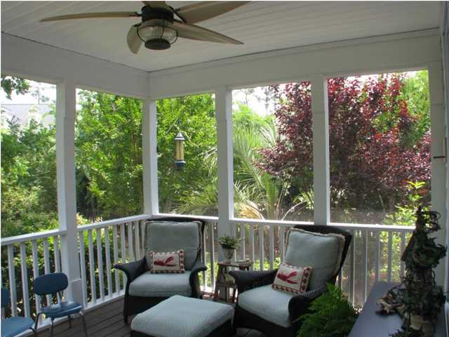
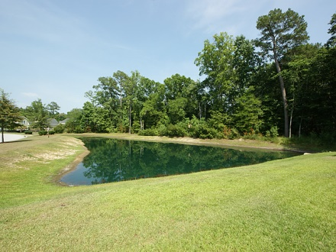
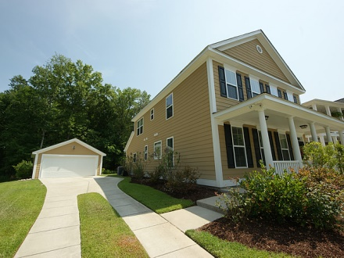


1309 Carol Oaks
Carol Oaks
Mount Pleasant
MLS# 15001716
$374,900
3% Co-op Commission & $500 Gift Card at Closing for Closing by 6/30/15
You NEED to see this home before you choose where you will live in Mount Pleasant! Like new but better on a lot that has a pond on one side and a private wetland in the back, this beautiful home has a kitchen with stainless appliances, a breakfast area with a bay window, and a tiled backsplash. There is also a separate room for dining...There are dual masters, two additional bedrooms, and there is plenty of storage too! The yard is private and has a nice stamped concrete patio...If you are looking for a great home in a smaller neighborhood with wonderful space for your family and with low HOA fees, this could be the home that you are looking for!
Cheryll Woods-Flowers
ABR, e-Certified, SHS
(843) 442-2219
www.woodsflowers.com

