Slide 1
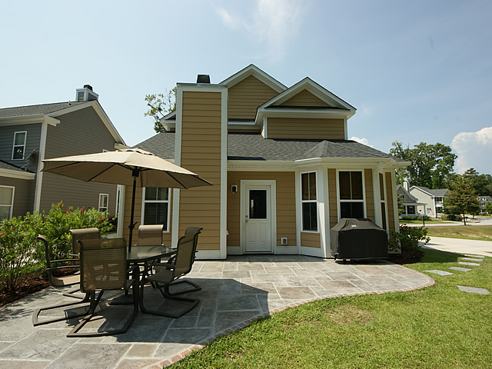
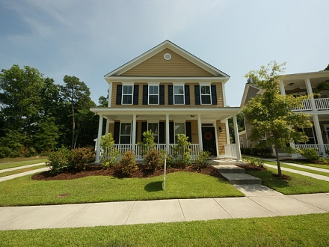
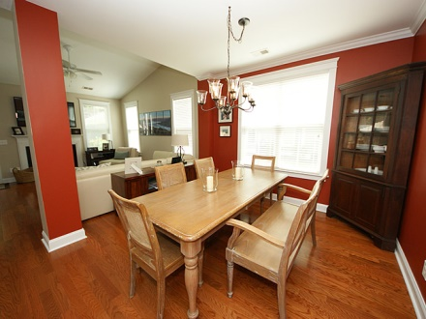
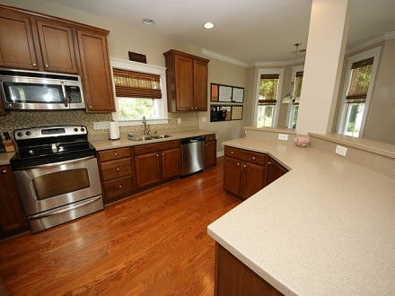
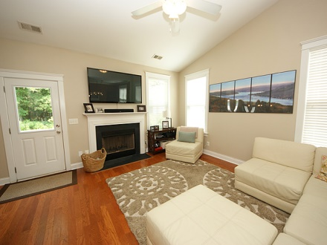
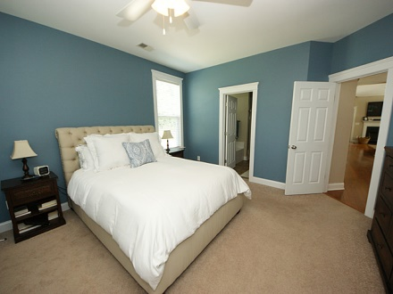
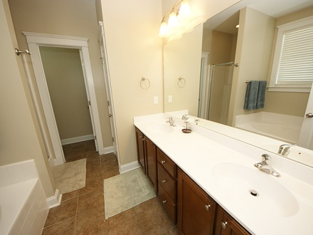
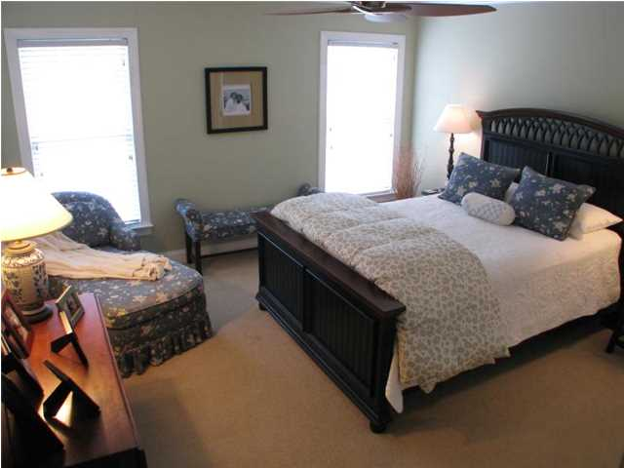
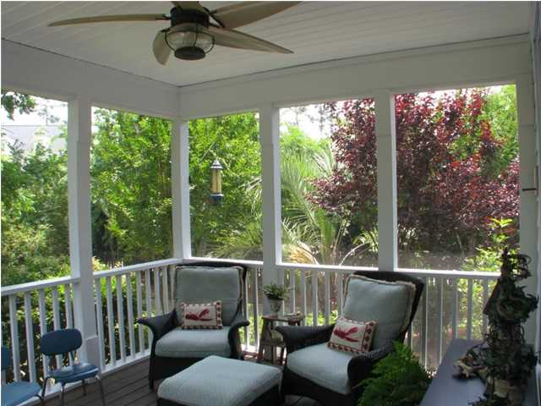
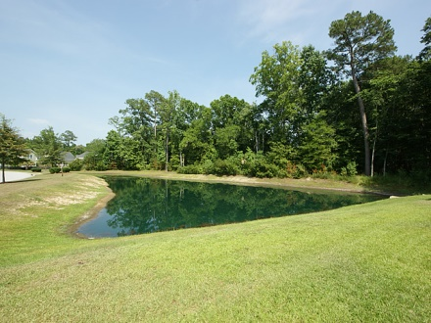
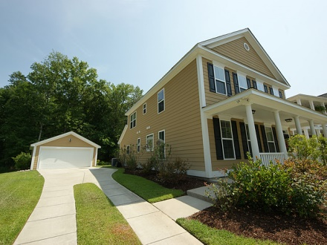


1309 Carol Oaks Carol Oaks Mount Pleasant MLS# 1416805 $374,500
$500 Gift Card at Closing for Contract Written by 10/15
3 year old home like new but better with 4 Bedrooms and 3.5 baths! Recently painted, recently installed tile backsplash in kitchen, and beautiful stamped concrete patio overlooking the pond are just a few of the nice changes that have made. Kitchen overlooking family room with fireplace has stainless appliances and breakfast area with bay window. There are dual masters, both of ample size, as are the other two bedrooms. Home is bordered by pond and green area that can not be developed...You NEED to see this home before you choose where you will live in Mount Pleasant!
Cheryll Woods-Flowers
ABR, e-Certified, SHS
(843) 442-2219
www.woodsflowers.com

