Slide 1
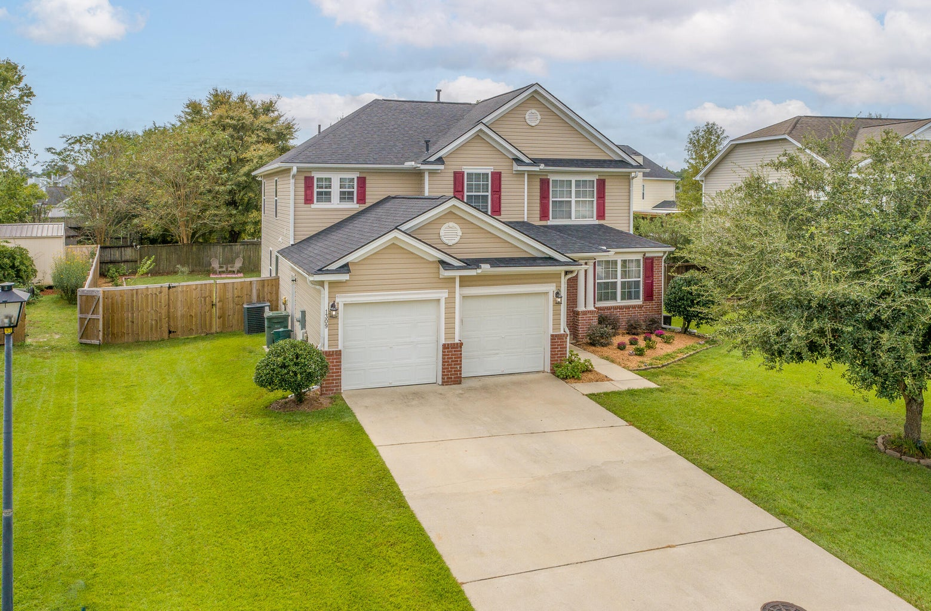
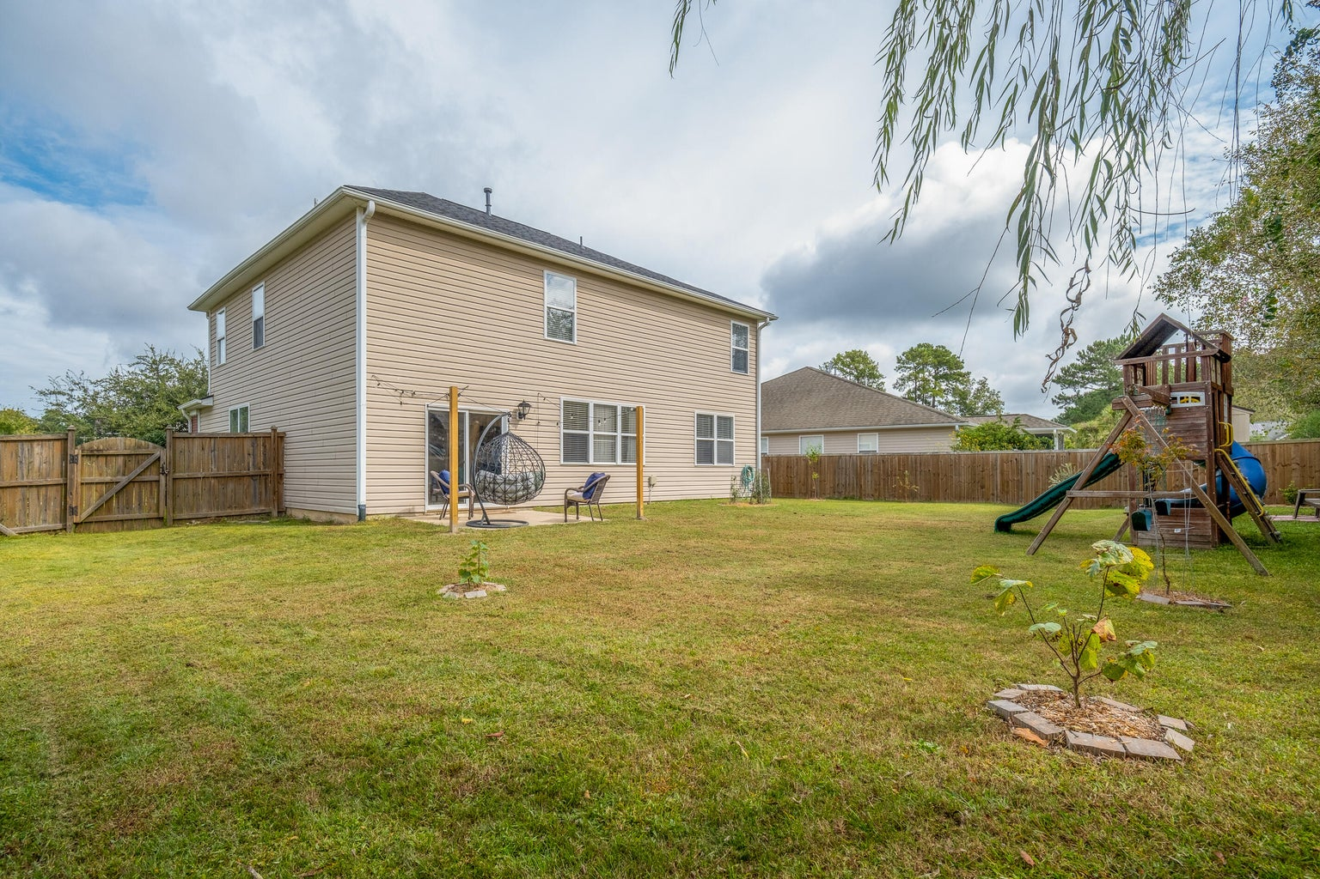
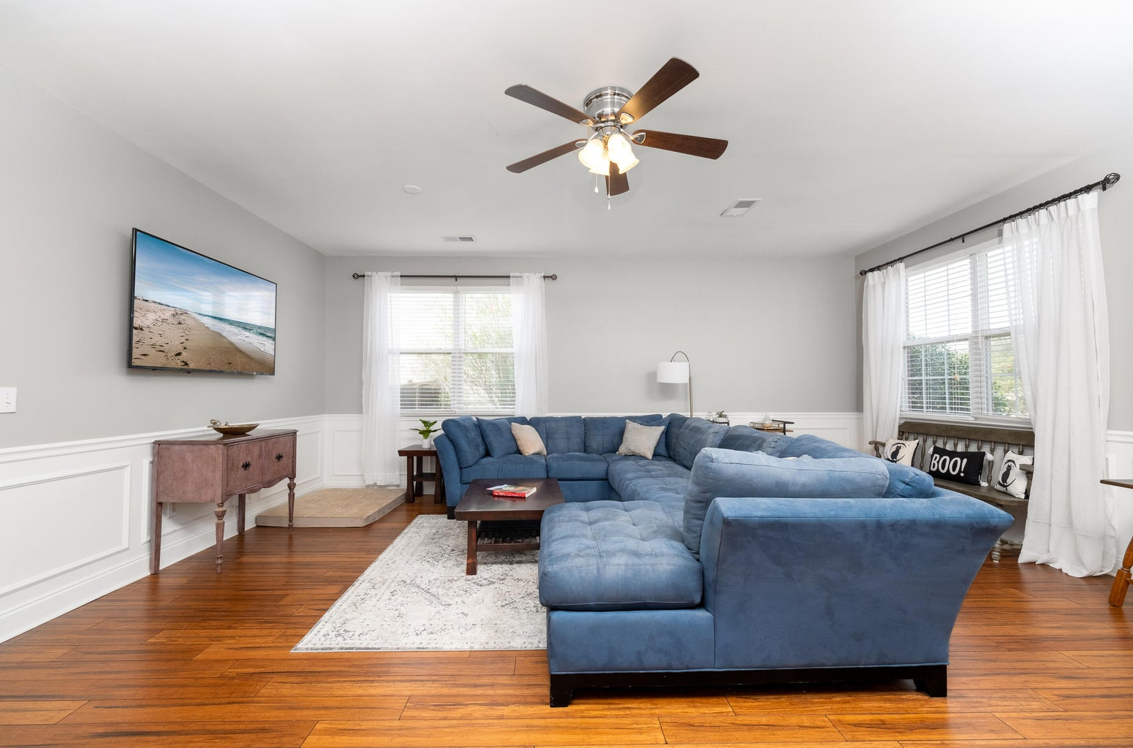
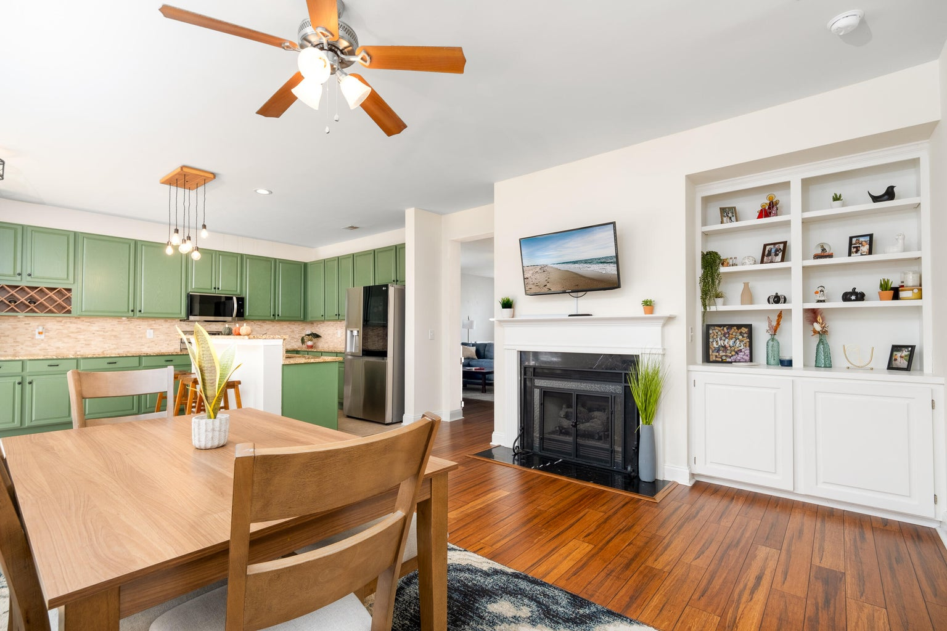
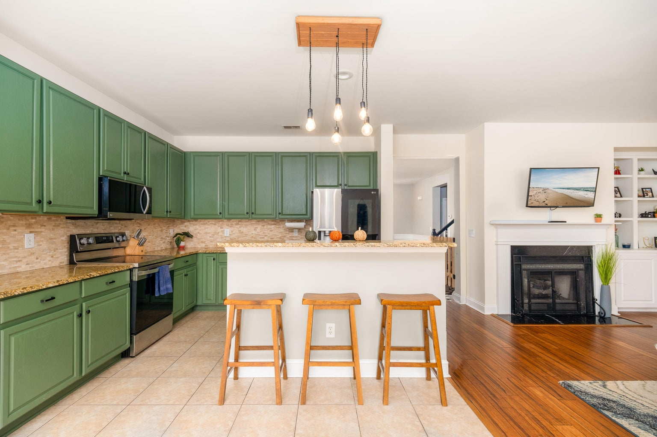
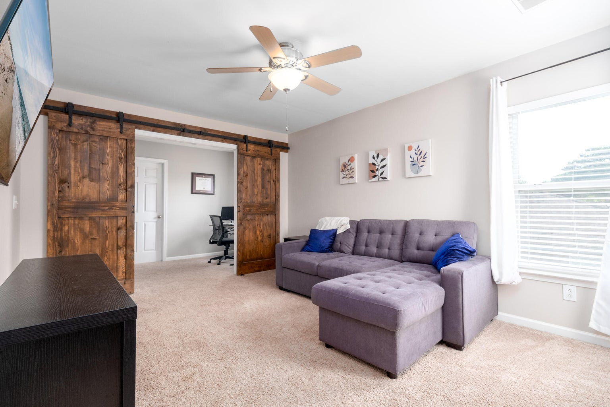



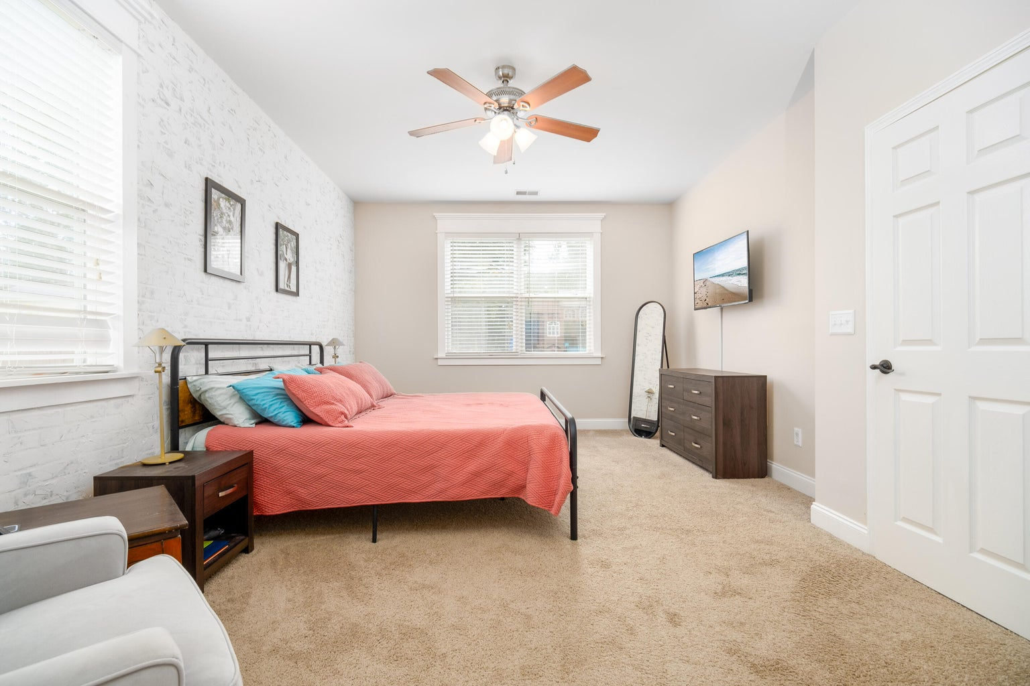
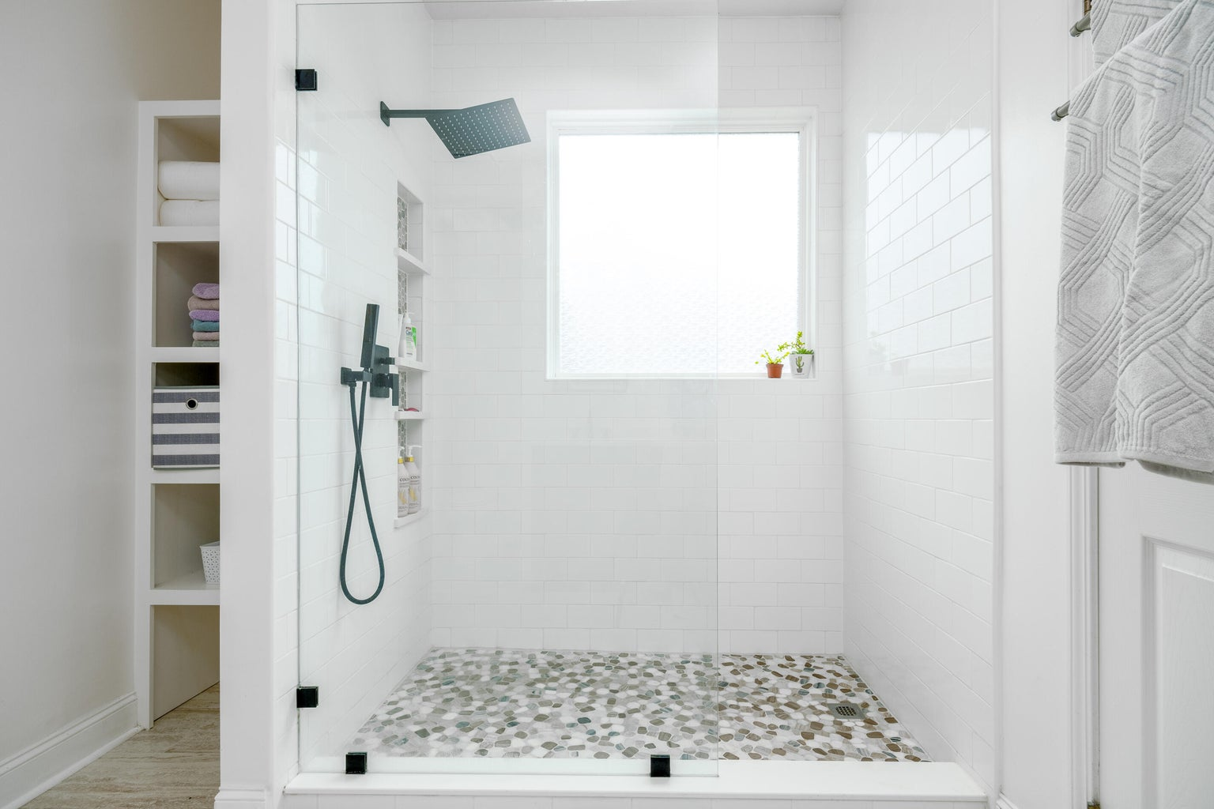
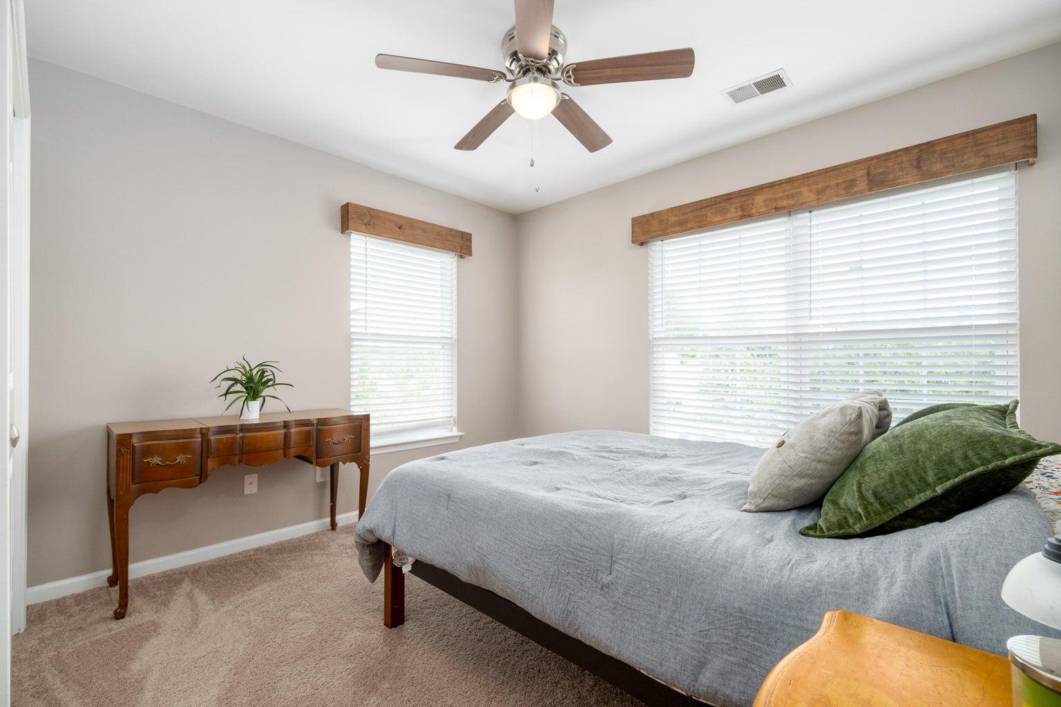
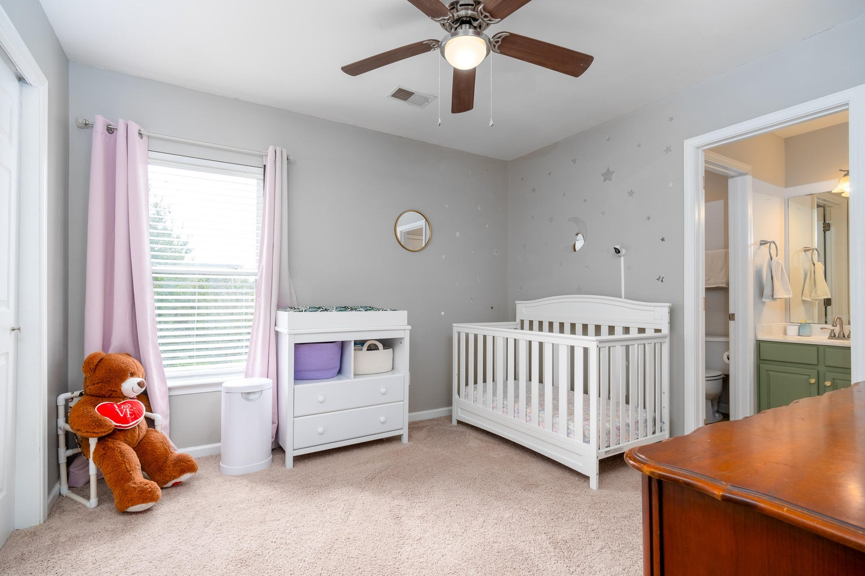


Must-See Home Tanner Plantation
1309 Song Sparrow Way
Tanner Plantation | Hanahan, SC 29410 | MLS# 23023133 | $560,000
This home in popular Tanner Plantation checks all the boxes. Before even walking in the door you'll be impressed by the well manicured front yard and large fenced backyard. Enter the home into a large living room area perfect for lounging in front of the TV, playing games or entertaining guests. The kitchen area has been updated with custom painted cabinetry, new light fixtures and new appliances. Adjacent to the large eat-in kitchen you have a keeping room with fireplace. The primary bedroom is conveniently located downstairs with more custom features including tastefully paneled wall treatments and more impressive lighting. The well designed upstairs has four additional bedrooms as well as personal office space. The large backyard it completely fenced with new landscaping.
Property improvements include New roof Aug 2023,
New appliances July 2023 (kitchen appliances, washer, dryer),
Painted kitchen cabinets and upstairs jack-and-Jill bathroom cabinets,
Fresh paint in dining room/kitchen,
Planted some trees for shade and fruit trees in the backyard
4
3
1,844
Cara Schaafsma 843-345-3612
cara.schaafsma@carolinaone.com
http://www.carasellscharleston.com
Carolina One Real Estate
1101 St. Thomas Island Dr
Charleston, SC 29492

