Slide 1
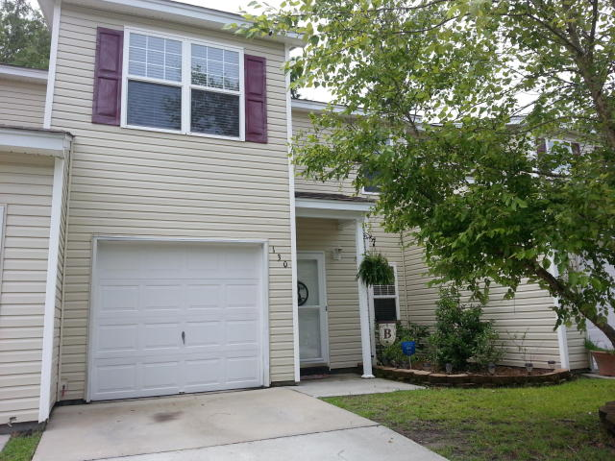
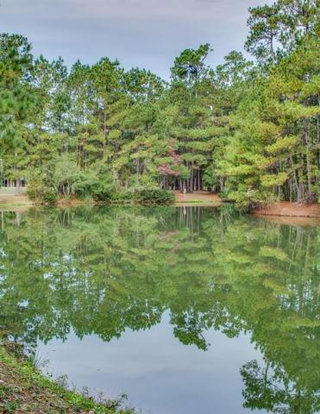
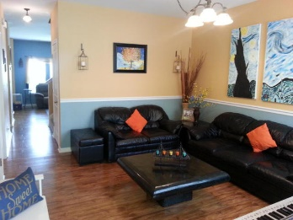
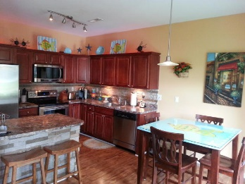
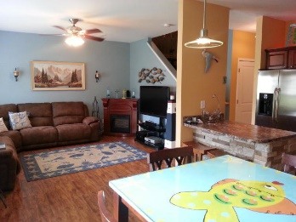
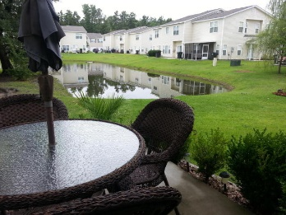
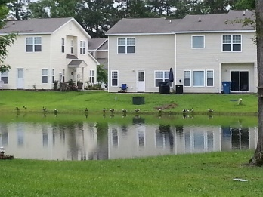
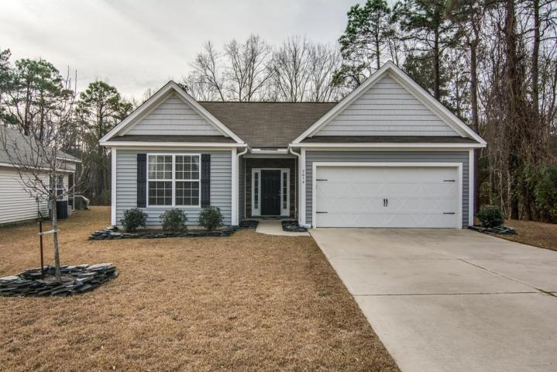
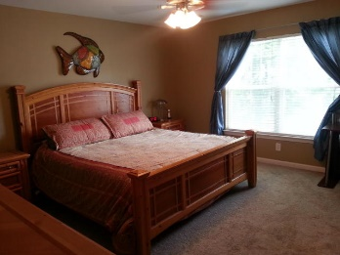
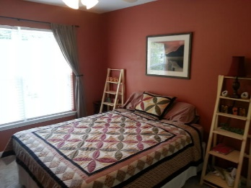
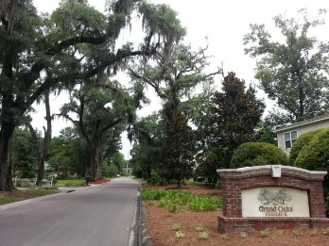
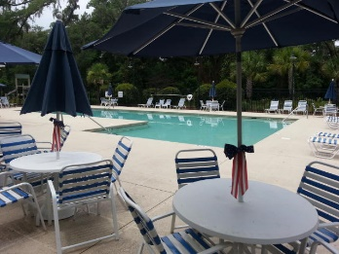
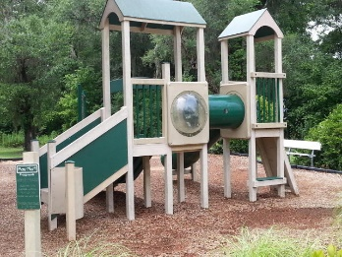


Location…
Location…
Location!
Just Reduced to $129,000
130 Grand Oaks Drive
Grand Oaks Preserve
Ladson, SC 29456
MLS# 15017302
Charming &
Comfortable Living
Beautifully upgraded, 3 bedroom, 2.5 bath, pond-view condo with bonus room is sure to please. Centrally located in an Award Winning Dorchester II school district, this home has so much to offer with nearly 1700 sq Ft of space. Enjoy an open floor-plan with kitchen adjoining the dining and living room. The Kitchen has upgraded cherry cabinets, faux stone backsplash, nearly new Samsung stainless steel 5 burner flat-top range with convection oven, warming drawer & self-cleaning/steam cleaning oven, full size stainless steel microwave, GE Stainless steel dishwasher, island & pantry. Enjoy beautiful views of the pond from your kitchen, dining and living room or outdoor patio. Downstairs bonus room has so many possible uses. All bedrooms located upstairs. Master bedroom has two walk-in closets, dual sinks in master bath and separate shower and garden tub. The other two bedrooms are separated from the master on the other side of the hallway. The second bedroom has Built-in-closet shelving and the 3rd bedroom is also quite large. Convenient Upstairs laundry room. This unit is on a premium lot due to great water views. Spacious one car garage with storage closet, outside parking pad and guest parking nearby. Too many upgrades to mention. Shows like a model home. HOA also includes basic cable and garbage pick-up. Great location on the border of Summerville and Ladson. Taxes here are less expensive since you don't pay the Summerville city tax, but you still get access to Award winning Dorchester 2 school! Easy commute to most area employers. Neighborhood pool & playground. Priced right and can close quickly.
Make sure to show this one and bring us an offer. Thank you.
Julie Johnson
843-826-0088
juliemjohnson123@Gmail.com
AgentOwned Realty Premiere Group · 1800 Old Trolley Rd · Summerville, SC 29485

