Slide 1
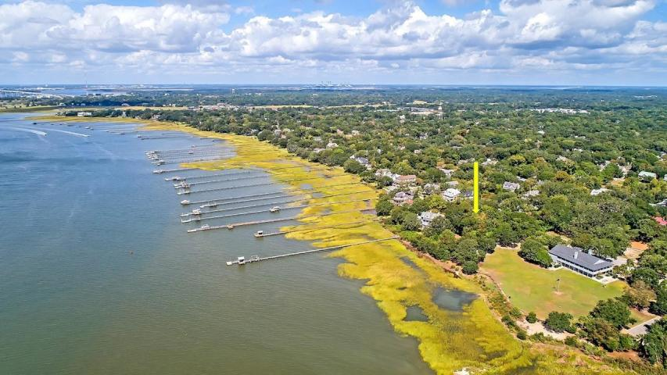
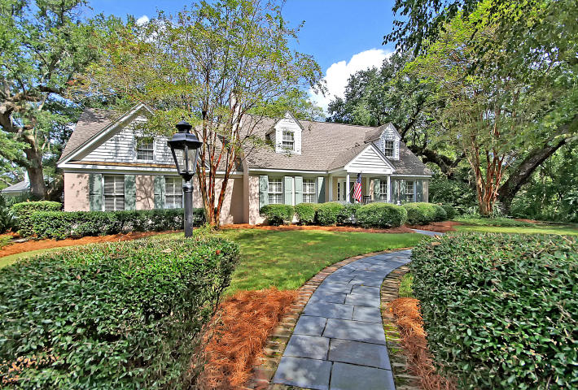
Recent Price Reduction - Bring All Offers
Harbor Views in Old Village
130 Middle Street Old Village ~ Mount Pleasant ~ MLS# 18027346 ~ $1,299,000
It doesn't get much better than being able to wake up every morning and see the Charleston Harbor and Fort Sumter from your front door but that's what you get with this unbelievable custom home that sits on close to half an acre in Old Village. Located adjacent to Alhambra Park, walking distance to Pitt Street Shops and Old Bridge Park and even biking distance to Sullivan's Island and Shem Creek, this is simply a fantastic location. A dramatic fireplace in the family room, eat-in kitchen, massive game room with wet bar and full bath and a first floor master suite make this home memorable. Also, this is one of only a few homes in the low country that has a basement, which would make a great wine cellar. With 3 grand oaks on the property this parklike setting is a relaxing place to call home.
Tyler Hawkins tyler@mattoneillteam.com (843) 908-2734

