Slide 1
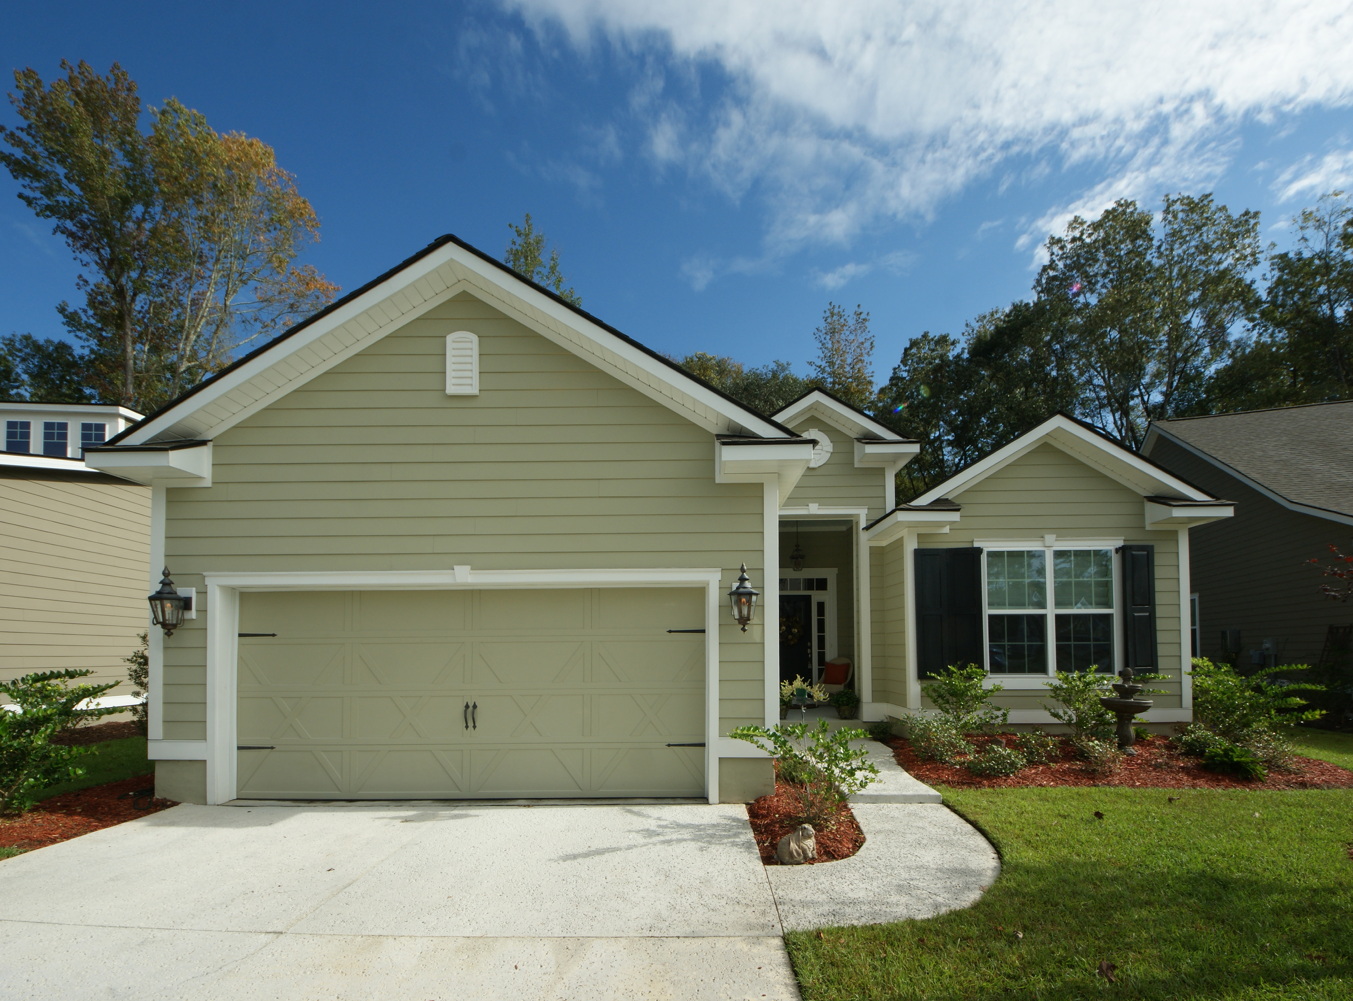
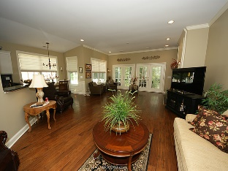
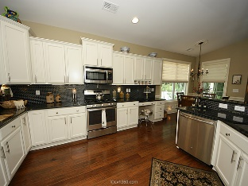
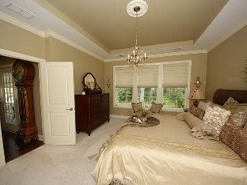
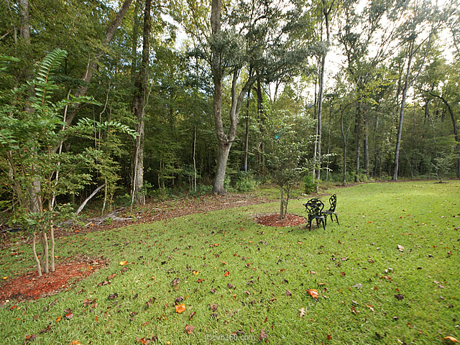
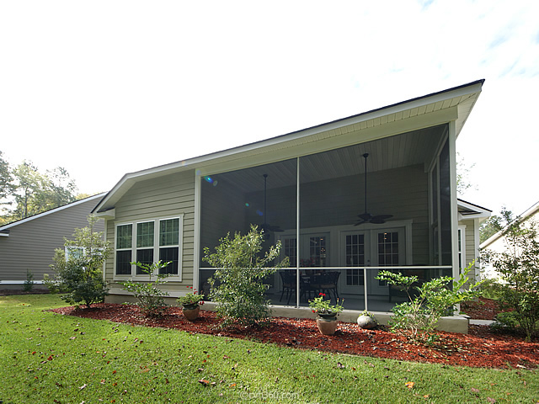



130 Phoebe Road
The Ponds | Summerville | MLS# 15025858 | $349,000
Great Designer Features!
Described as "a model home" you will see why. This stunning home boasts classic decorator paint colors, upgraded wood floors, a designer kitchen with granite and mosaic tile backsplash, upgraded appliances, five burner gas stove, double French doors to a wooded back yard and screened porch, perfect to sit and privately enjoy nature. Gas lanterns at entry, wainscoating in foyer and dining, tray ceilings, custom light fixtures. The list goes on.
Must see!
Janis Flodin
843-729-0584 M
jflodin.bcd@gmail.com
B C D Properties LLC | 123 Piccadilly Loop | Summerville, SC 29483

