Slide 1
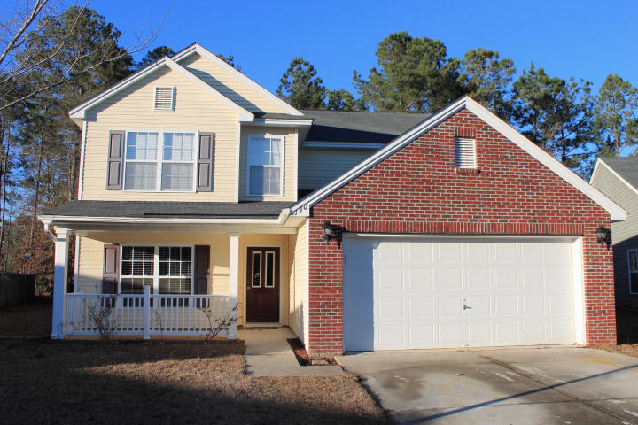
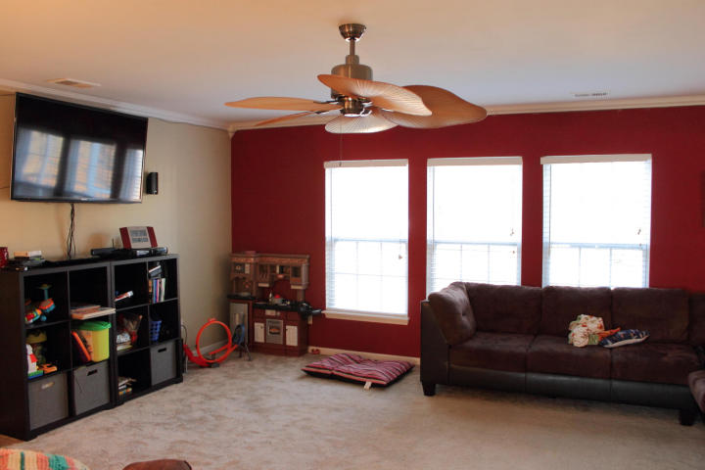
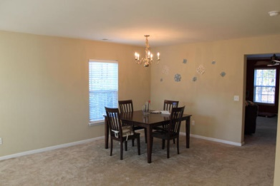
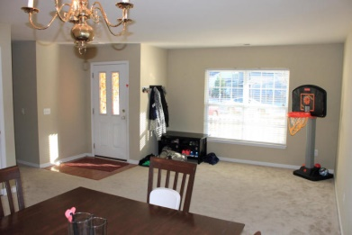
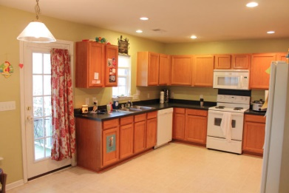
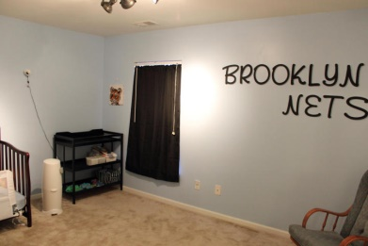
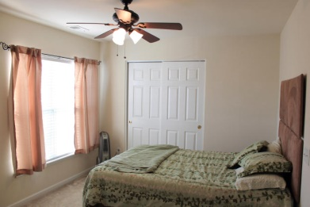
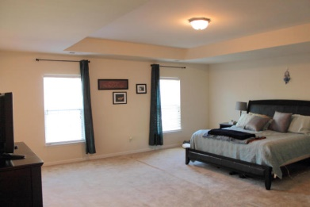
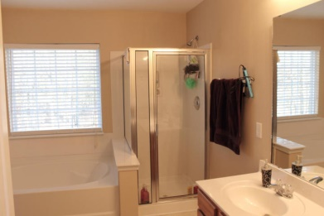
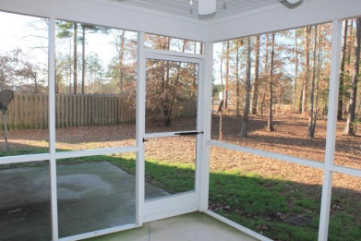
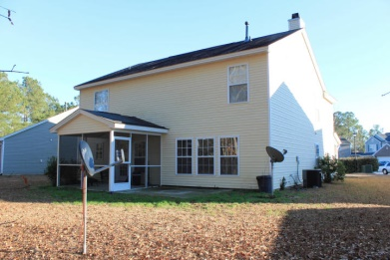
Priced to sell!! Great buying opportunity!!
130 Surlington Dr
Summer Park
Ladson, SC 29485
MLS# 15001366 | $214,900
Super home in great family neighborhood!! The desirable '‘Richmond'' floor plan built by Centex offers style, quality and space for a great price!! Major features include a spacious family room with wood burning fireplace, oversize 18x 20 master bedroom suite with trey cut ceiling, luxurious bathroom with garden tub, separate shower and a huge walk in closet great kitchen with tons of counter top and cabinet space... Downstairs office, formal living/dining areas... Enjoy the wooded views from the screened in porch... Play with the in the large backyard--safe cul-de-sac living.
Sean Harrington
Office: 843-821-1111
Cell: 843-226-9652
sean@milerproperties.com www.milerproperties.com

