Slide 1
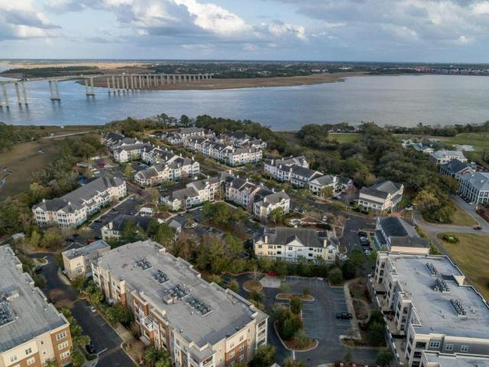
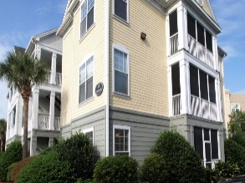
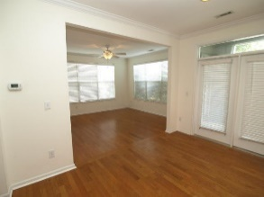
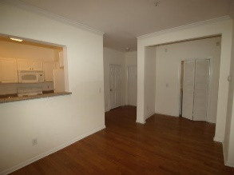
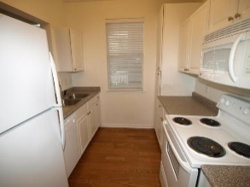
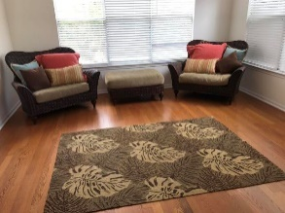
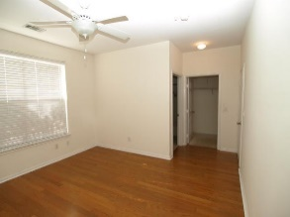
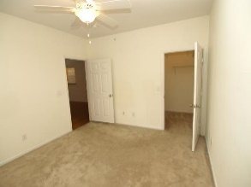
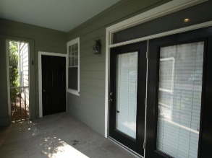
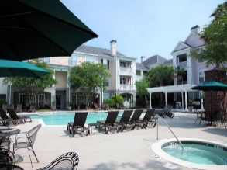
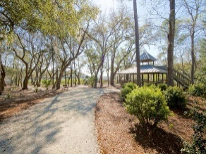


130 River Landing Drive #10100 Daniels Landing ~ Charleston, SC 29492 MLS# 17025294 ~ $229,000
Open House Sunday, Oct 15th
1-4 PM
Great first floor move-in ready end unit in very desirable Daniels Landing is quite the find! Hardwood floors, screened porch, large walk-in closets and lots of windows make this condo exactly what you have been looking for. With walkable shopping, restaurants, tennis, and walking trails all within easy access, you will love living in the heart of Daniel Island. Daniels Landing also boasts a very nice amenity center with clubhouse, workout facility, pool, and community grills at your disposal. This is a great property to own and join the friendly community of Daniel Island!! In addition, this unit is sparkling clean, vacant and ready to move in immediately.
Kimberly Roberts
(843) 687-1246
krrconsulting1@gmail.com www.charlestonforever.com
Engel & Volkers Charleston Mt. Pleasant | 1000 Johnnie Dodds Blvd | Mt. Pleasant, SC 29464

