Slide 1
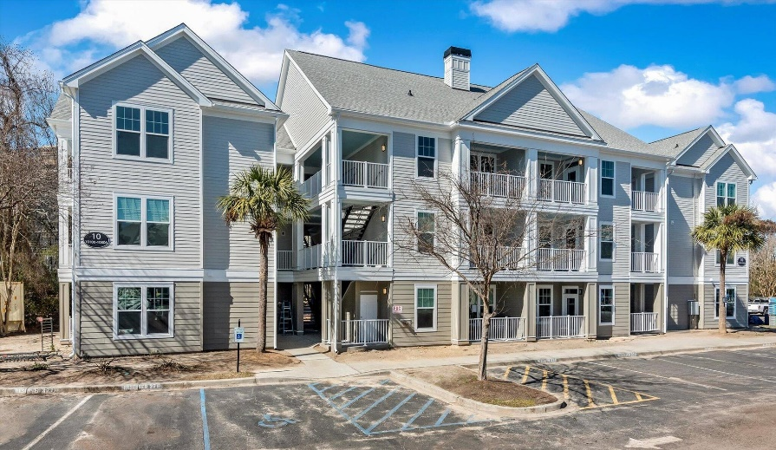
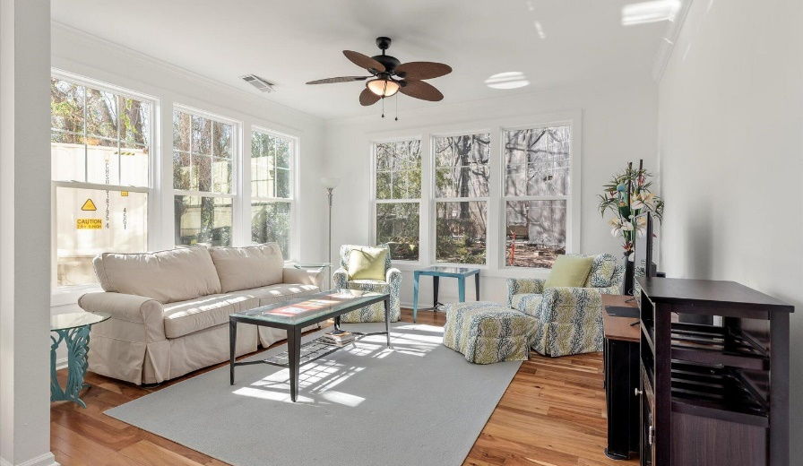
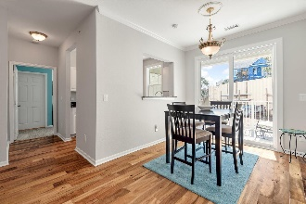
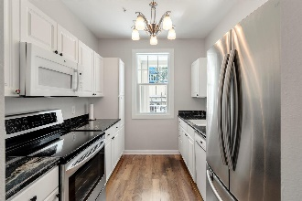
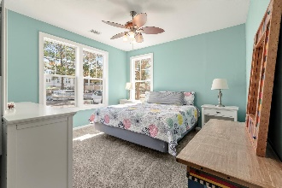
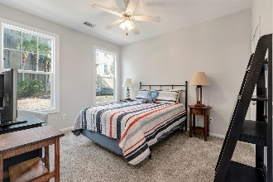
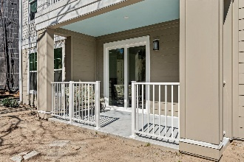


$10,000 Buyer Incentive!!!!
130 River Landing Drive 10106
Daniels Landing · Daniel Island, SC 29492 · MLS# 24003848 · $498,000
Sunny 1st floor end unit with screened porch and green space! Be the first to purchase in the NEWLY RENOVATED condominium building in Daniels Landing! NEW impact resistant windows, NEW roof, NEW Sliding Glass Doors to NEW screened in porch and door installed in April, NEW paint, NEW carpet in bedroom. PLUS, this is the best condo because of the porch with a door faces green space, barbecue grill out the back door, and no traffic. The condo faces south and west so it gets plenty of sunshine and sunset views. Great privacy as it does not face parking lot and is not in a high traffic area. Includes washer, dryer and refrigerator Daniels Landing is as close to the water as you can get without spending a million dollars, and conveniently located in the heart of downtown Daniel Island! Water heater 2022. HVAC 2015. Water, Flood and all exterior maintenance included in HOA. Living here is an amazing lifestyle, a golf cart community with golf cart charging stations, a marshfront salt water pool, and a fabulous social committee where neighbors meet neighbors! Down at the waterfront park there are concerts all summer, and the Daniel Island Ferry to downtown Charleston. The gym and game room are open 24/7, and the beautiful clubhouse with full kitchen can be rented out for private parties and is open during the day for social gatherings. There is also a library book exchange, and computers and printers for residents. Each year there is a great Christmas party, and throughout the year there are pool parties and chili cook offs, and other events.
Therese Jenkins
843-568-9748
therese@beautifulhomesllc.com
Beautiful Homes Realty
130 River Landing Dr #7322
Daniel Island, SC 29492
www.theresejenkins.com

