Slide 1
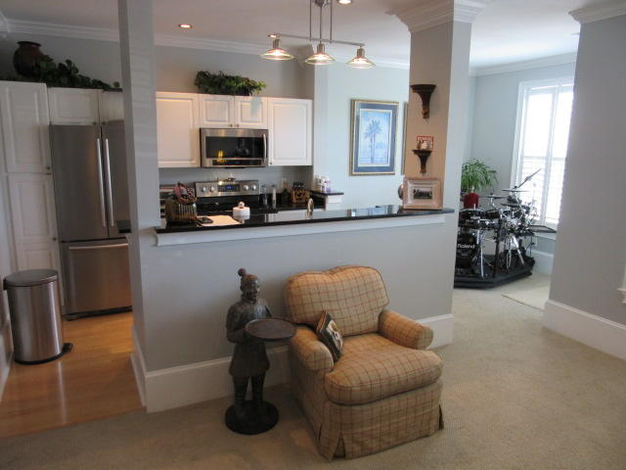
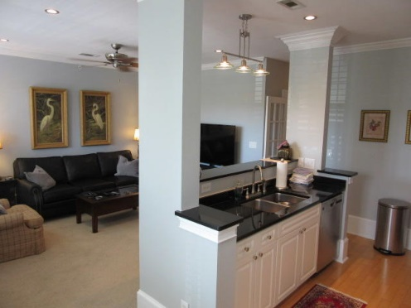
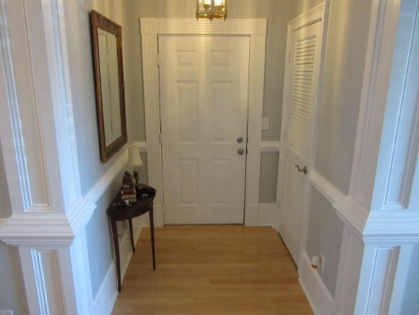
Updated in Daniels Landing
$199,000
$40,000
Price Reduction!
130 River Landing Drive #11202
Daniel Island, SC 29492
MLS# 18013807
A 10 on a 10 point scale...updated and upgraded in every way. This second floor unit has new stainless steel appliances, freshly painted designer colors with grey walls and white trim, granite countertops, ceramic tile, carpet and wood floors, plantation shutters, can lighting plus upgraded lighting over the breakfast bar. This home has custom woodworking usually reserved for homes $500,000+...including baseboards, crown molding, wainscoting, columns, and window trim. This unit is larger than the average 1 bedroom unit and includes a separate office area with French doors. Your new home is in the center of everything...just 1-2 blocks from the tennis center, retail area with restaurants, grocery store and all other Daniel Island services. When you live here you can enjoy the swimming pool, exercise/workout area and clubhouse. You even have a reserved parking spot directly in front.
Rick Willis
843-327-3017 Rick@RickWillis.com The Group, LLC

