Slide 1
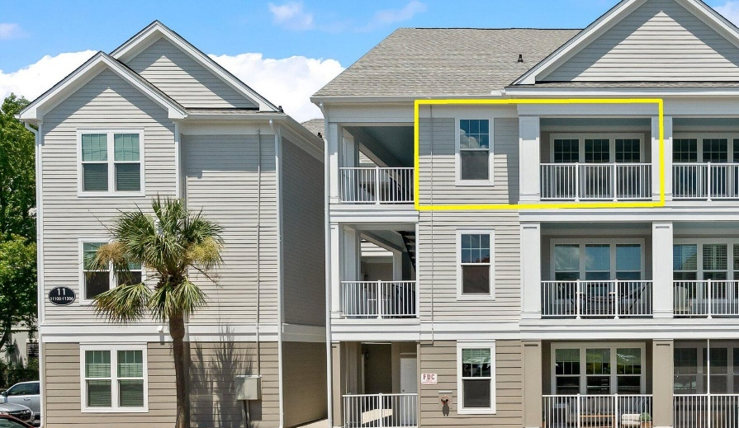
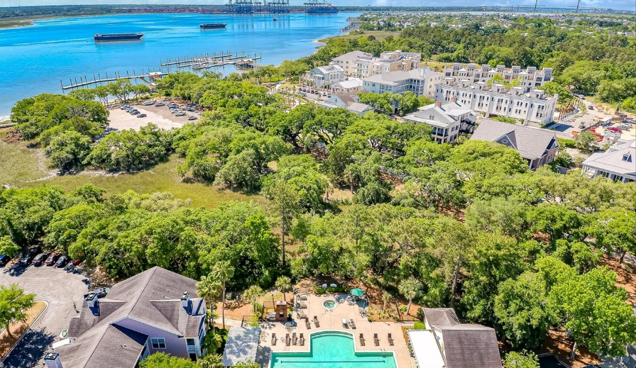
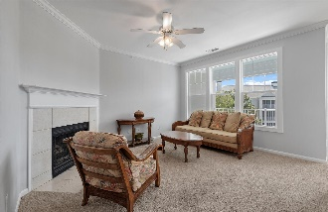
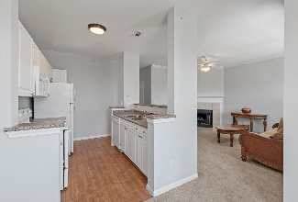
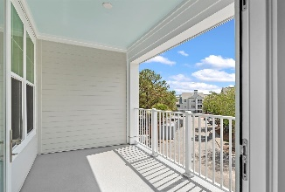
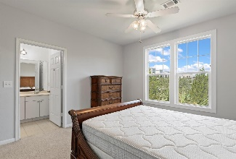
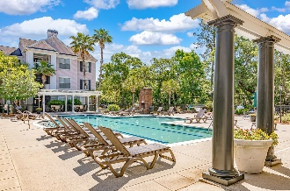


PRICE REDUCED For Quick Sale - 2% Buyers Comp!
130 River Landing Drive 11304
Daniels Landing · Daniel Island, SC 29492 · MLS# 24017793 · $417,000
BRAND NEW renovated building so close to The Waterfront on Daniel Island!
This top floor unit has New impact resistant windows, new roof, new impact resistant porch door, new paint, and new light fixtures! Separate private office/den space or guest room. Extra large porch overlooking treetops and water fountain, this is extremely peaceful. Gorgeous clubhouse is rentable for private parties and has a 24-hour fitness center, 24-hour game room, full kitchen and a library book exchange with computers and printer for owners use! Outside saltwater pool and hot tub. A social committee organizes events throughout the year such as a Christmas Party, summer music party at the pool, and of course the annual chili-cook off! Short walk to ferry downtown Charleston and live concerts at Credit One.
Just down the street at The Waterfront park you will find free summer and fall concerts, the Carefree Boat Club, fine dining and cocktails overlooking the water at The Kingstide restaurant, and coffee/lunch hot spot The Dime - all within a stones throw! Enjoy the golf cart lifestyle as there are also charging stations in the complex. The Credit One Stadium is next door where you can avoid traffic and just walk over and grab a ticket to a show. This is a great lifestyle and a great turn-key condo to call home, or your vacation getaway. Water and flood insurance, and exterior insurance are all included with your monthly HOA dues.
Therese Jenkins
843-568-9748
therese@beautifulhomesllc.com
Beautiful Homes Realty
130 River Landing Dr #7322
Daniel Island, SC 29492
www.theresejenkins.com

