Slide 1
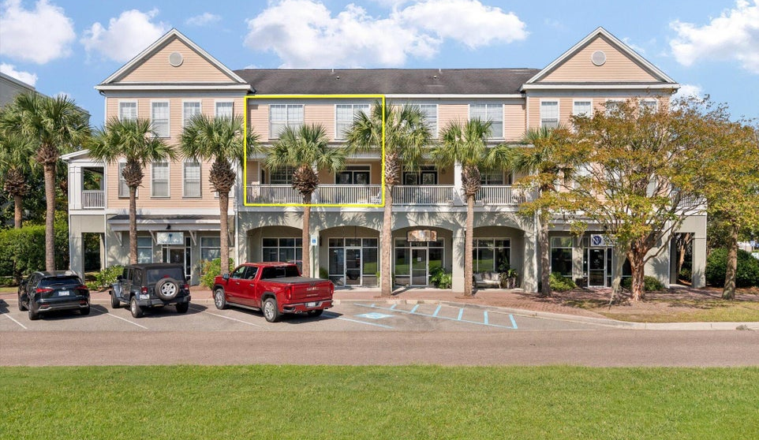
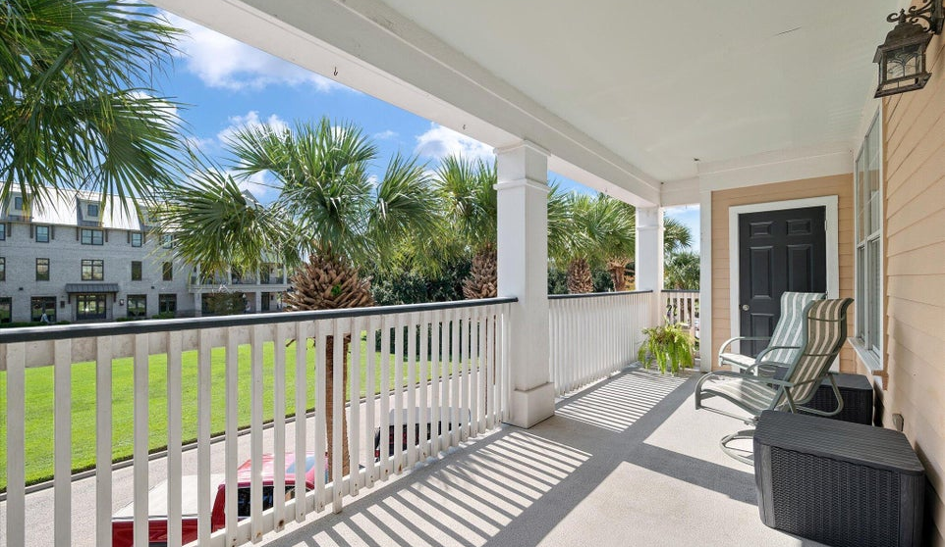
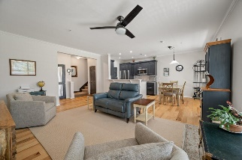
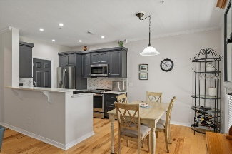
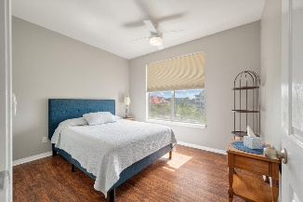
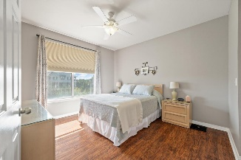
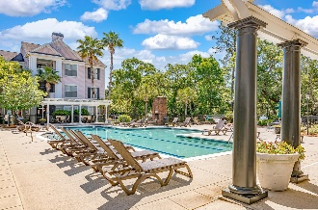


CLOSE TO THE WATERFRONT ON DANIEL ISLAND!
130 River Landing Drive 12203
Daniels Landing · Daniel Island, SC 29492 · MLS# 24025198 · $490,000
Enjoy Daniel Island lifestyle in this beautiful townhome style condo with no one above or below you! As you enter the home you are in a bright and sunny living room with open kitchen and dining area overlooking the huge porch and palm trees! Enjoy the breezes and sunsets while relaxing on your patio furniture. Southern exposure maximizes sunlight. The kitchen has been remodeled with all wood extra deep cabinets, quartz countertops and stainless appliances, wood flooring on both levels with carpeted stairs. Upstairs are the primary and guest bedrooms, plus updated bathrooms. The buildings are currently being renovated with all NEW windows, NEW roof, NEW siding, and NEW porches! This is the opportunity to buy brand new on Daniel Island, located just steps from The Waterfront park, The Dime and Kingstide Restaurants and Carefree Boat Club. There is on site property management and the clubhouse can be rented for private parties. The pool overlooks gorgeous marsh views and has BBQ grill for your cookouts! There is a fabulous social committee where you can meet your friendly neighbors at the annual Christmas party, the chili cookoff, or various summer pool parties. Clubhouse also has a 24 hour game room with tv and pool table. Daniel Island is a golf cart community with easy access to restaurants and shopping, and Daniels Landing Condos has golf cart charging stations! If you enjoy walking or riding bikes, there are miles and miles of beautiful trails. Flood insurance and water are included with your HOA dues.
Therese Jenkins
843-568-9748
therese@beautifulhomesllc.com
Beautiful Homes Realty
130 River Landing Dr #7322
Daniel Island, SC 29492
www.theresejenkins.com

