Slide 1
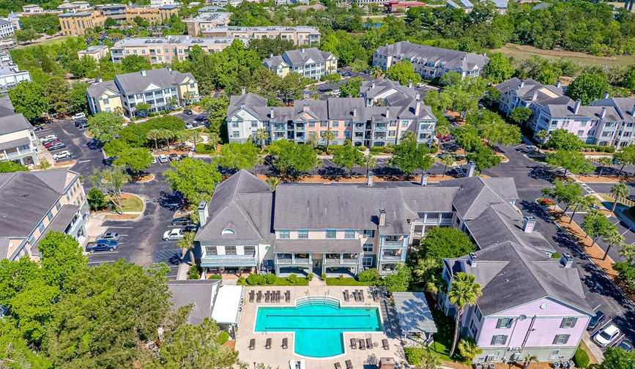
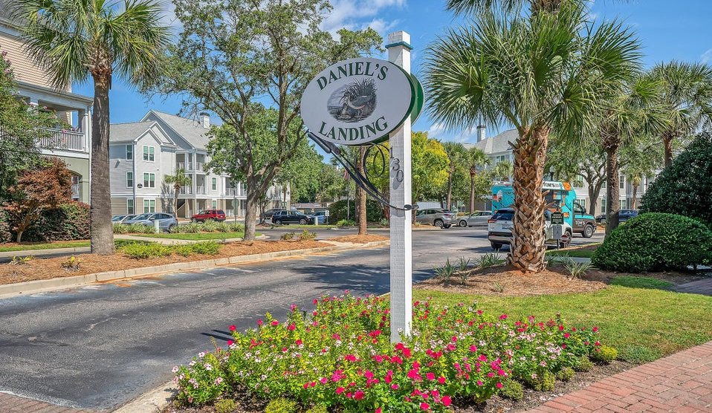
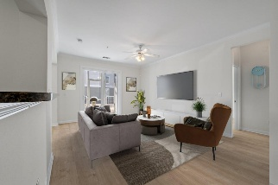
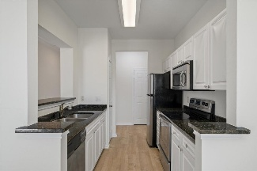

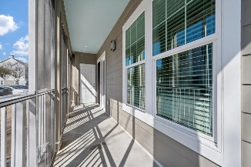
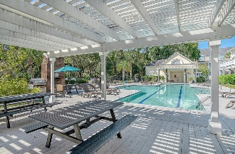


Offering 2.5% Commission DI Luxury Condo
130 River Landing Drive 5108
Daniels Landing · Daniel Island, SC 29492 · MLS# 25003569 · $509,000
Rare opportunity for one-level living in this beautifully renovated first-floor condo featuring two bedrooms plus a versatile office or guest room. This move-in ready home has been thoughtfully updated with Sherwin Williams Alabaster paint, new LVP flooring, new roof, cement siding, impact-resistant windows, new sliding glass door, and a full HVAC replacement in 2022. The open-concept eat-in kitchen has granite counters, and both bedrooms have private baths. Located in one of Daniel Island's most social communities, with a clubhouse, pool, hot tub, fitness center, library, and game room. Golf cart charging, on-site management, and events like pool parties create a true community vibe.
Enjoy the miles and miles of walking/biking trails through beautiful marsh views, ferry access to downtown Charleston, and walkability to dining, Credit One Stadium, tennis events, and more. Pickleball? Only $15/mo at the famous LTP Stadium that hosts the annual Women's Tennis tournament in April! Renovations are almost complete and new landscaping is expected by August. The clubhouse is undergoing an interior facelift that will be outstanding! Clubhouse is available for private parties and includes a full kitchen, game room, multiple TVs, a library and computer/printer use for owners.
TAKE A VIRTUAL TOUR
Therese Jenkins
843-568-9748
therese@beautifulhomesllc.com
Beautiful Homes Realty
130 River Landing Dr #7322
Daniel Island, SC 29492
www.theresejenkins.com

