Slide 1
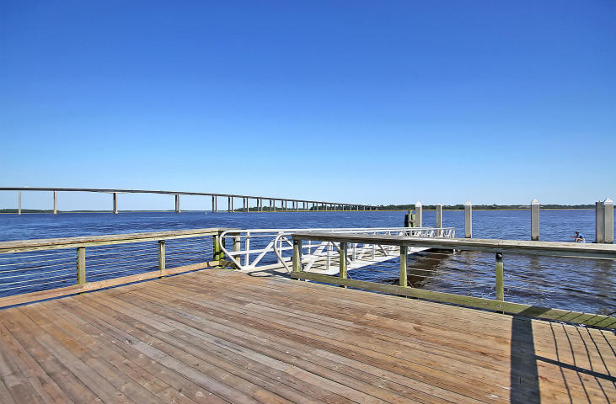



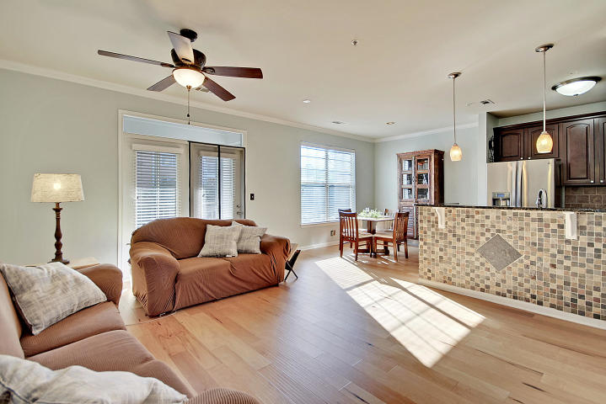
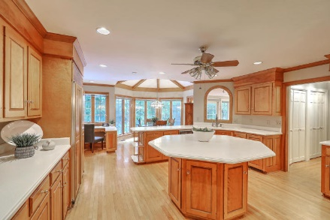
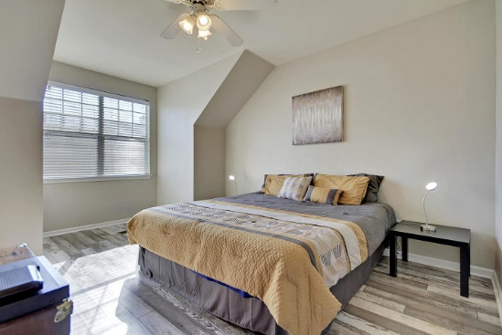



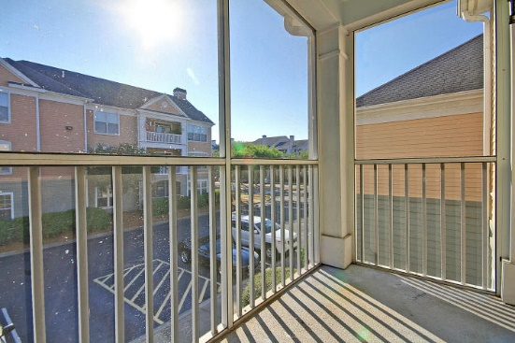

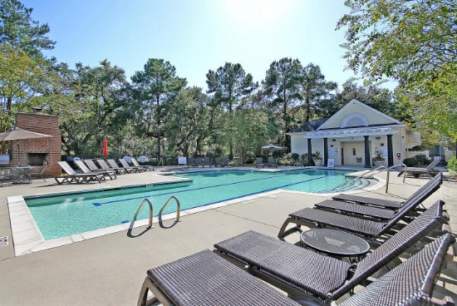
Parkshore Marshfront
Island Living Awaits!
130 River Landing Drive 5208
Daniel Island, SC 29492 ~ MLS# 19016365 ~ $237,875
THE SELLERS ARE OFFERING A $3,000 CREDIT AT CLOSING TOWARDS ANY INTERIOR UPDATES, HOA FEES OR CLOSING COSTS. DON'T MISS OUT!!
Maintenance-free, island lifestyle living awaits you on Daniel Island's River Landing condo community. This second and third level end-unit boasts high ceilings, laminate floors, two bedrooms, two full baths and a screened-in porch. There's a nice private office or sitting area when you first enter the unit and then the open concept includes the spacious living room, kitchen and dining area. The kitchen features granite counters, tile backsplash, SS appliances and a tiled breakfast bar seating area. The master bedroom has an en-suite full bath with dual vanity, garden tub/shower and access to the large walk-in closet. You'll love being just steps away from walking trails on the Wando River and the pond with water fountain and grilling area that's located just behind the unit.
Additional features include:
Clubhouse has a saltwater pool, hot tub, fitness center, grilling area putting green and game room
Daniel Island has walking trails, shopping, dining, playgrounds, kayak launches, splash pad, tennis center and golf
One assigned parking space included. Plenty of guest parking also available throughout community.
Water and common area flood insurance are included with HOA.
Book your showing today!
Christopher Smith christopher@mattoneillteam.com 843-267-0735

