Slide 1
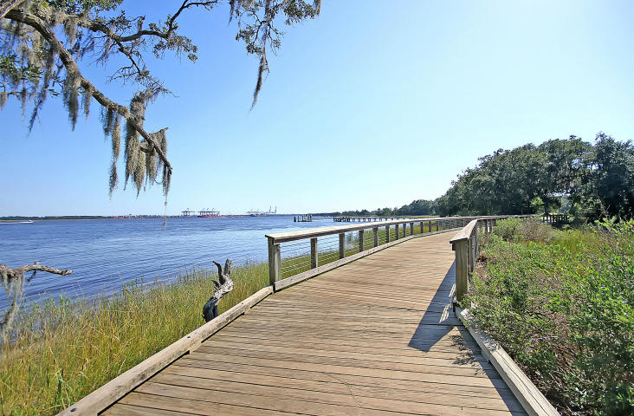
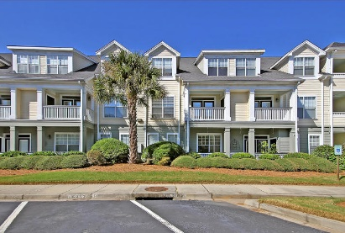
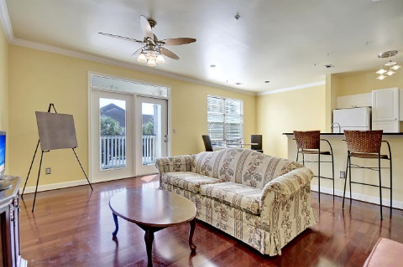
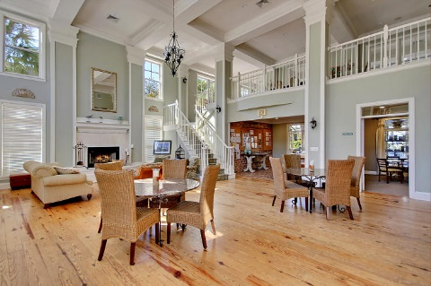
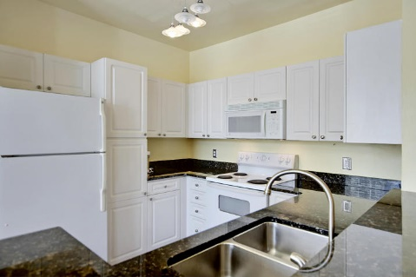
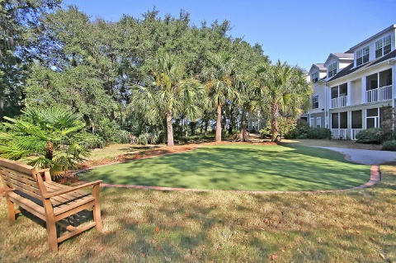
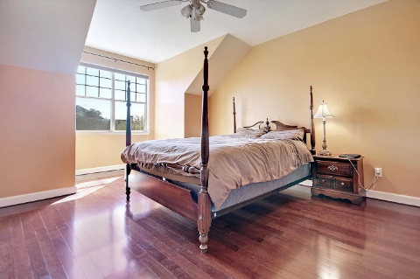
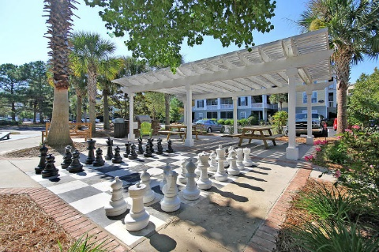
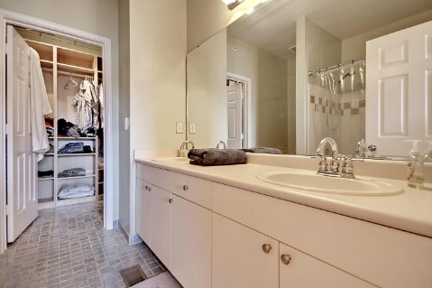
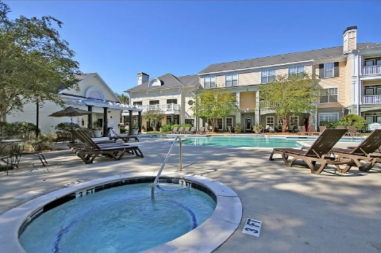
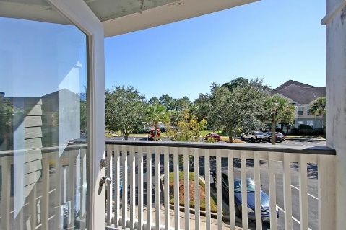
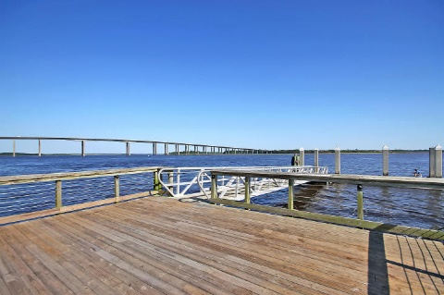

Carefree Living
on Daniel Island
130 River Landing Drive 6204
Daniel Island, SC 29492 ~ MLS# 15028282 ~ $254,000
Welcome to River Landing where once you get here you never have to leave!
Everything you could want is right here for you, shopping, dining, walking trails along the Wando river, swimming, a splash pad, pier with floating dock, barbeques, a giant chess set, you name it, it’s here.
This move in ready 2BR, 2BA condo presents an open floor plan with wood flooring, spacious living room that flows into the eat-in kitchen and sliding doors with access to the patio.
An office on the first level is great additional space. Upstairs are two large bedrooms, two full baths, a walk-in custom closet and the washer/dryer area.
Hop right onto I-526 and be on your way to downtown, the beaches or wherever you need to get to with ease.
Come by to experience convenient, maintenance-free living!
Nate Gainey nate@mattoneillteam.com 843-513-2038

