Slide 1
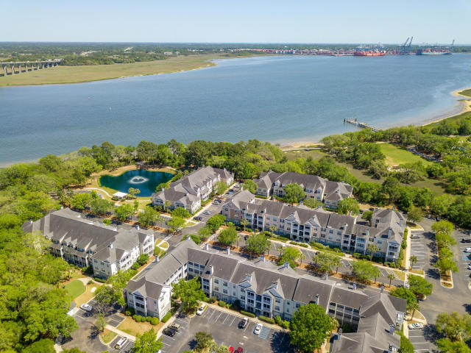
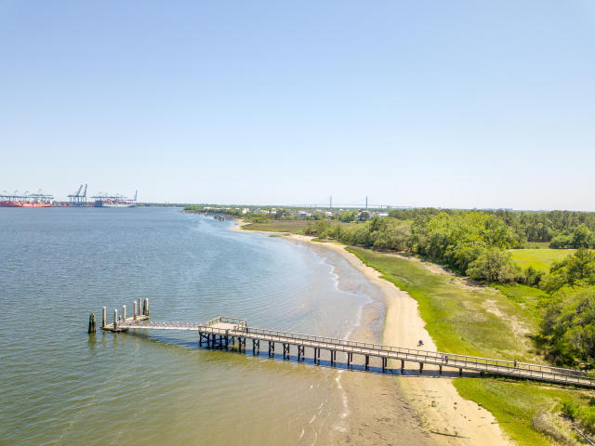
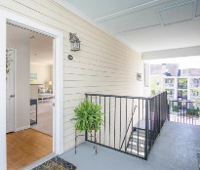

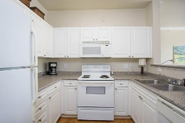


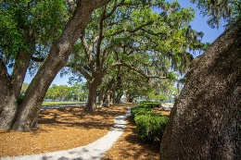



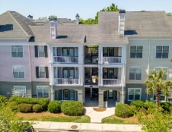



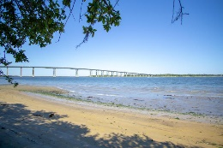

Water Taxi To Downtown Charleston!
130 River Landing Drive #7314
Daniels Landing ~ Daniel Island ~ MLS# 18012269 ~ $165,990
This spacious one bedroom on top floor has fireplace, open kitchen, separate dining, and washer dryer room with plenty of storage space. Cool off in the hot summer in the salt water pool, and enjoy chilly evenings by your wood burning fireplace! Beautiful outdoor patio for the "porch sitter" and entertaining friends. This is the ONLY condo complex on Daniel Island with its own gorgeous clubhouse with full kitchen, gym, free coffee all day, and a community computer room for owners use! Enjoy activities like game night, ladies lunches, and an annual Christmas party to meet your neighbors! There is an on sight maintenance crew and HOA which is very convenient! Just down the street is a public boat dock which the DI Water Taxi is going to provide service to Charleston.
In 2020 the new Daniel Island Performing Arts Center will be right up the street, and the Volvo Car Stadiumis located just around the corner for concerts all summer long! Family Circle tennis club is approx. $550/year and a great way to meet new people and enjoy state of the art tennis and play on teams . MUSC soccer stadium hosts international games - there are biking, hiking trails surrounding the island at your back door step, this is a dream lifestyle within 20 minutes drive to downtown Charleston and Isle of Palms beaches!
Therese Jenkins
(843) 568-9748
therese@beautifulhomesllc.com
Beautiful Homes Realty
130 River Landing Dr #7322
Charleston, SC 29492
www.beautifulhomesllc.com

