Slide 1
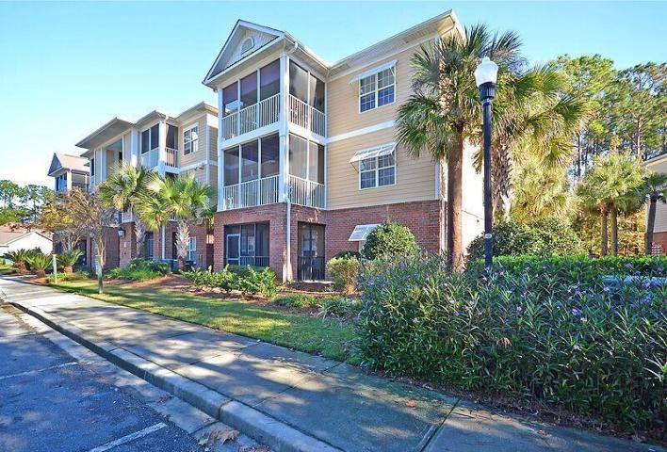
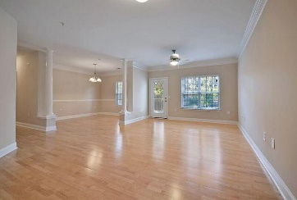
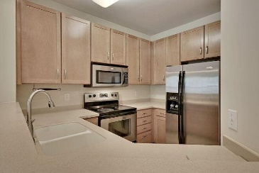
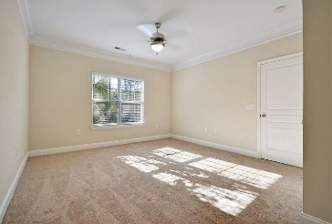
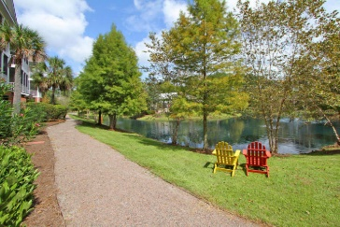
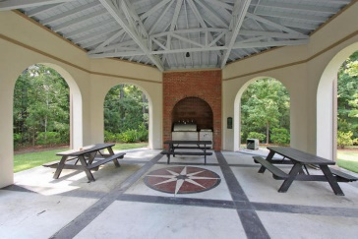


DON’T MISS THIS DEAL!
1310 Basildon Road
Park West
Mount Pleasant
MLS# 15029799
$199,900
Remarkable one level end unit condominium that is located in The Battery at Park West subsection. This Incredible freshly painted home with 9 ft. smooth ceilings and classic moldings through-out offers beautiful new wall-wall carpet in the two large bedrooms including the spacious master bedroom with a private full bathroom.
The modern kitchen if fully appointed with upgraded stainless appliances, beautiful 42 inch crafted wood cabinets, quality Corian Counter Tops, the Awesome gathering room is filled with natural light and is appointed with stylish laminate/wood flooring, the flex room/office is located adjacent to the gathering room and is appointed with the gorgeous laminate/wood flooring and could be used as a Glamorous Formal Dining Room.
There is a private walk-out to the large Popular screened porch that offers views of the community pond. Amenities include an elevator in the building, pool, tennis courts, walking trails, dog parks, clubhouse with media/game rooms, fitness center and outdoor grill area. The Line Forms Here so please bring your check book!
Age, sqft, regime fee, HOA fee, schools, acreage and taxes are approx. buyer to verify.
Bill Everett, Jr
Broker
843-693-8539
Bill@TheEverettGroup.net
RE/MAX Pro Realty, 9209 University Blvd, Charleston, SC 29406

