Slide 1
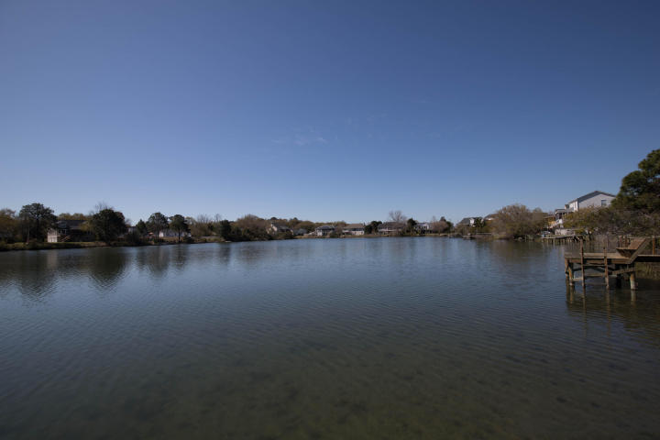
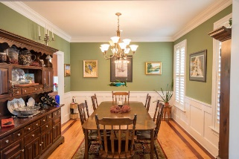
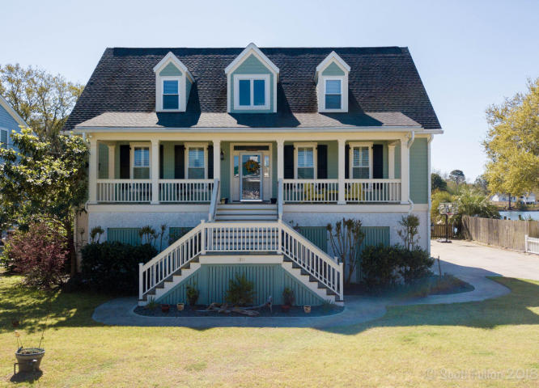
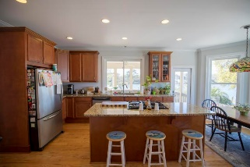
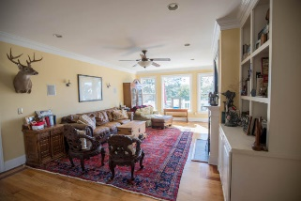
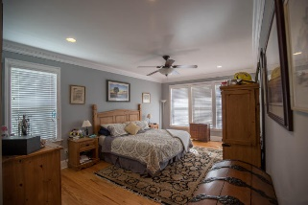
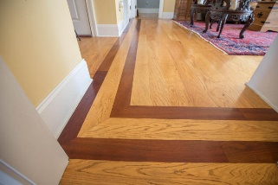
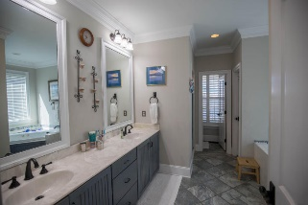
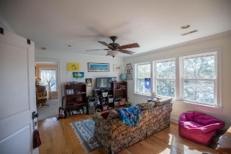
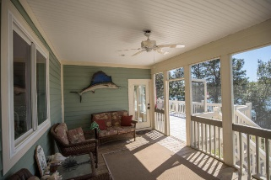
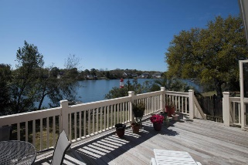
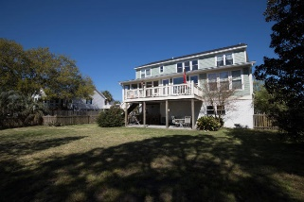
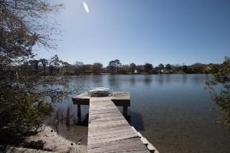

1311 Battle Ground Road
Charleston, SC 29412 ~ MLS# 18008048 ~ $625,000
Custom home on beautiful lake!
Custom Home On Beautiful Lake in Fort Lamar
Welcome home! Beautiful, elevated, custom home in the desirable Fort Lamar subdivision on James Island. Minutes to schools, beach, and shopping! Downstairs you will find a powder room off the foyer, formal dining room, large Great Room with built in shelves and views of the lake, large spacious kitchen with plenty of cabinet and counter space, eat in breakfast area, separate laundry area with large sink and room for a secondary refrigerator, and a large master bedroom with spacious master bathroom and walk-in closets. Upstairs you will find a large bonus area, 3 spacious bedrooms, and 2 full bathrooms. The home does have an elevator shaft for future elevator if needed. Outside, you will find a large, fenced backyard, a lower covered patio, large upper deck, and a dock.
Scott Fulton
(843) 324-8845 O | (843) 324-8445 M
scott.fulton@agentownedrealty.com
AgentOwned Preferred Group | 824 Johnnie Dodds Blvd | Mt Pleasant, SC 29464

