Slide 1
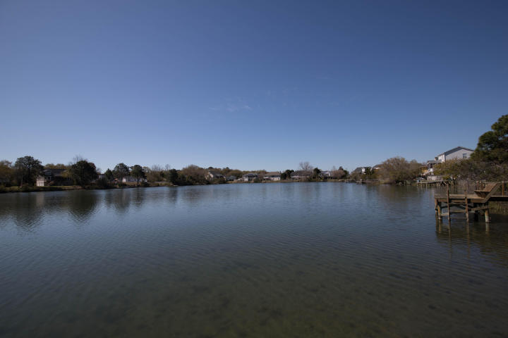
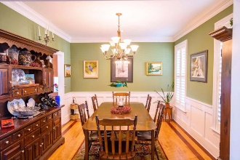
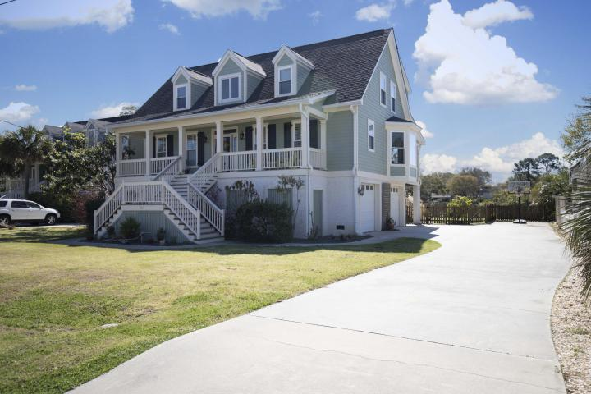
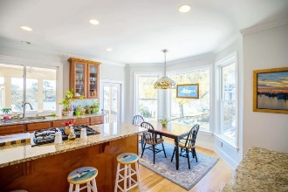
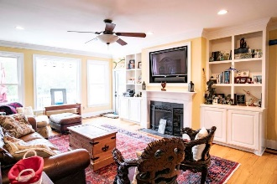
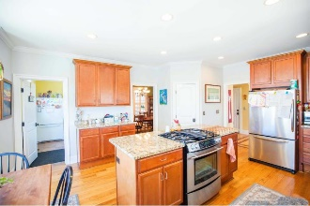
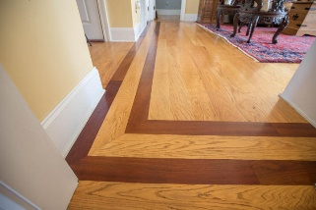
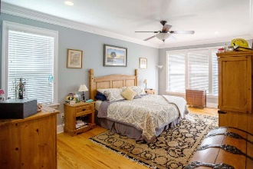
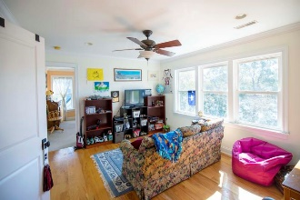
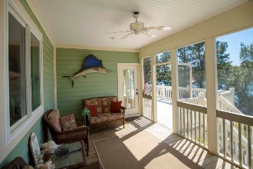
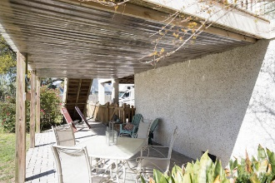
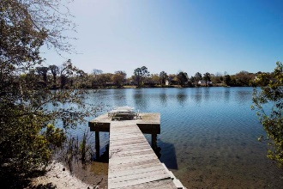
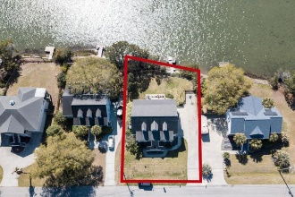

1311 Battle Ground Road
Charleston, SC 29412 ~ MLS# 18008048 ~ $619,900
Custom home on beautiful lake!
Motivated Sellers - Bring Your Best Offer!
Elevated, custom home located minutes to Downtown Charleston and Folly Beach on James Island. Downstairs you will find a powder room off the foyer, formal dining room, large Great Room with built in shelves and views of the lake, large spacious kitchen with plenty of cabinet and counter space, eat in breakfast area, separate laundry area with large sink and room for a secondary refrigerator, and a large master bedroom with spacious bathroom and walk-in closets. Upstairs you will find a large bonus area, 3 spacious bedrooms, and 2 full bathrooms. The home does have an elevator shaft for future elevator. Screen porch, deck, covered patio on the rear of the home and plenty of room for kayaks and sports equipment in the over-sized garage and carport. Boat and camper parking allowed on property.
Scott Fulton
(843) 324-8845 O | (843) 324-8445 M
scott.fulton@agentownedrealty.com
AgentOwned Preferred Group | 824 Johnnie Dodds Blvd | Mt Pleasant, SC 29464

