Slide 1
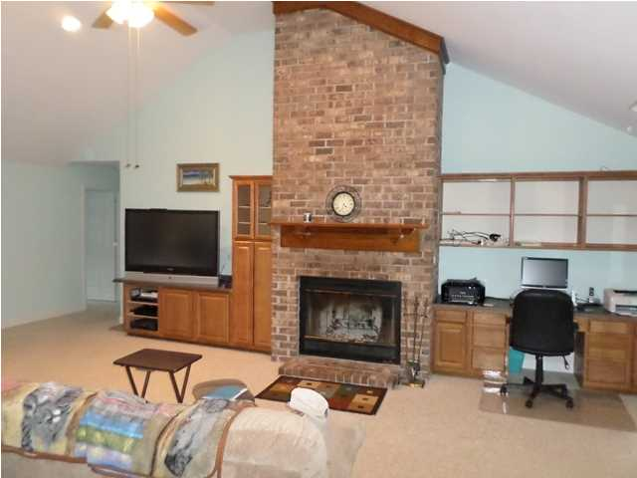
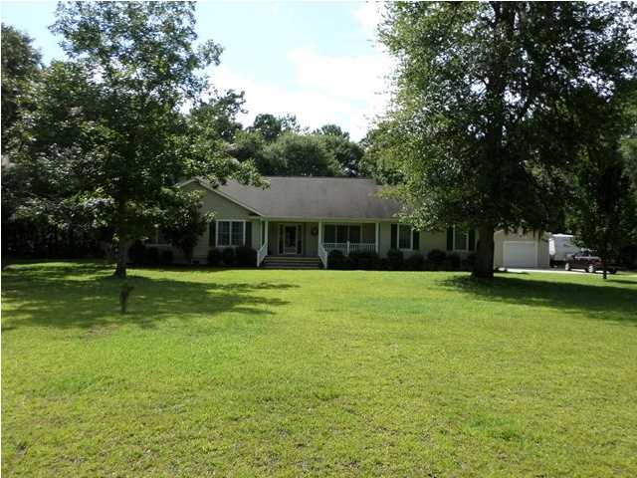
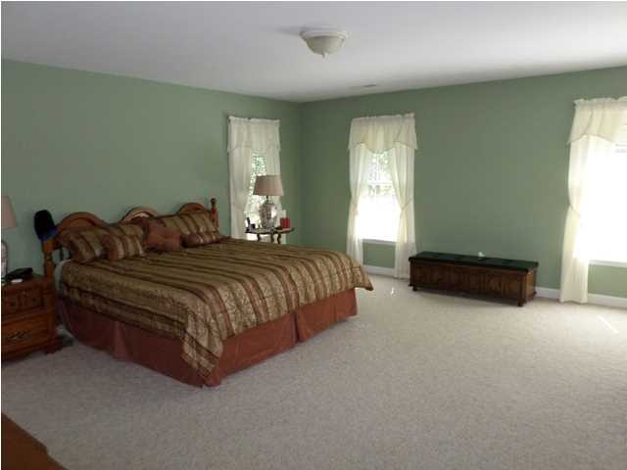
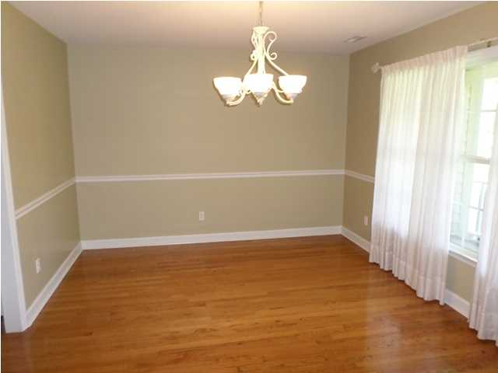
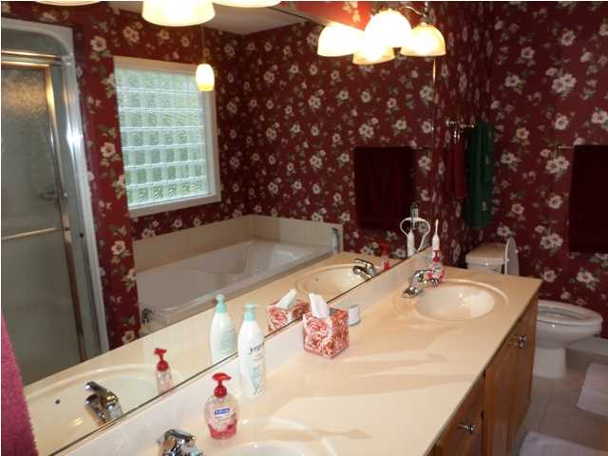
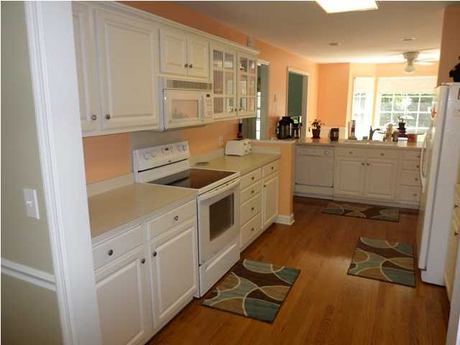
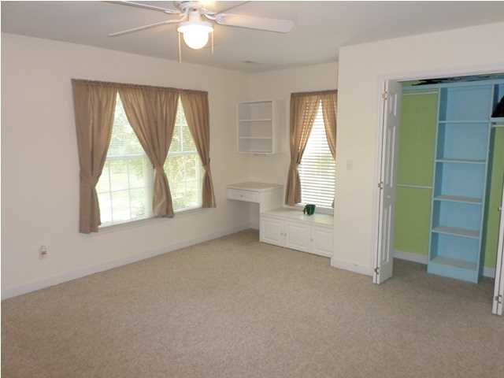
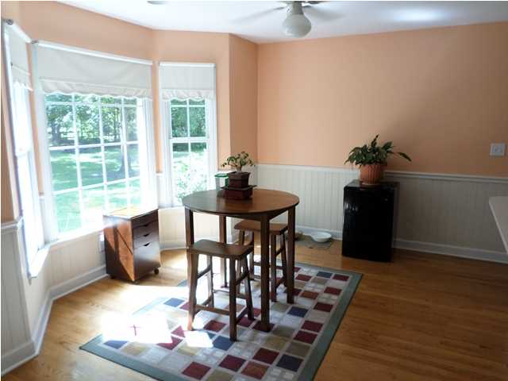
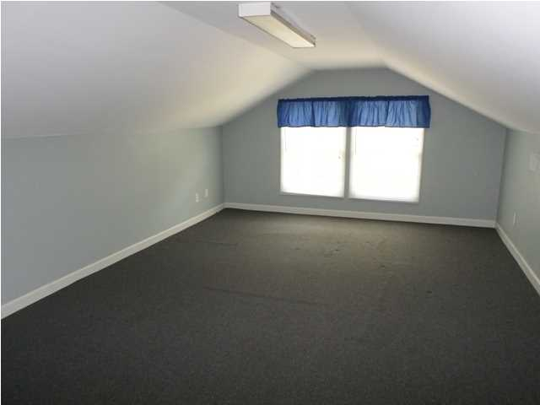
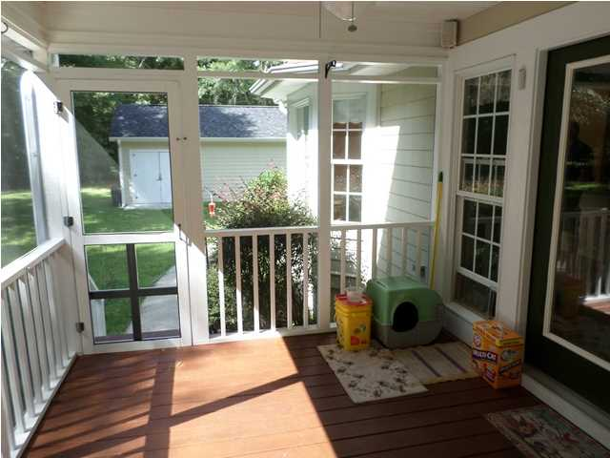
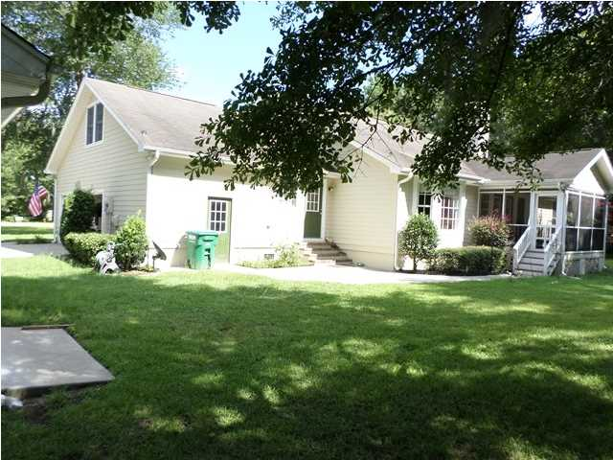
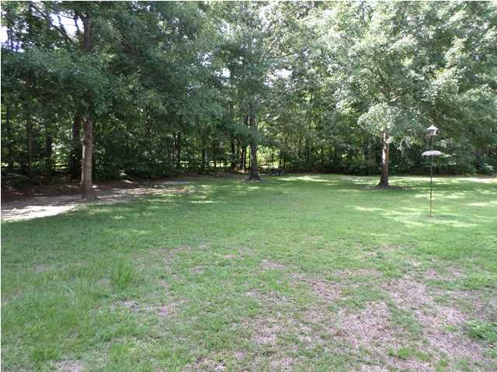
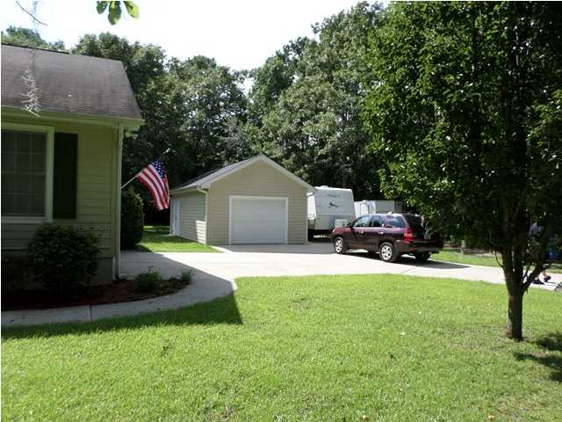
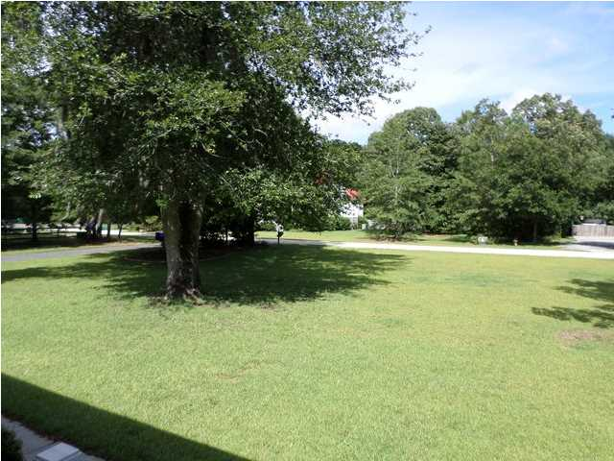


Open House ~ Sunday 2-5
Room to Roam!
1312 Whippoorwill Farm Rd
Johns Island – MLS# 1419722 – $360,000
Enjoy the open spaces and wild life of Johns Island in this 2700+ sq ft custom built home on an acre and third lot-plenty of room for a garden. Located off Chisolm Road in Whippoorwill Farms. House has a very functional floor plan with nice sized rooms, hardwood flooring, brick fire place in family room, eat-in kitchen with pantry and nice view out bay window of back yard and woods. Master bathroom has two walk-in closets and dual vanities, shower stall and separate bath tub. There is also a 200+ sq ft Frog over two car garage. The attached spacious garage also has it own work shop. There is also a screened porch to enjoy the quiet setting. Additionally, there is a detach garage with room for a car, lawn equipment, and or boat. Enjoy also the benefits of not being a flood zone and still be on Johns Island
Jerry Wise, Realtor
843-442-7633
jwise@eratidesrealty.com
ERA Wilder Realty, 125-F Wappoo Creek Dr, Charleston, SC 29412

