Slide 1
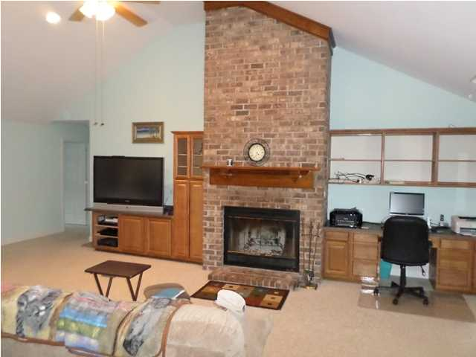
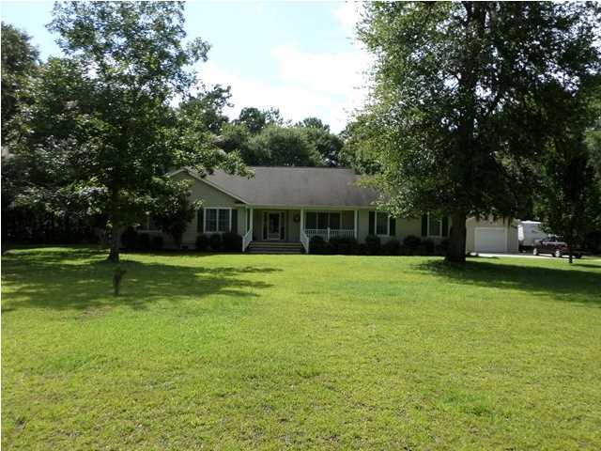
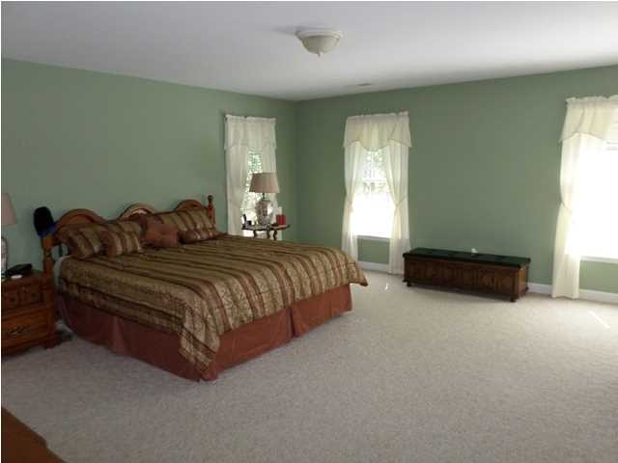
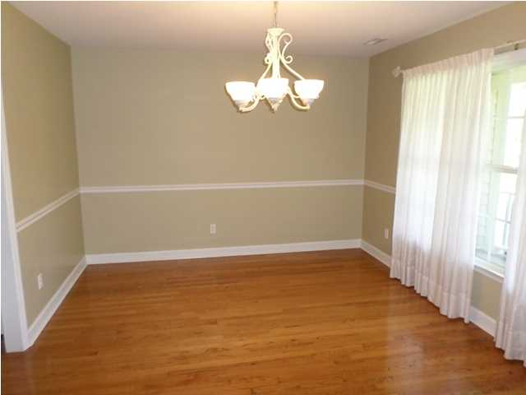
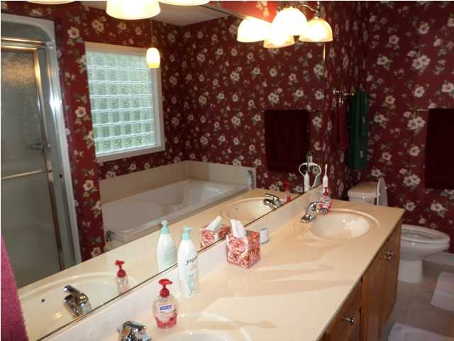
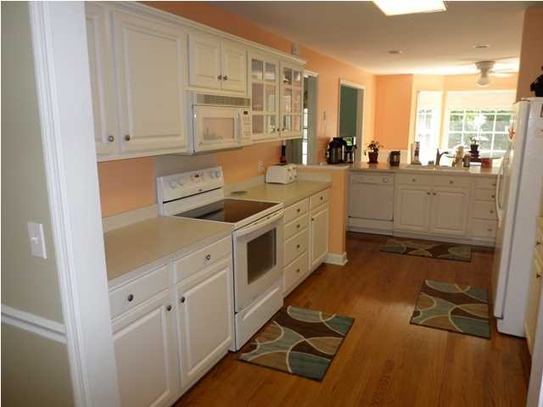
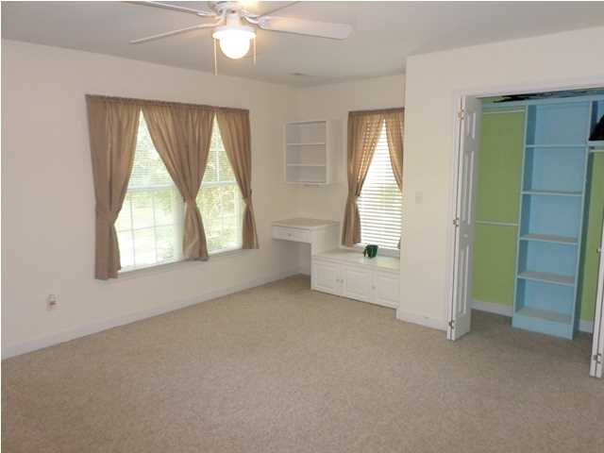
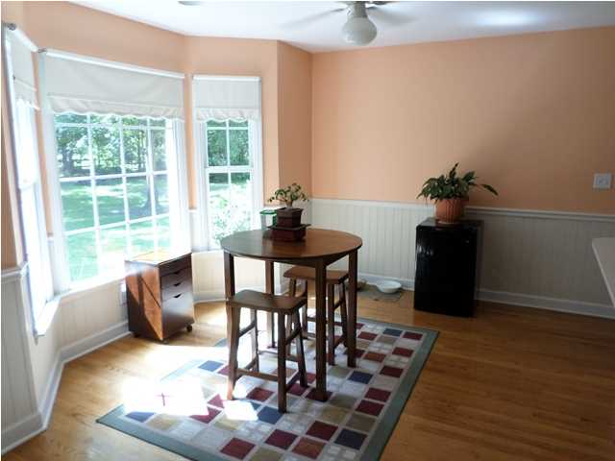
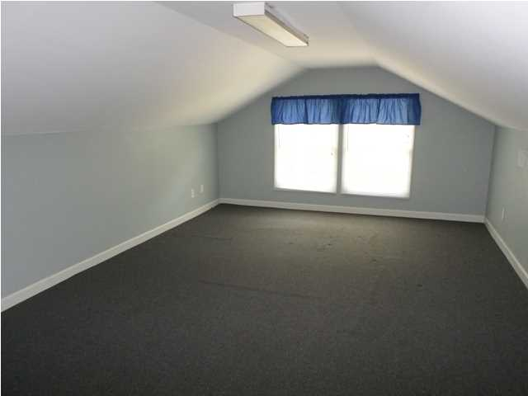
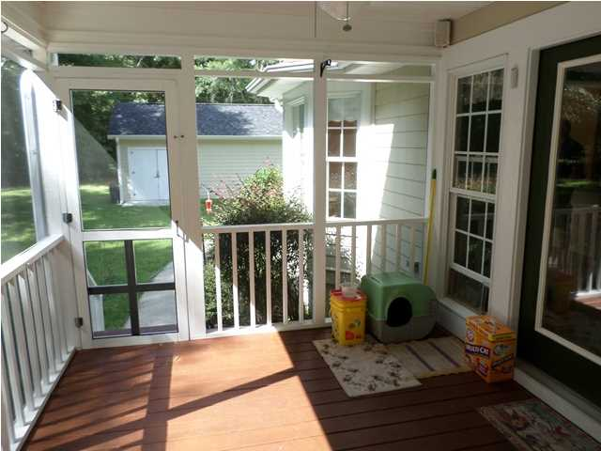
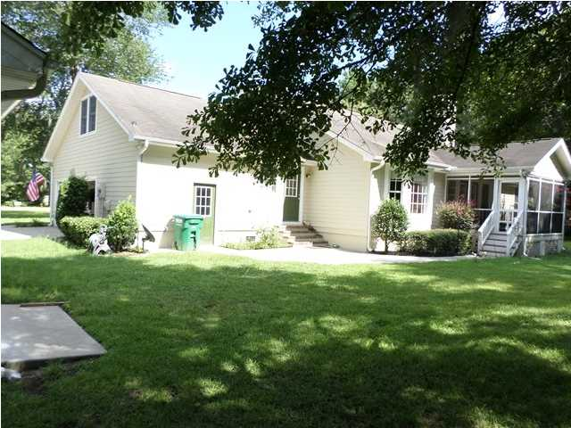
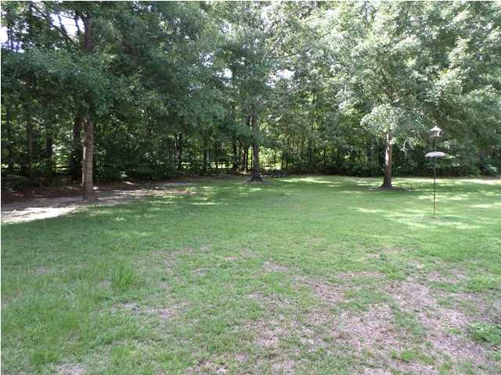
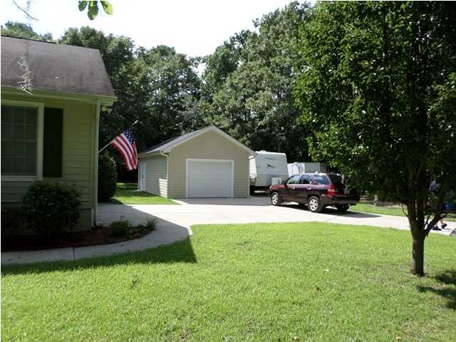
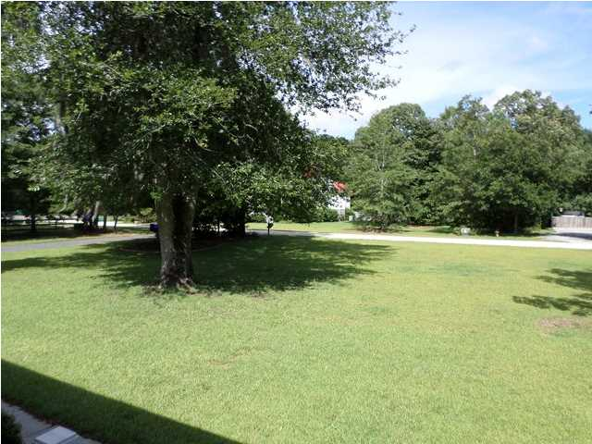


Back on the Market!
Room to Roam!
1312 Whippoorwill Farm Rd
Johns Island – MLS# 1419722 – $354,500
Only 30 minutes from airport, enjoy the open spaces and wild life of Johns Island in this 2700+ sq ft custom built home on an acre and third lot-plenty of room for a garden. Located off Chisolm Road in Whippoorwill Farms. House has a very functional floor plan with nice sized rooms, hardwood flooring, brick fire place in family room, eat-in kitchen with pantry and nice view out bay window of back yard and woods. Master bathroom has two walkin closets and dual vanities, shower stall and separate bath tub. There is also a 200+ sq ft Frog over two car garage. The attached spacious garage also has it own work shop. There is also a screened porch to enjoy the quiet setting. Additionally, there is a detach garage with room for a car, lawn equipment, and or boat. Enjoy also the benefits of not being a flood zone and still be on Johns Island.
Jerry Wise, Realtor
843-442-7633
jwise@eratidesrealty.com
ERA Wilder Realty, 125-F Wappoo Creek Dr, Charleston, SC 29412

