Slide 1
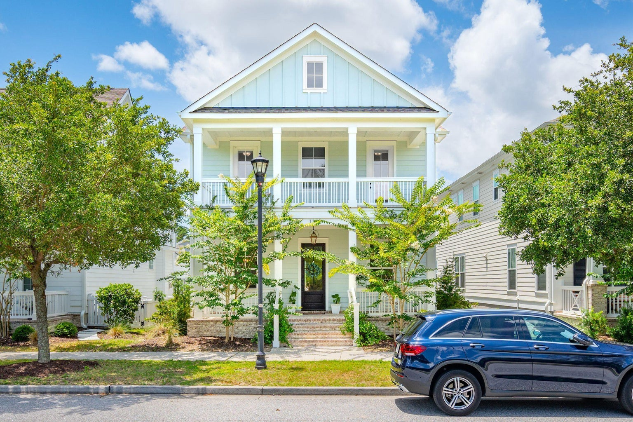
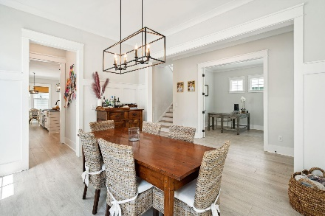
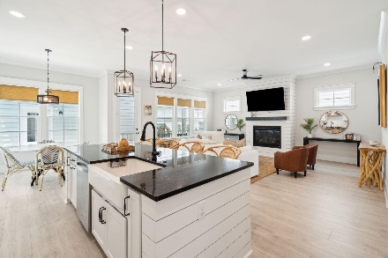
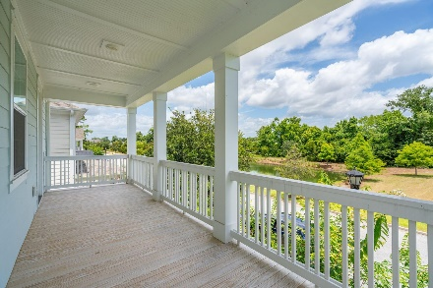


Price Reduction - Bring Offers!!
1313 Founders Way | Mount Pleasant
Midtown | MLS# 24025915 | New Price $1,239,000
Why renovate when you can buy nearly NEW?? Don't miss your chance to own a pristine, 2021 newer construction home with the potential added benefit of a mother-in-law suite or rentable accessory dwelling studio apartment (FROG). Situated in the heart of the picturesque town of Mount Pleasant, and just 10 minutes to the beach, this stunning home located at 1313 Founders Way perfectly combines convenience and Southern charm as you are welcomed into the home with double front porches. Located in the highly sought after Midtown neighborhood and built in 2021, this meticulously maintained home feels even better than new.
Just minutes from the beautiful Sullivans Island and Isle of Palms beaches, Historic downtown, and in close proximity to the Charleston Airport, this lovely home offers quick access to Coleman Boulevard, Highway 17, and Interstate 526. You'll find an array of shopping, dining, golfing, and other recreational activities nearby, making this area a true oasis. These opportunities do not arise often in Mount Pleasant. Book your showing today!
Greg Boger
843-277-5845
gboger@avenuerealtyco.com
Avenue Realty Company
www.avenuerealtyco.com

