Slide 1
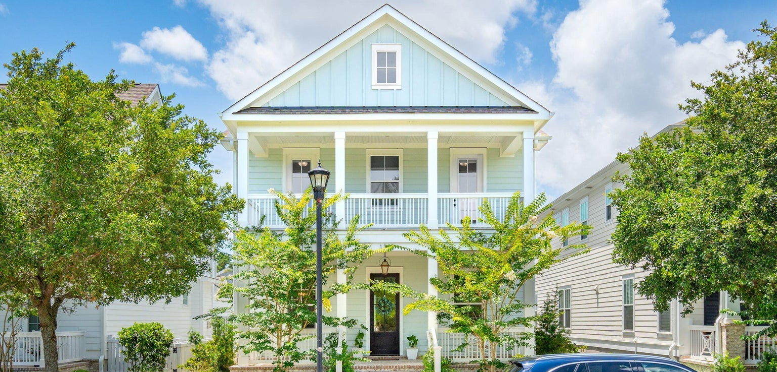



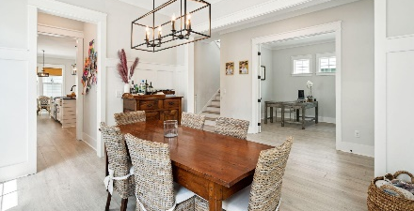
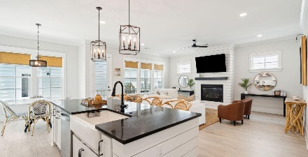
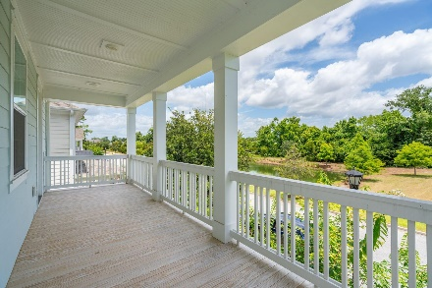






Open House Saturday 12-2
1313 Founders Way | Mount Pleasant
Midtown | MLS# 24025915 | Now Offering at $1,239,000
Why renovate when you can buy nearly NEW?? Don't miss your chance to own a pristine, 2021 newer construction home with the potential added benefit of a mother-in-law suite or rentable accessory dwelling studio apartment (FROG). Situated in the heart of the picturesque town of Mount Pleasant, and just 10 minutes to the beach, this stunning home located at 1313 Founders Way perfectly combines convenience and Southern charm as you are welcomed into the home with double front porches. Located in the highly sought after Midtown neighborhood and built in 2021, this meticulously maintained home feels even better than new.
Greg Boger
843-277-5845
gboger@avenuerealtyco.com
4 Beds
3½ Baths
2,997 SF
0.11 Acres
Avenue Realty Company
www.avenuerealtyco.com

