Slide 1
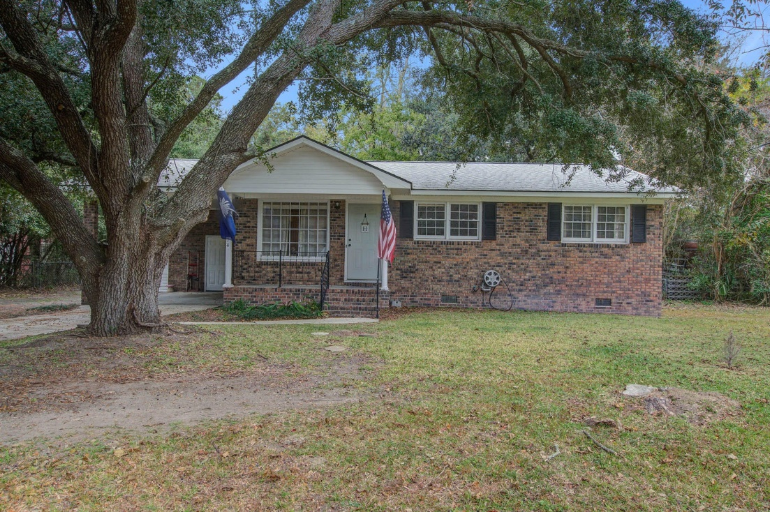
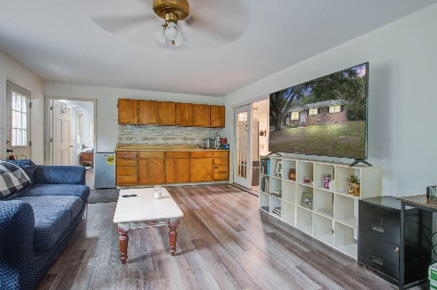
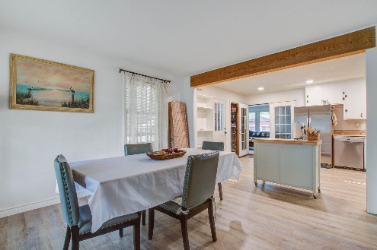
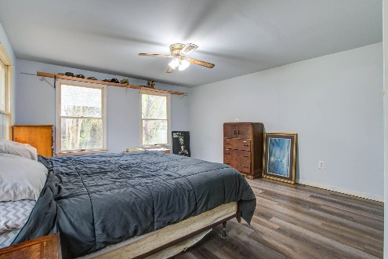
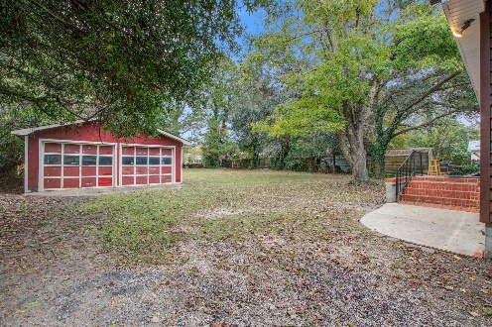


Just Listed!
REDUCED
1314 Teal Avenue
Clarks Sound · Charleston, SC 29412
MLS# 23025838 · $525,000
Michael Dew
O 843-769-5100
M 843-870-7000
michaeledew@gmail.com
www.michaeldewrealestate.com
Great Location!
4 bed 2 bath brick ranch on James Island.
Large lot with huge detached 2 car garage/workshop.
Convenient to downtown, Folly Beach, shopping and restaurants.
AgentOwned Charleston Group
902 Savannah Hwy
Charleston, SC 29407
Real Estate ● Mortgage Insurance ● Business Brokerage

