Slide 1
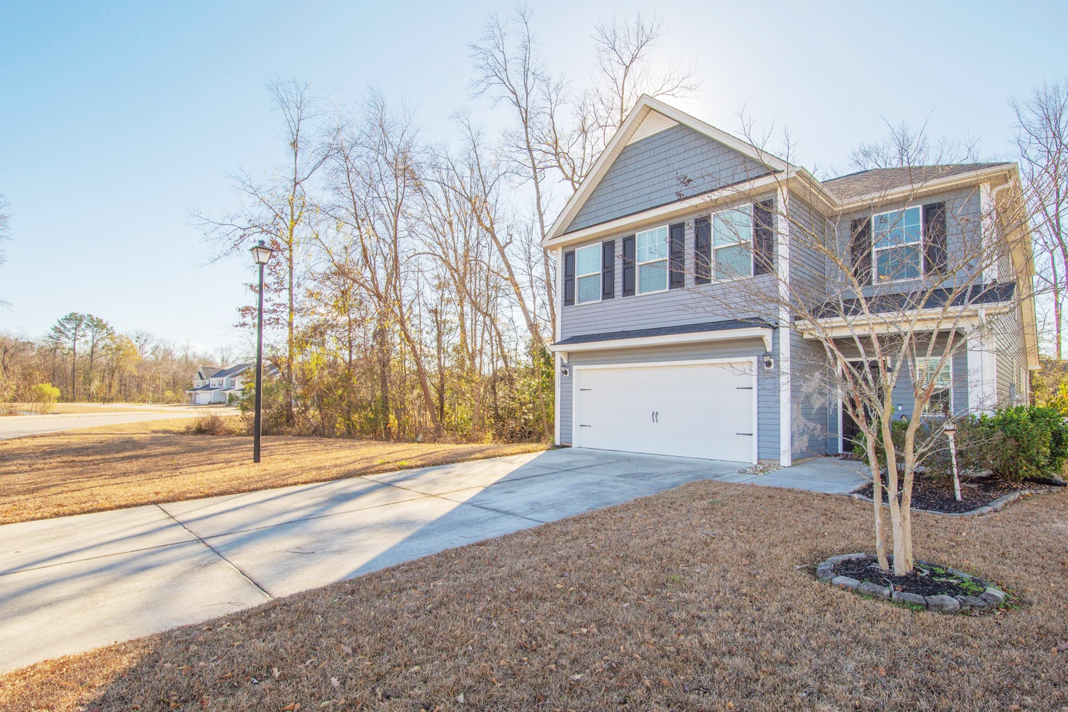
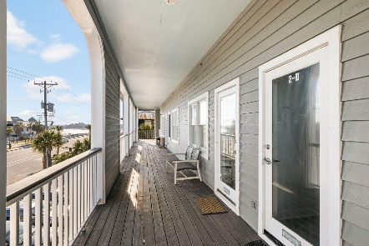
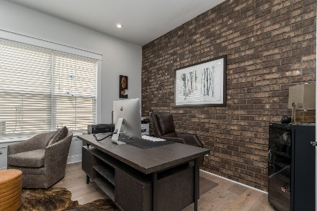
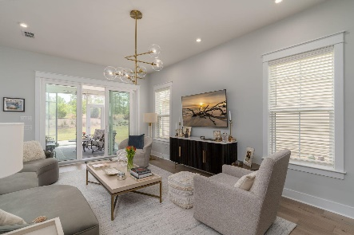

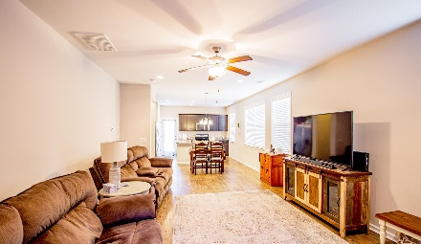
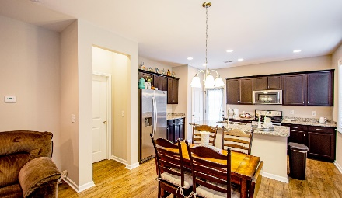
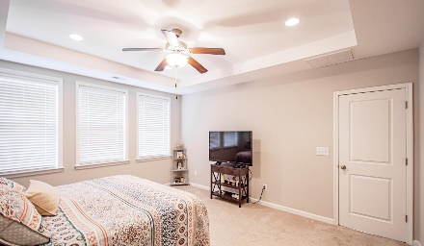
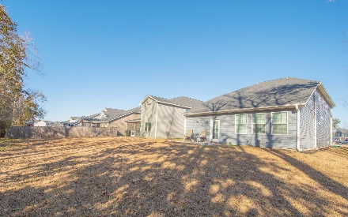
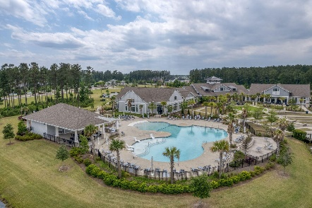
1315 Discovery Drive Hunters Bend | Ladson, SC 29456 | MLS# 24002180 | $394,999
Darrell Creek Elevated Home With Elevator & Salt Pool
Spacious 5 Bedroom
In Hunters Bend
Co-sponsored by
Offering $3000
Lender Credit
Welcome to your dream home! Looking to be close to Nexton without Nexton prices? All the new restaurants, Publix and Harris Teeter opening soon, close to I-26. Tucked away at the back of the neighborhood, this home offers a peaceful and private setting with beautiful wooded views. This well kept property boasts 5 spacious bedrooms and 3 1/2 baths, providing ample space for the whole family. Lovingly cared for it feels barely lived in.The kitchen is a chef's delight, featuring granite countertops and sleek stainless steel appliances. The downstairs master bedroom includes his and her closets, providing plenty of storage space, has a tray ceiling and is situated at the back of the home for privacy and views of the woods. The loft area adds even more room for relaxation and entertainment.
One of the guest bedrooms has its own bath for a private ensuite. Come see for yourself and fall in love with this beautiful home! Seller offering $5000 toward buyer closing costs or rate buy down with full price offer.
Rochelle Rennert
843-847-9694 | rochellesellscharleston@gmail.com | www.RochelleSellsCharleston.com
AgentOwned Premiere Group, Inc. | 219 N Highway 52 Ste A | Moncks Corner, SC 29461-3926

