Slide 1
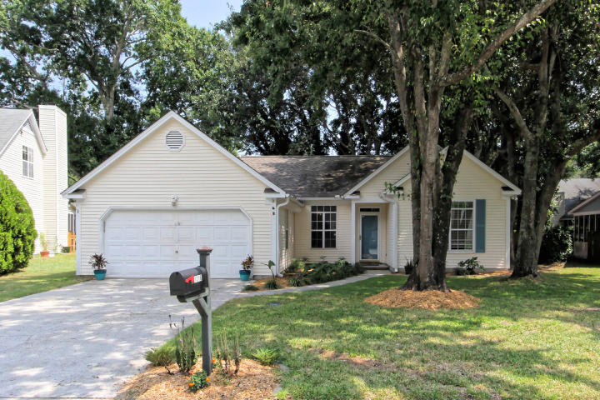
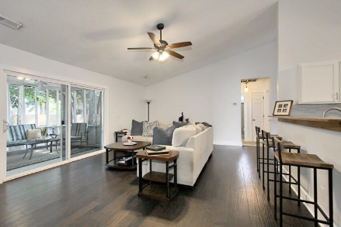
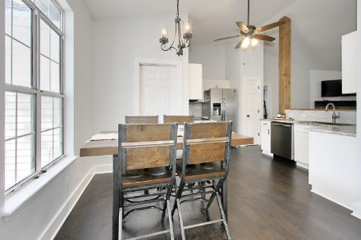
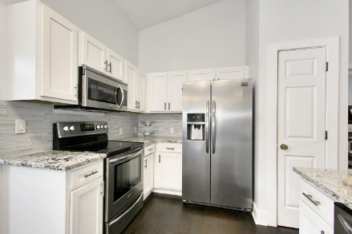
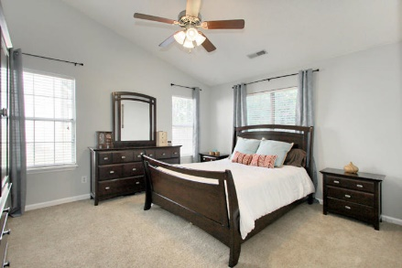
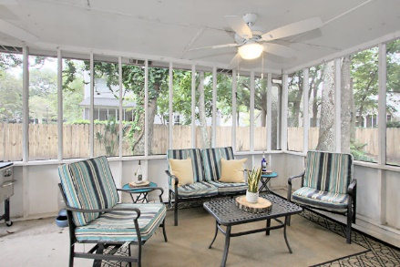
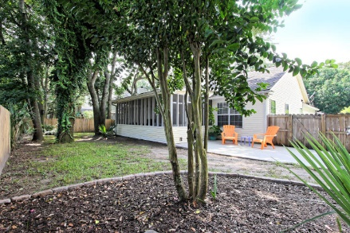



PRICE REDUCED - MOTIVATED SELLERS
1316 Old Mill Lane Sweetgrass | Mount Pleasant, SC 29464
MLS# 18023759 | $391,500
Recently renovated home on a Cul-de-sac inside Sweetgrass subdivision. Sweetgrass is one of the most sought out neighborhoods in Mount Pleasant, 5 minutes to beaches, 15 minutes to downtown, close to shopping, restaurants and interstate access. This home is 3 bedrooms with bonus room that could be used as a 4th bedroom. Nice size screened in patio perfect for gathering with friends. Renovated kitchen with Stainless steel appliances, crisp white cabinets, wood bar and new counter tops really open the kitchen up. The entire home has been freshly painted. The yard is beautifully landscaped complete with fenced in back yard.
Barb Burleson
(843) 425-4801
Barb@Southerngenerationsgroup.com
AGENTOWNED PREFERRED GROUP 824 JOHNNIE DODDS BLVD
MT PLEASANT, SC 29464
Marley Presswood
(843) 568-3212
Marley@SouthernGenerationsGroup.com
AgentOwned Preferred Group | 824 Johnnie Dodds Blvd | Mt Pleasant, SC 29464

