Slide 1
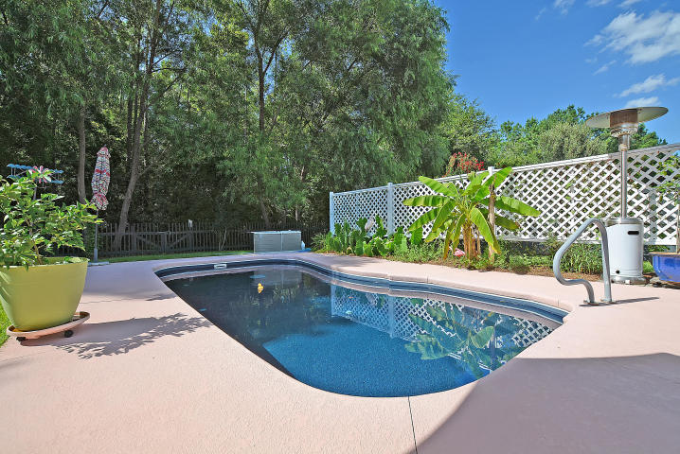
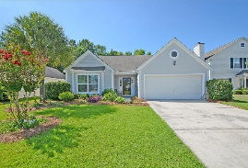
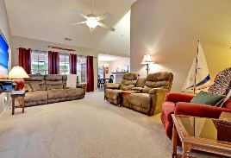
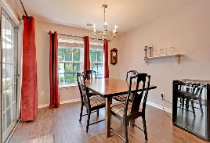
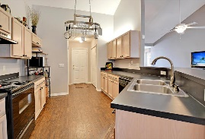
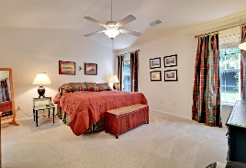
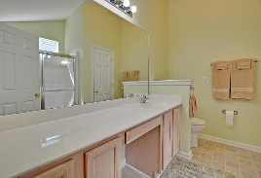
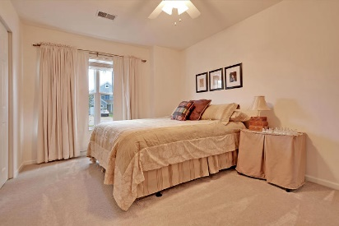
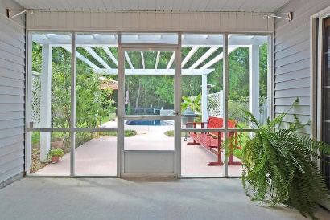
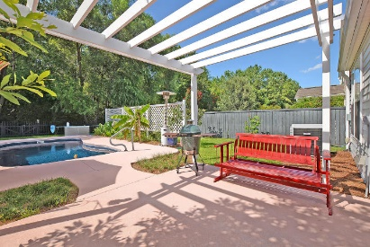
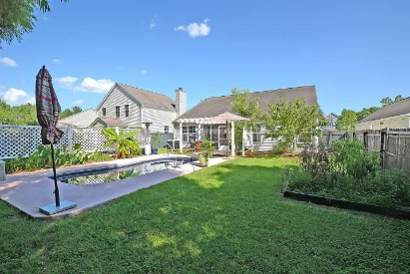

1318 Palm Cove Drive The Peninsula | Charleston | MLS# 16019001 | $274,771
Soaring Ceilings, Open Concept & Dock
Private Paradise in the Heart of it All
One of a Kind Home with Amazing Upgrades! Enjoy this HUGE Lot that is Fully Fenced and backs up to the Woods! Check out the Gorgeous, Crystal Clear, in-ground Salt Water Pool! Open Concept Living with NEW Interior Paint in the living & dining areas. NEW laminate floors. 3 Ton A/C unit installed in 2008. Kitchen has Tons of Counter Space & Cabinets with an Extended Pantry and Whirlpool Appliances. The Master Bathroom boasts a Spacious Shower you can sit down in! A large pantry, New Toilet, Raised Vanity, & Upgraded Faucet. Lounge in your Master Suite with Vaulted Ceilings, loads of Natural Light and a view of the Stunning Backyard! You even have a Walk-in Closet. Ceiling Fans in Every room! Just minutes to Mt Pleasant & I-526. New Phillips Simmons Schools being built 1.5 miles away. K-8 scheduled to open August 2016. Shop & Play on Daniel Island just minutes from your home. The back yard is really special... with Peach Trees, Banana Trees, an Avocado Tree & Lady Banksie Roses on the trellis, you are bound to linger. You even have your very own vegetable garden. The large Screen Porch & Extended Patio with Freshly Painted Pergola provide the perfect space for Entertaining & enjoying the fantastic Charleston weather! Rare "Rain-Bird" Irrigation System installed with 150-gallon water catchment. GUTTERS Throughout the home! The Garage is any man's dream workplace. It has been Dry walled & Painted & includes Florescent Lighting & Garage Door Opener. Pegboard and Wall Shelves Convey. Two other Bedrooms are really Roomy with Large Closets. Guest Bathroom has Raised Vanity, NEW Toilet & Upgraded Faucet. Two more Closets in the Hallway provide excellent Storage! The owner has so many special touches in this home...The A/C is tilted properly so it does not rust, the Hot Water Heater is on a Timer to conserve electricity. The windows Tilt-In for easy cleaning. The Attic has a drop-down Ladder and Plywood has been lain for additional storage. The Amenity Center is just down the street and boasts 2 pools with one Olympic Sized. A play park is right next door. Carpet has been professionally cleaned. NO FLOOD INSURANCE required! Termite Bond in Place! 52" TV in the Family Room CONVEYS! All curtain rods, Venetian Blinds & Curtains Convey! Pot Holder in Kitchen Conveys! This home is MOVE IN READY! Don't miss out!
Call or email for details: (843) 214-8451 or Robin@ThePhillipsRealtyGroup.com

