Slide 1
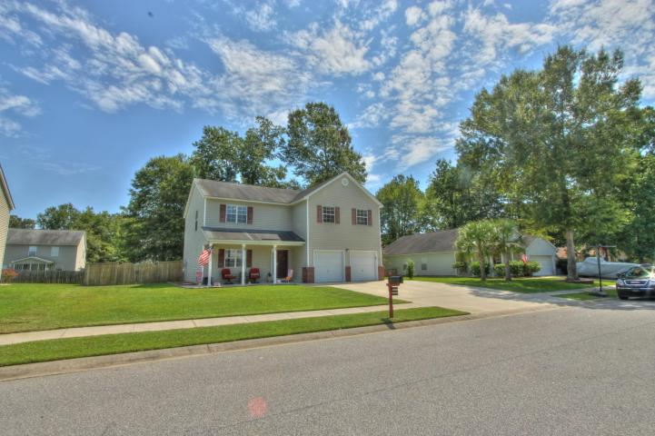
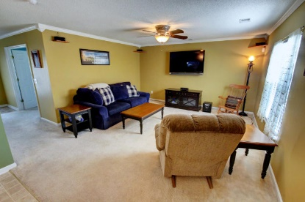
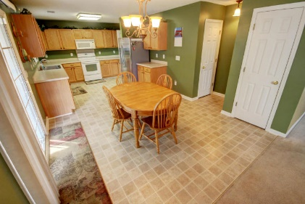
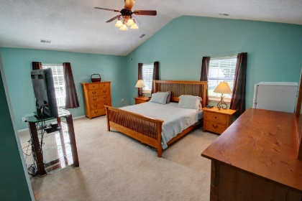
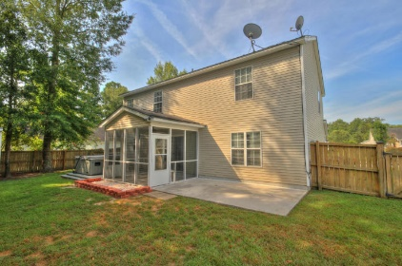

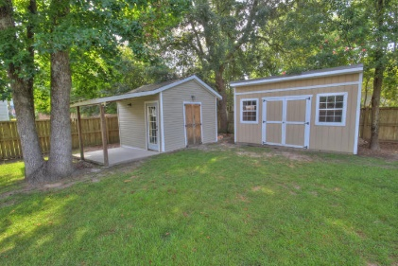
1319 Pinyon Pine Dr
Tall Pines
Ladson, SC 29456
MLS# 15021705
$199,990
4 Bedrooms
2½ Bathrooms
2,252 Sq Ft
Only 4½ miles to
Downtown Charleston!
100% Financing - NO PMI*
IMMACULATE home with ENORMOUS rooms throughout!
Welcome to the Harrison plan by Centex! This home has 4 bedrooms, 2.5 bathrooms, an office, an open great room, screen porch, patio, 2 sheds, spacious mud room, two car garage with service door, extended driveway and MORE!
Recent updates include: freshly painted walls and trim(some rooms), Crown molding throughout, Remodeled master bath, upgraded light fixtures, 3rd driveway, Garage door opener both doors, Extended back patios,
Hot tub (conveys AS-IS), 2 sheds custom built, new front door & screen door (with glass door insert), hot tub, pool and camper electric hookup, Master bedroom and garage interior walls have extra insulated, new blinds throughout.
Ceiling fans & dimmer switches throughout and Cable & phone hookups in every room including garage. Plus, this home is in a well kept community with no HOA!
Meg Hopkins Kandik
Cell - 843-814-5137
meg@holycityre.com
*Financing based on credit, income, assets etc. See lender for details.

