Slide 1

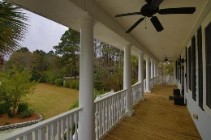
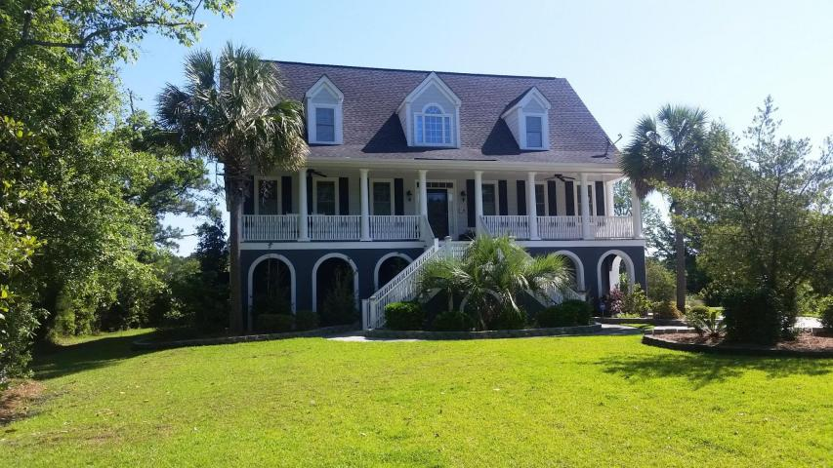
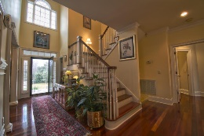
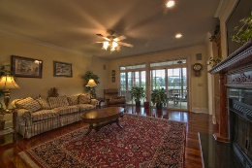
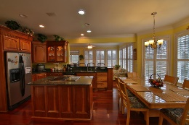
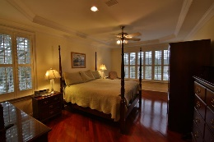
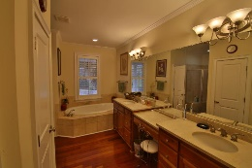
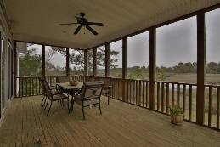
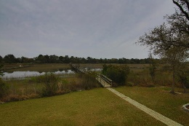
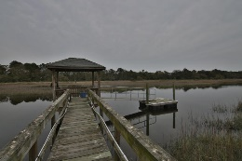
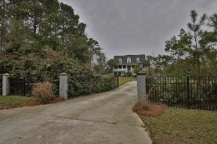


Views ~ Sunsets ~ Water
1319 River Road
Johns Island, SC 29455 • MLS# 16007875 • $1,150,000
This beautiful custom built 3 level home sits on 1.31 acres, professionally landscaped w/ amazing views of Penny Creek. 9' Ceilings on the main floor, gas fireplace w/ custom built-ins. Wainscoting and a tray ceiling in formal dining room. Kitchen cabinets were custom built on site w/ granite counter tops, eating area and a bar height counter going into a sun room. Master Bedroom overlooks the backyard, dock and Penny Creek. Marble floors in bathroom w/double sinks, 2 closets, jetted tub, & large walk-in tiled shower. Top level has the other 4 bedrooms, one of which is another master suite. Ground level has a 3+ car garage w/ tons of extra storage. An enclosed man cave/media room that is separately heated & cooled, included in the square footage.
See more at www.1319riverrd.2seeit.com
Lisa Stine, REALTOR
(843) 364-5359
lisastine61@gmail.com
Elaine Brabham and Associates, LLC • 1890 Sam Rittenberg Boulevard, Suite 217 • Charleston, SC 29407

