Slide 1
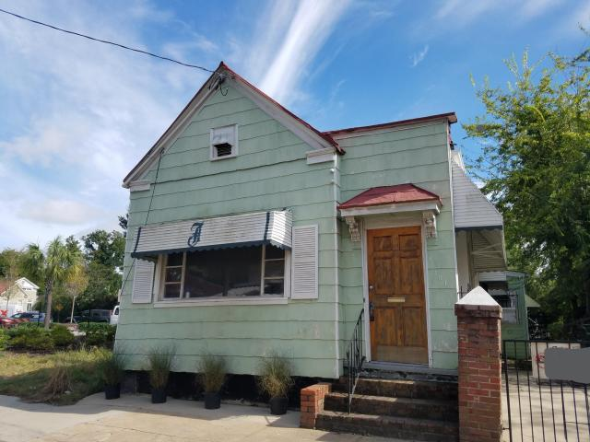
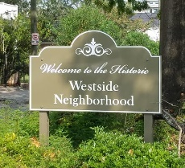
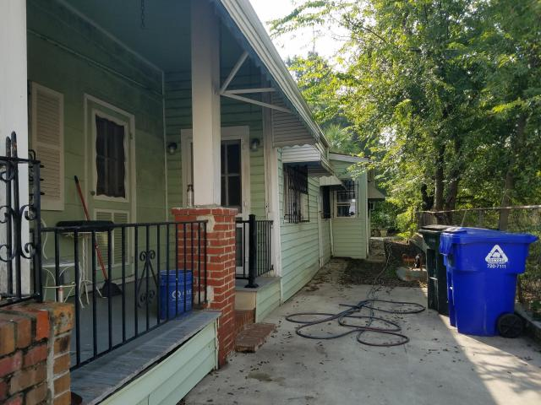
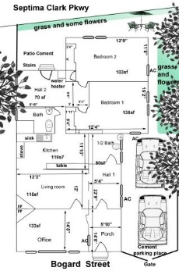
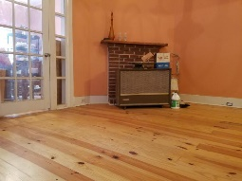
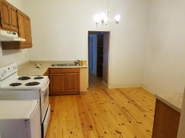
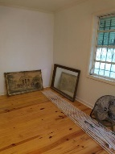
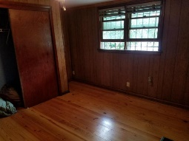
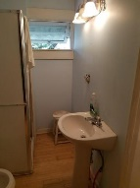
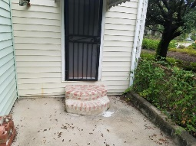
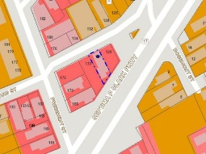


Just Listed Downtown Residential/Commercial - $325k
131 Bogard Street
West Side | Charleston, SC 29403 | MLS# 17026549 | $325,000
This Charleston single is loaded with potential.
Blocks from MUSC, the VA Hospital, Restaurants and the new WestEdge development featuring a Publix Grocery Store. You will be in the center of everything.
This property is zoned for Residential OR Commercial (General Business). The current owner has added new heart of pine and bamboo flooring in addition to a half bath. The kitchen space has been relocated to a larger space allowing more flexibility for its use.
The front of the house has high ceilings and is ideal for an office and/or living area. There is a concrete patio with a sitting area behind the house.
The area is undergoing sewer & drainage projects by the City of Charleston. Off-street parking for a small car or scooter.
Whitley Boyd
(843) 324-4761
w.boyd@agentowned.com
www.PropertiesofCHS.com
AgentOwned Preferred Group | 824 Johnnie Dodds Blvd | Mt Pleasant, SC 29464

