Slide 1
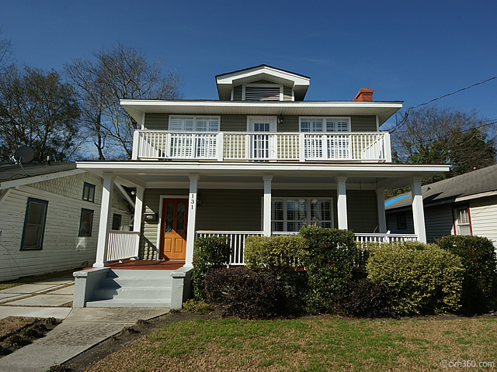
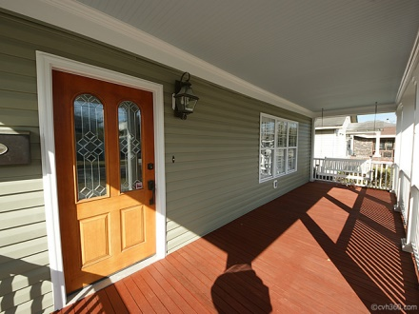
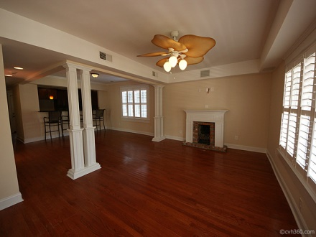
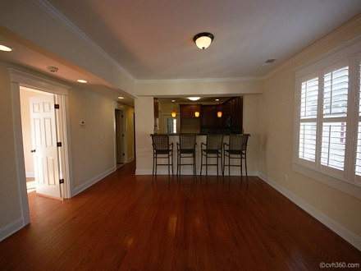
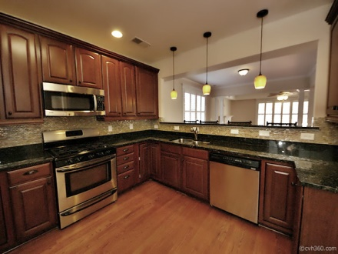
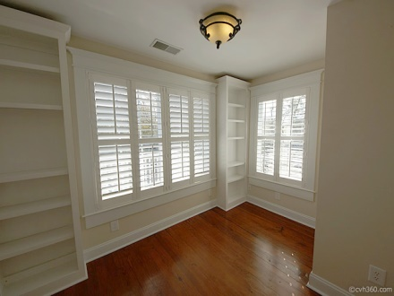
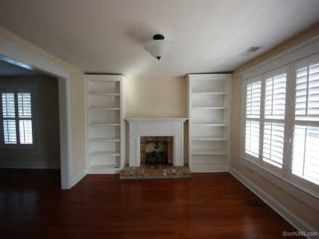
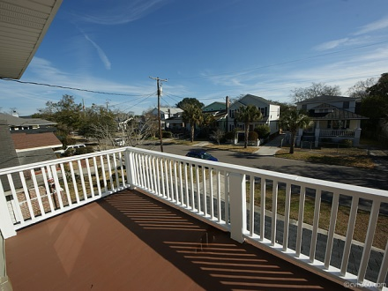
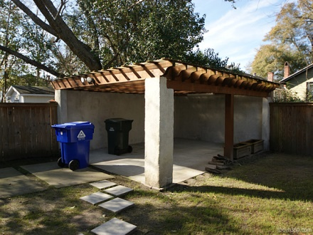

$3,000 buyer’s agent bonus if a contract is ratified before July 30th Must be broker approved and only paid at closing.
131 Darlington Ave
Wagener Terrace ~ Charleston
MLS# 1403413 ~ $529,000
Jennifer LePage
ABR, SRES
Mobile (843) 478-2600
Office (843) 769-5100
lepagej@bellsouth.net

