Slide 1
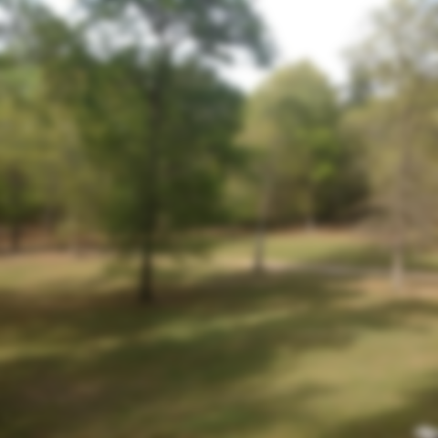
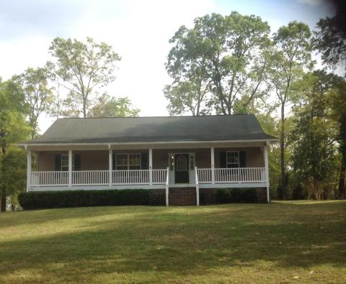
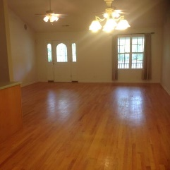
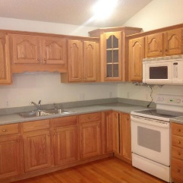
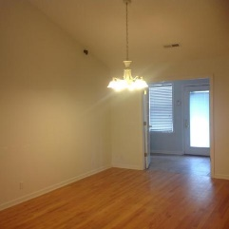
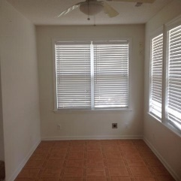
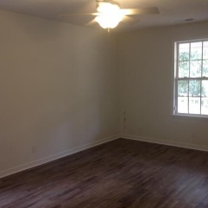
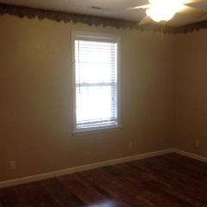
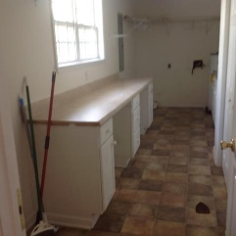
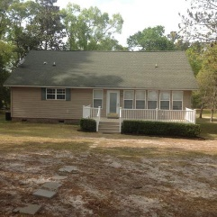
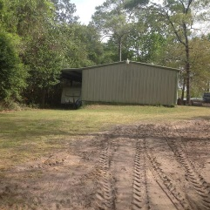
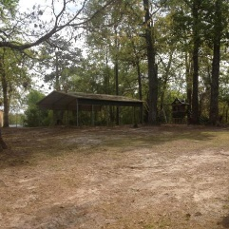

Secluded property which affords privacy
but is still within 10 minutes of lake access!
131 Epiphany Road
Eutawville, SC 29048 | MLS# 18009571 | $239,000
3 Beds | 2 Baths | 1,710 Square Feet
This large 3 bedroom and 2 baths home is on 2.75 acres with 3 bay garage/workshop. There is also an additional 2 car carport as well. The house is vinyl sided and the laundry room has additional storage. This secluded property is around 10 minutes from the lake with mature landscaping and located at the end of the road so not much traffic. Security cameras convey.
Carla C Davis
Mobile - (843) 437-4873
gaweber@tds.net
AgentOwned Premiere Group
141 A N. Main Street
Summerville, SC 29483

