Slide 1


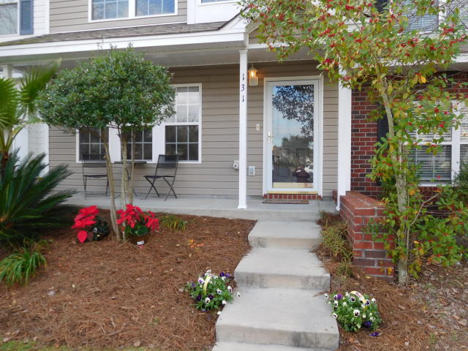
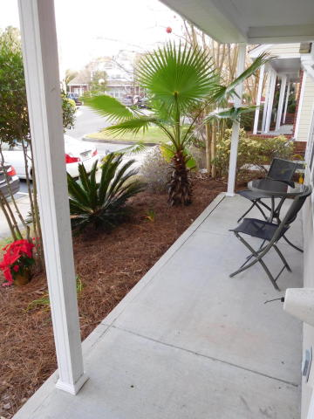
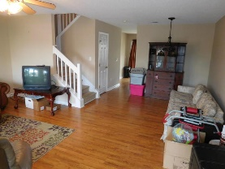
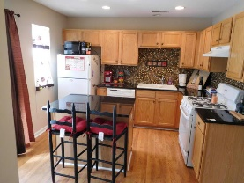
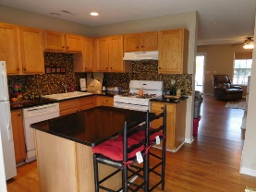
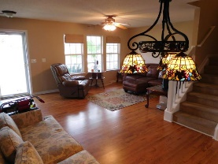
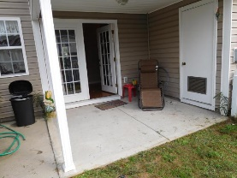
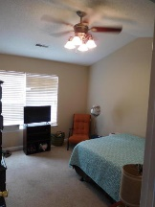
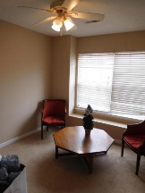
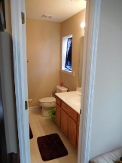
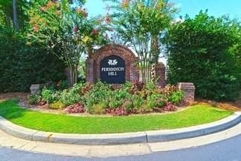

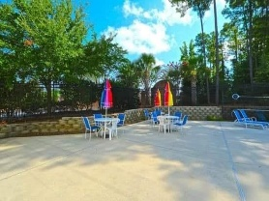
Jodi Griffin
Office - (843) 860-9369
letjodisellyourhome@gmail.com
Freshly painted...
Make a offer!
131 Hornby Circle
Persimmon Hill Townhouses | Goose Creek | MLS# 15030399 | $117,750
Beautiful 3 bed 2.5 bath home that was renovated 4 years ago.
Granite counter tops, Tiled back splash. Master has vaulted ceiling. Covered patio out back with a fenced back yard for pets etc. Full covered front porch.
Close to everything. Seller has to move so show this one and make and offer.
Paradigm Homes & Investments, LLC | 182 Darcy Avenue | Goose Creek, SC 29445

