Slide 1
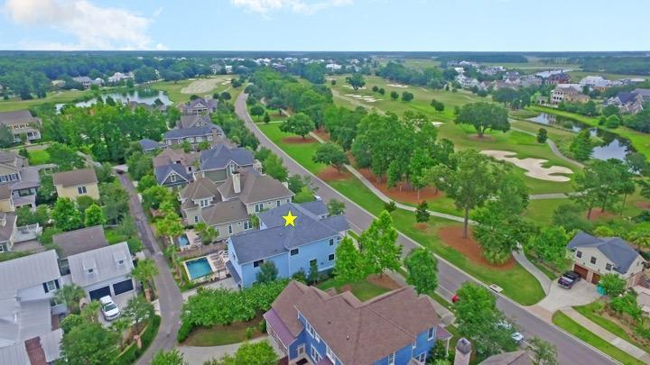
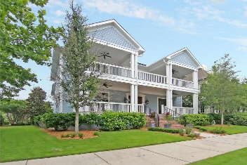
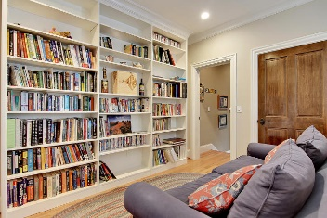
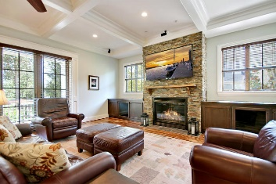
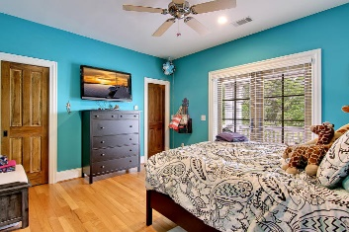
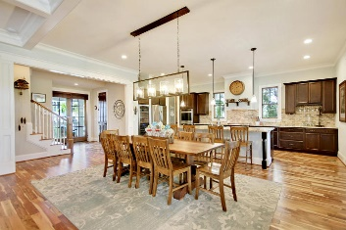
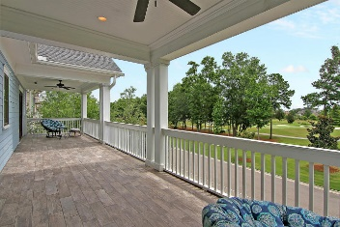
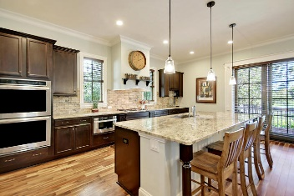
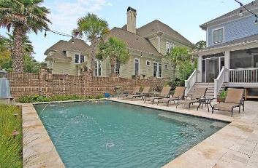
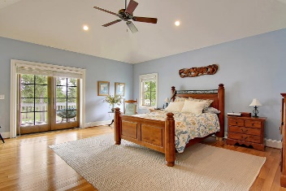
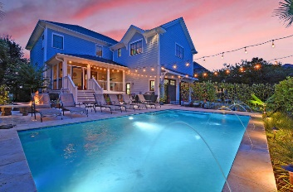
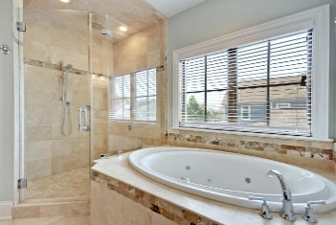
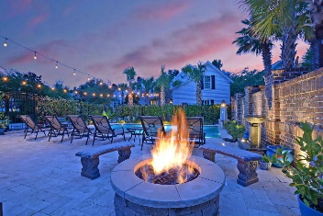
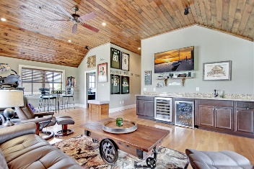
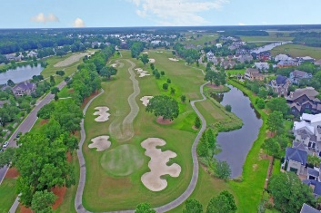

Live in the Heart of Daniel Island
Price Reduced!
131 Island Park Drive
Daniel Island Park ~ MLS# 17025186 ~ $1,249,999
Live the Daniel Island lifestyle from this gorgeous, custom, pool home that is directly across the street from one of two Daniel Island Golf Club Courses. While some may favor the giant 3 car garage, or the bonus room w/ its wet bar & full bath, everyone will fall in love w/ the outdoor oasis pool area that features a gas fire pit, a lighting system to light up the night & a screened porch. A full front porch w/ gas lanterns & a full balcony w/ tile flooring above boasting views of the golf course provide more outdoor living spaces. Stunning wood floors, an open floor plan, a custom, stone gas fireplace & a high-end kitchen w/ built in 25 lb ice maker, wine storage for 200 bottles & gas appliances. Add a wall to the bonus room for a 4th BR w/ large closet & still have room for a man cave!
Additional features include:
The property is conveniently located in Daniel Island Park and is a short walk to the Daniel Island Club, Volvo cup Tennis stadium and the shops of Daniel Island
Easy access to the boat launch with boat storage just minutes away on Daniel Island
Spacious master suite with heated floor in master bath, whirlpool tub and large walk in closet
Less than 12 miles to the Charleston airport for the active business traveler
Incredible, large pantry with a sink and lots of counter and cabinet space
Miles of walking trails in the island
Charleston Battery stadium is less than 2.5 miles away for the active soccer fan
Has elevator shaft with pre-wired utilities ready for install if required by new owner
Central vacuum system, HEPA filter system for second floor
Exterior outlet for generator set up to power lights, etc.
Book your showing today!
Jeff Burda jeff@mattoneillteam.com 843-619-0405

