Slide 1
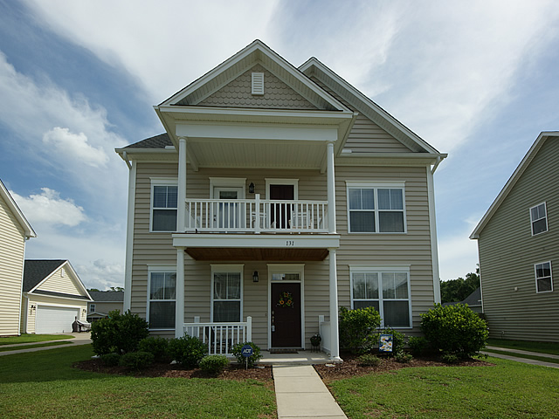
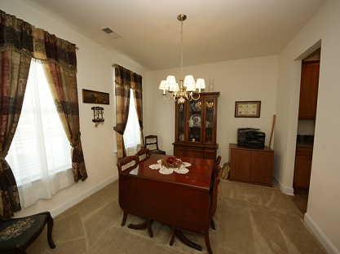
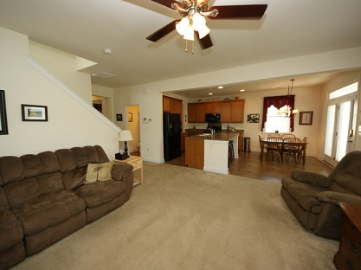
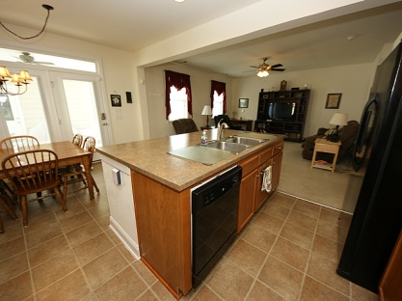
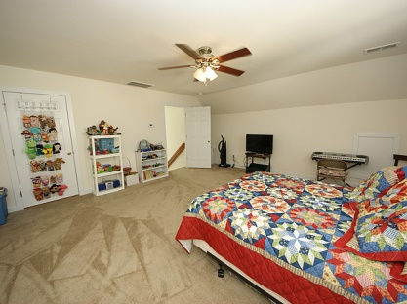
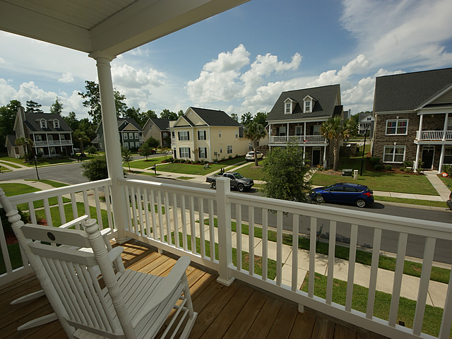
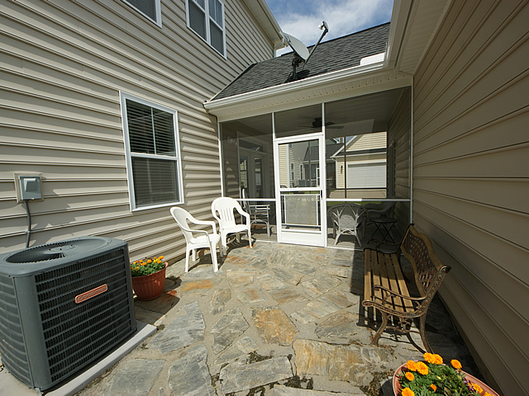

131 Tin Can Alley
Reminisce
Summerville, SC
MLS# 1414155 $219,500
2,530 Sq Ft - 4 Bedroom - 2½ Bath
Just Listed!
4 bedroom / 2.5 bath Charleston style Home Move in ready with double porches in Dorchester ll school district. This tastefully decorated home features a center hall with wood floors and architectural columns on either side that open to a formal dining room and a formal sitting / living room. Proceed down the hall to a large family room which is open to the upgraded kitchen and breakfast dining area. The kitchen has upgraded 42 inch cabinets, a large breakfast bar, a butler's pantry and black appliances. There is also powder room located on the first floor. The breakfast dining area has French doors allowing access to a nice size screened porch which acts as a breezeway between the house and the detached side entry two car garage. Just off the screened porch, the owners installed a nice stone patio which is ideal for grilling. The second floor has three nice size bedrooms, a guest bathroom and a large master suite. One of the guess bedrooms has access to the upstairs front porch. There is also a laundry room conveniently located on this floor. The deluxe master bath features a garden tub, separate walk-in shower, double sinks and a huge walk-in closet. The third floor has a very large bedroom which would also make a great ''man cave'' or play room. This home is situated in the Reminisce sub-division which has a community swimming pool, and is located a short commute to I 26 proving easy access to the Boeing and Air Force bases. The seller is highly motivated and is offering a $3,500 contribution to the buyers closing costs.
Bill Milo
Mobile: 843-412-0052
Bill@southernshoresre.com
Southern Shores Real Estate
1050 St. Andrews Blvd
Charleston, SC 29407

