Slide 1
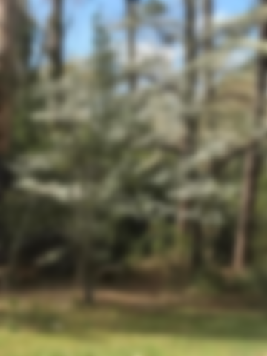
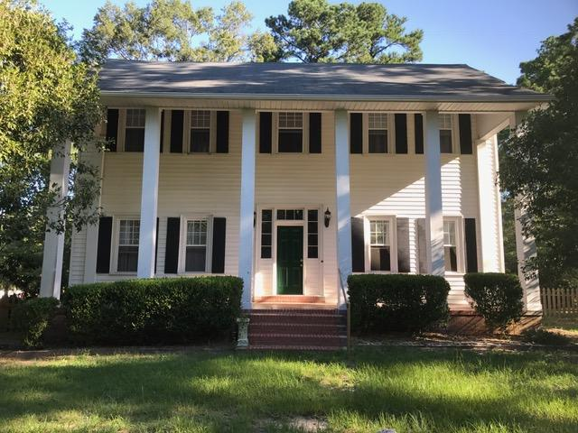
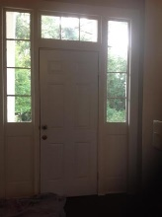
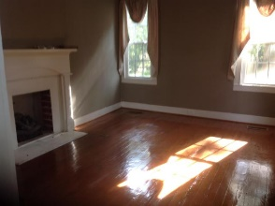
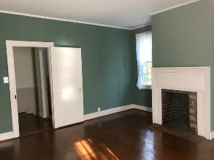
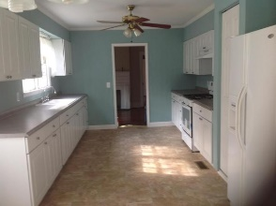
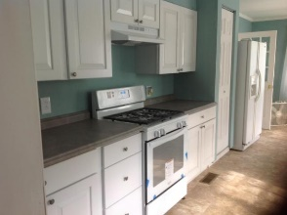
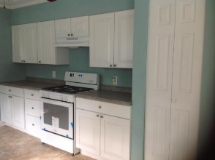
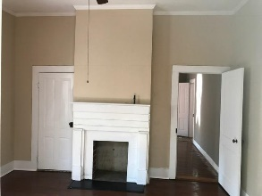
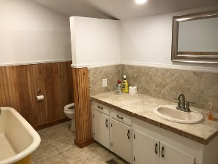
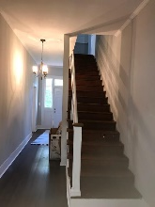
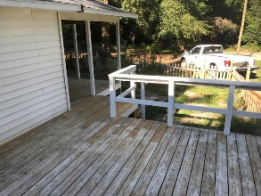
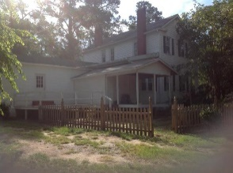
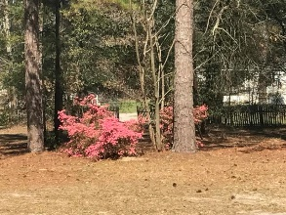

BACK ON MARKET! Unique property built in 1860!
131 Tucker Road
Eutawville, SC 29048 | MLS# 17021850 | $179,500
4 Beds | 3 Baths | 2,224 Square Feet
Large Colonial home on 3.5 acre parcel. New kitchen cabinets as well as gas stove. Beautiful refinished hard wood floors. Close to shopping and city park. This is a must see this property. Deer are frequent visitors.
Carla Davis
Mobile - (843) 437-4873
gaweber@tds.net
Karen Brown
Mobile - (843) 709-4029
karenbrown22@gmail.com
AgentOwned Premiere Group | 141 A N. Main Street | Summerville, SC 29483

