Slide 1
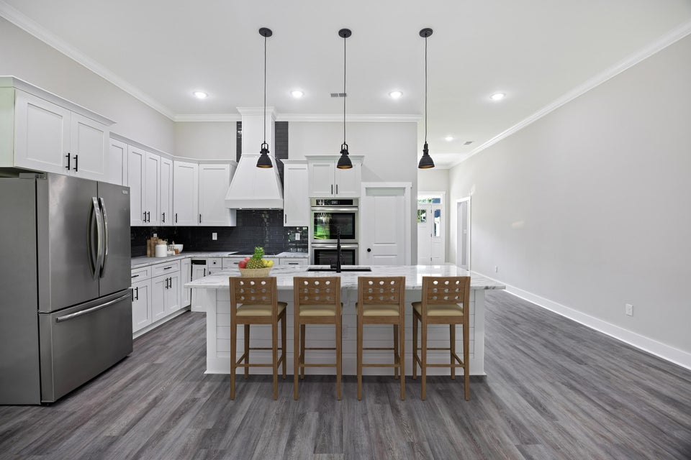
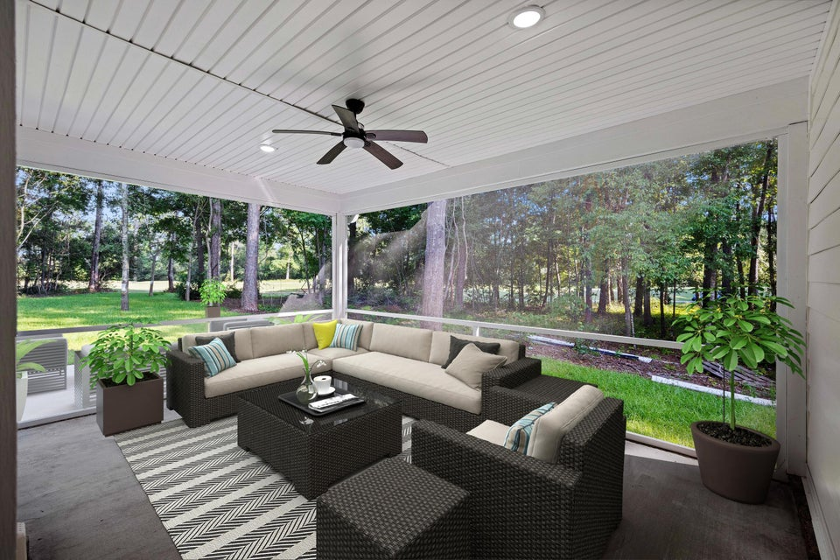
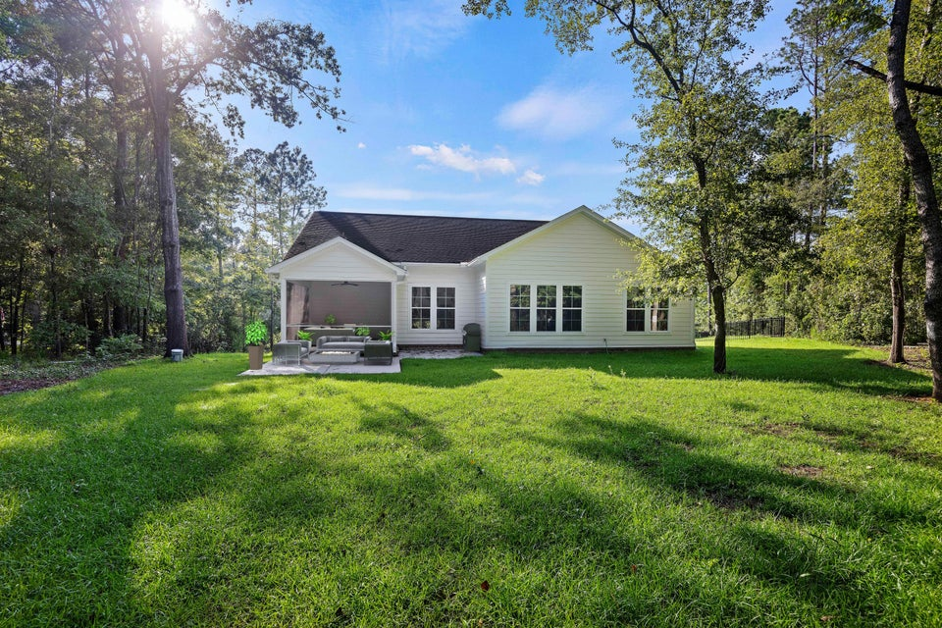
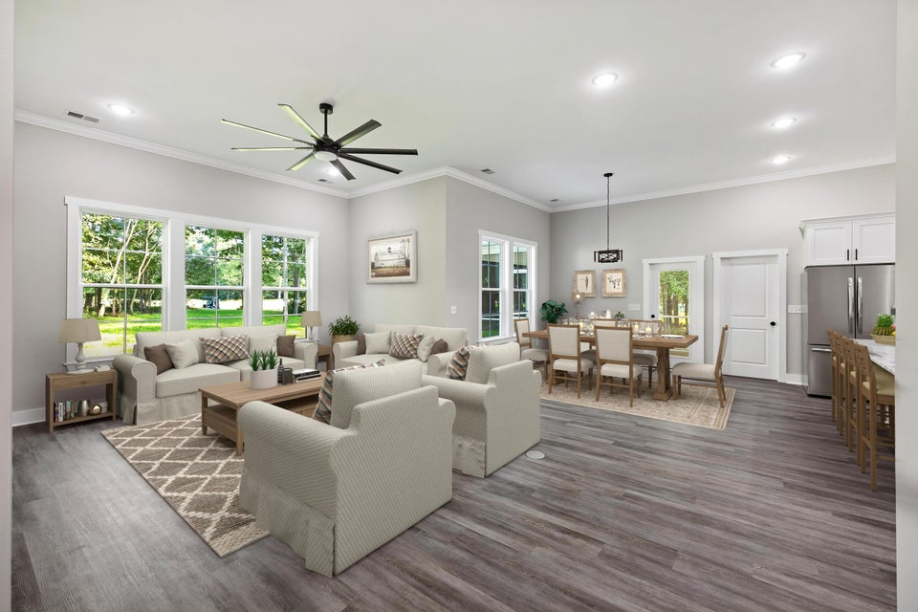
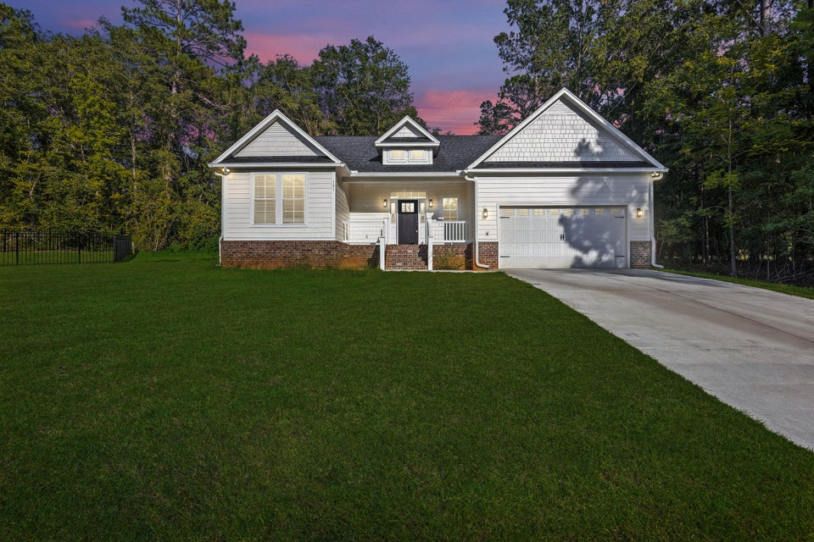
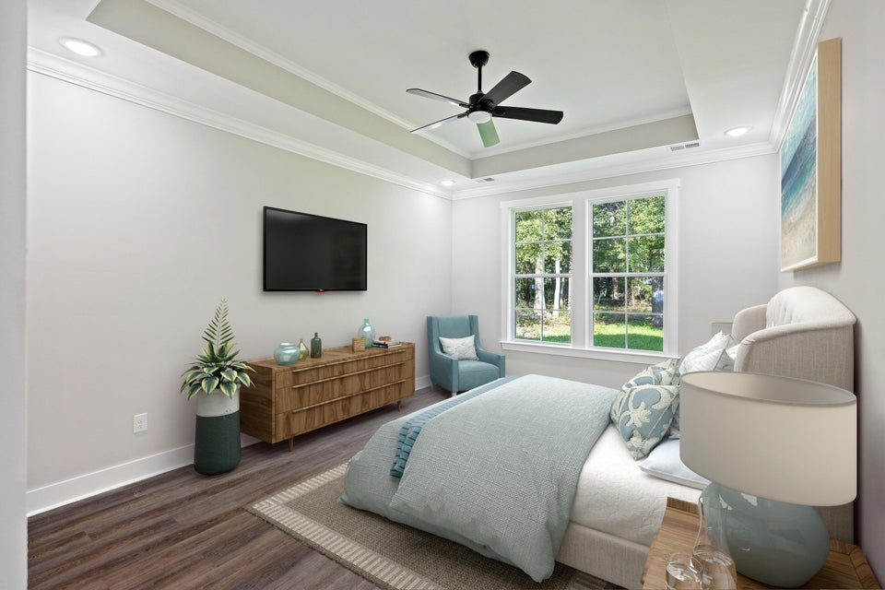


Beat The Crowd! Don’t Miss This Black Friday Deal!!
131 Green Court
Chapel Creek Plantation | Santee, SC 29142 | MLS# 24021226 | $434,800
New Construction
Move-in Ready!
1,950 Sqr Ft
Single-story Floor Plan
3 Bed / 2 Bath
Golf Course Lot (16th Hole)
Separate Shower And Soaking Tub
Screened-in Porch
Minutes To Fishing, Boating, Etc On Marion Lake
$2,000 BONUS Commission Is Offered For Any Offers Submitted Before Dec 9th 2024
Atlas Fathalla
The Home At Last Team
843-779-5613
atlas.home.expert@gmail.com

