Slide 1
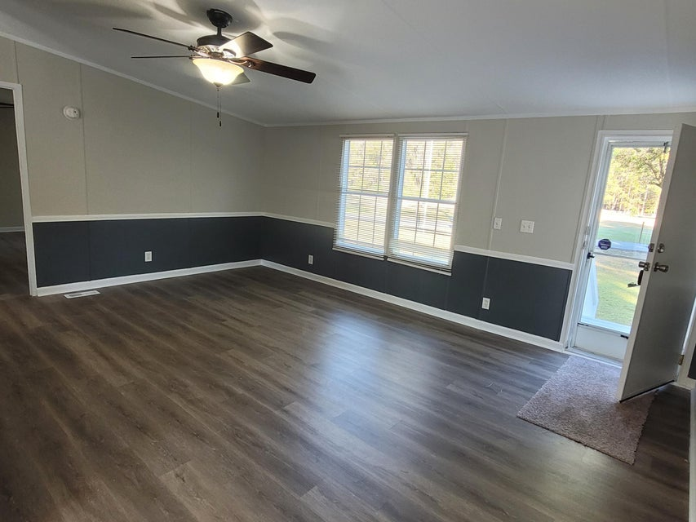
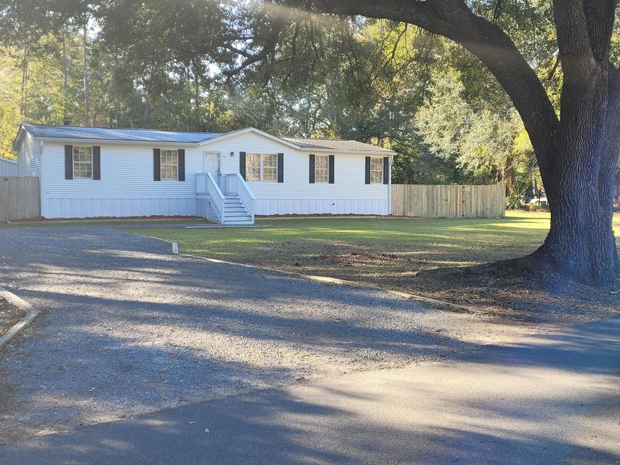
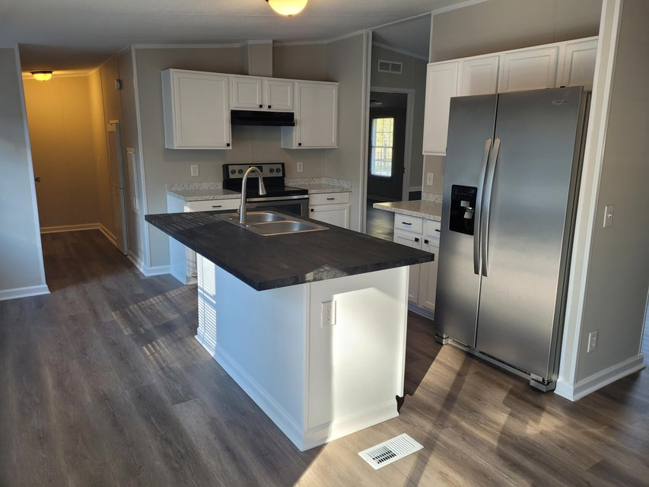
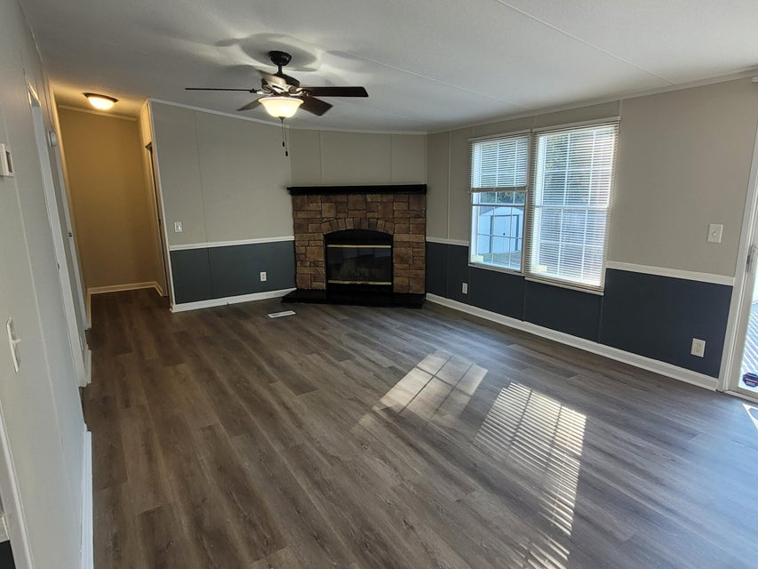
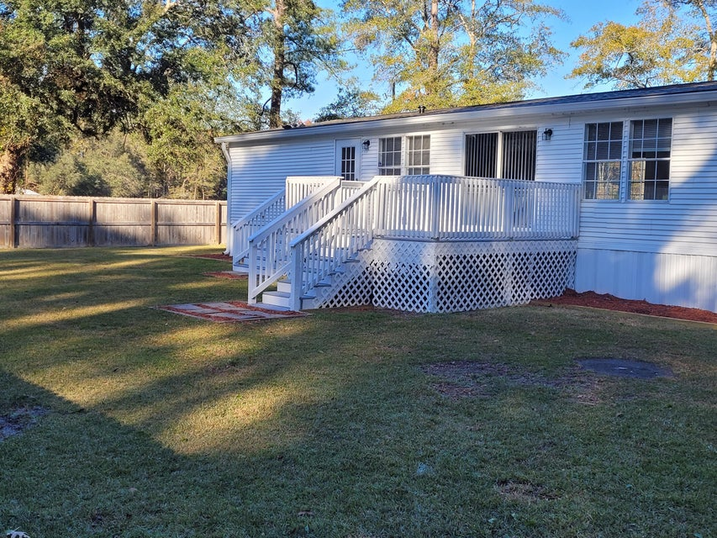
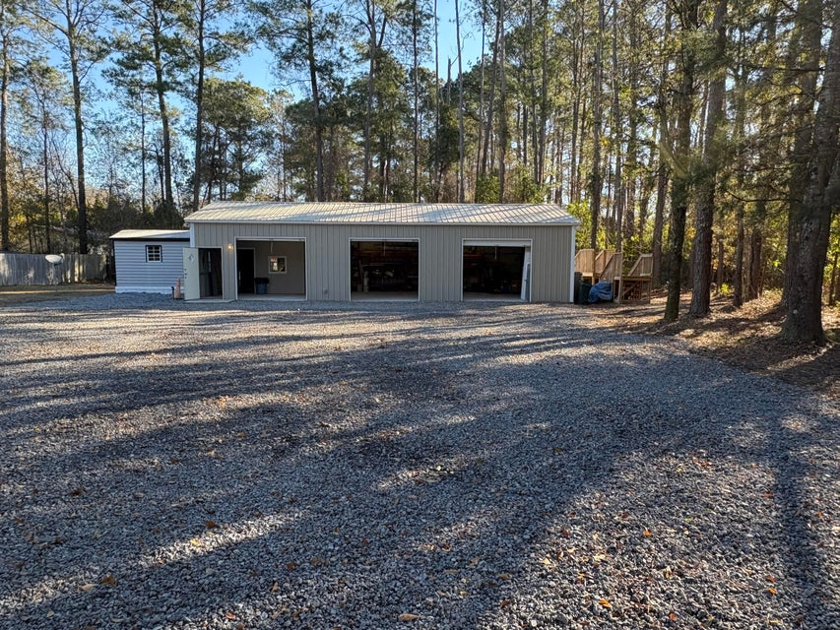
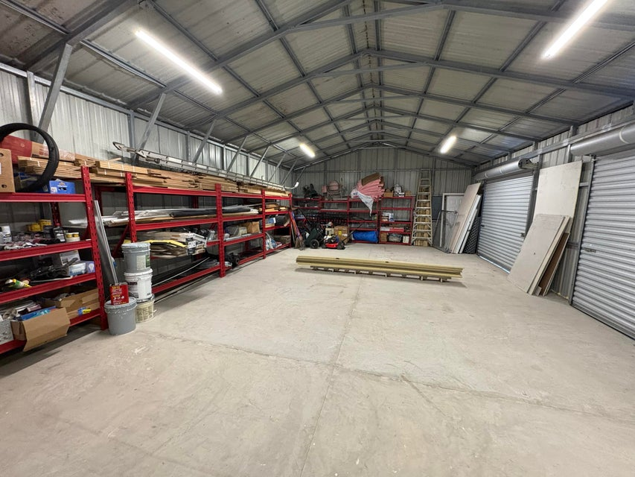
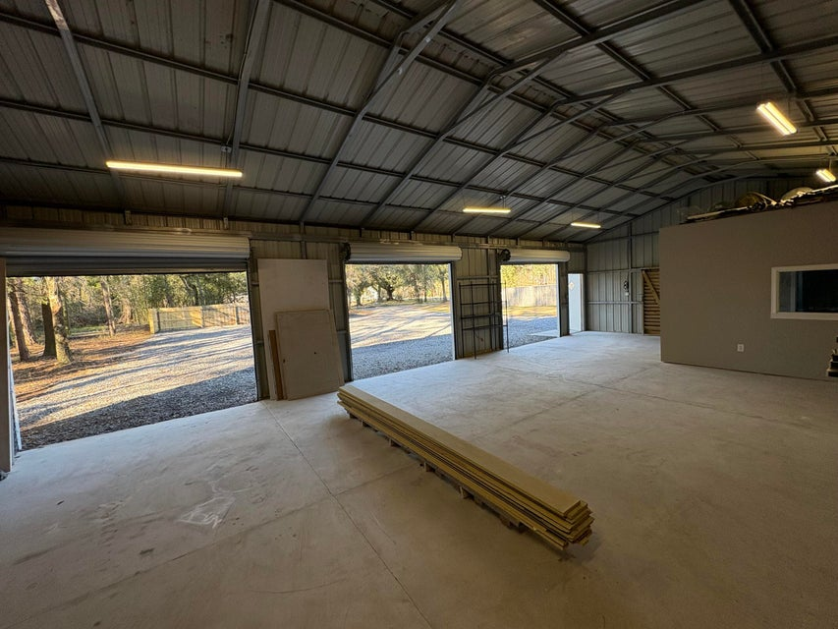
UNIQUE 1 ACRE PROPERTY IN SUMMERVILLE
WITH HOME AND LARGE SHOP BUILDING
131 Schultz Lake Road
Summerville, SC 29483 | MLS# 25001650 | $375,000
The perfect property for someone who owns a construction company, landscaping business, long haul trucker or just loves working on cars!
Large corner lot with 2 access points
Move-in ready 3 bedroom 2 bath manufactured home
Open floorplan with family room and a fireplace
Spacious yard with privacy fence
Large 30x50 shop with 3 roll up doors
Office space and full bathroom in shop
Plenty of parking for large equipment or multiple cars
2.5% Buyer’s Agent Compensation
Dora L McGillis
843-343-5012
doramcgillis@hotmail.com
www.hbrtwn.com
Harbourtowne Real Estate
672 Marina Drive, Ste 110
Daniel Island, SC 29492
Harbourtowne Real Estate | 672 Marina Drive, Ste 110 | Daniel Island, SC 29492

