Slide 1

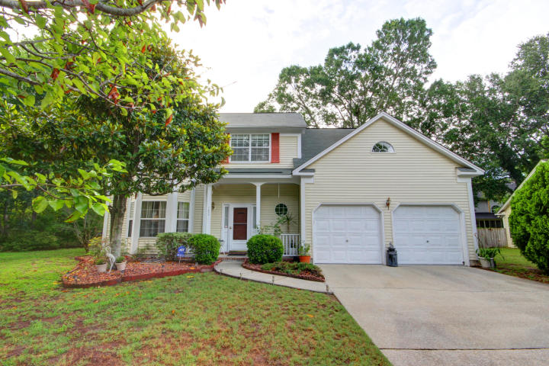
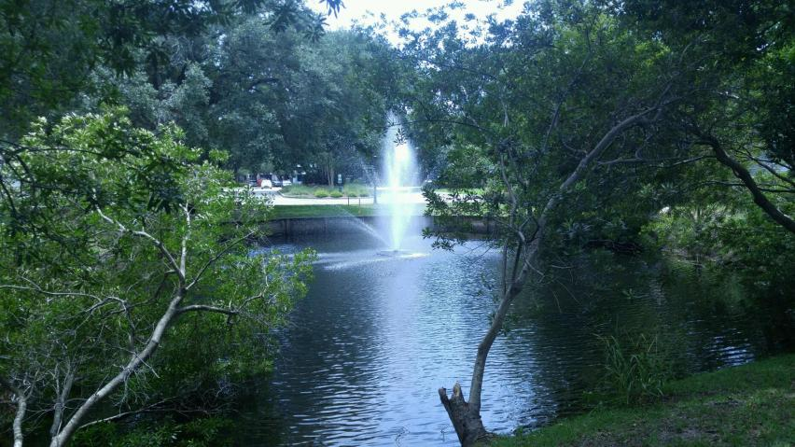
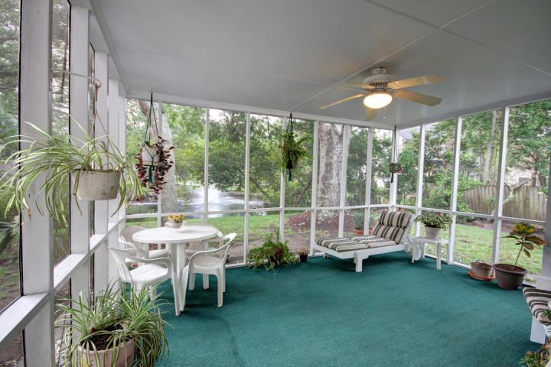
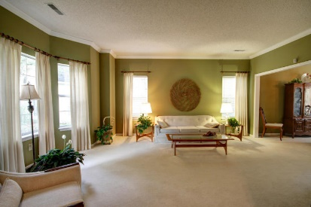
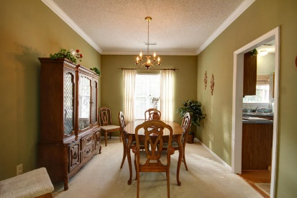
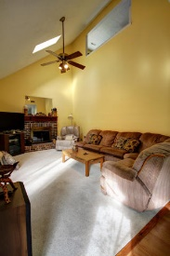
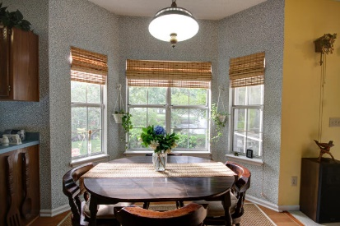
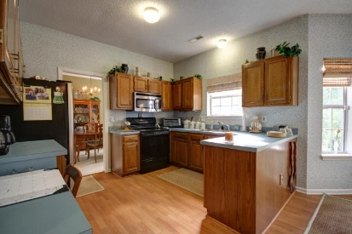
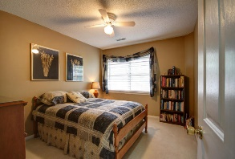
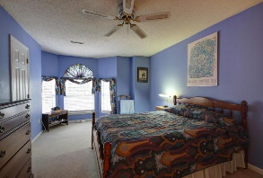
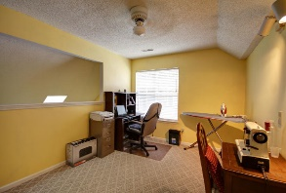
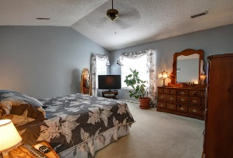
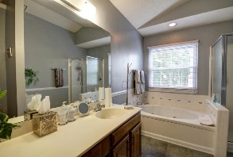
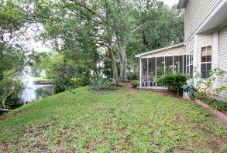
3.5% Commission Available To Buyers Agent!!
Liz Lyman
(843) 732-0017
liz@carrollrealtyinc.com
www.carrollrealtyinc.com
1320 Old Mill Lane | Sweetgrass | Mt Pleasant | MLS# 17015752 | $449,000
ORIGINAL OWNER is moving! Pristine 3 or 4 bedroom 2.5 bath home is superbly located in the heart of Mt Pleasant. Only 5 minutes to the beaches of Isle of Palms and Sullivans Island, 10 minutes to downtown Charlestown. Lots of nearby restaurants and shopping.
This pet free home has been meticulously kept for the last 25 years by the original owners. This beautiful traditional two story home on cul-de-sac, has a large family room, half bath, nice size kitchen with eating area, separate dining and living room with a wood burning fireplace. The living room overlooks the pond and fountain!! Very private!
There is also, a great screened in patio off the living room. No-one behind you! All bedrooms are located on the 2nd floor. The room above the garage can easily be converted to a 4th bedroom, has a window and closet! The master bedroom has large master bathroom with Jacuzzi tub. NO ISSUES OR STORIES WITH THIS HOME! Come see for yourself!
*** New 50 gal water heater recently installed, *** Renovation loans available contact Joann Terrell at South State Bank (843) 224-0525
Carroll Realty · 103 Palm Blvd · Isle of Palms, SC 29451

