Slide 1
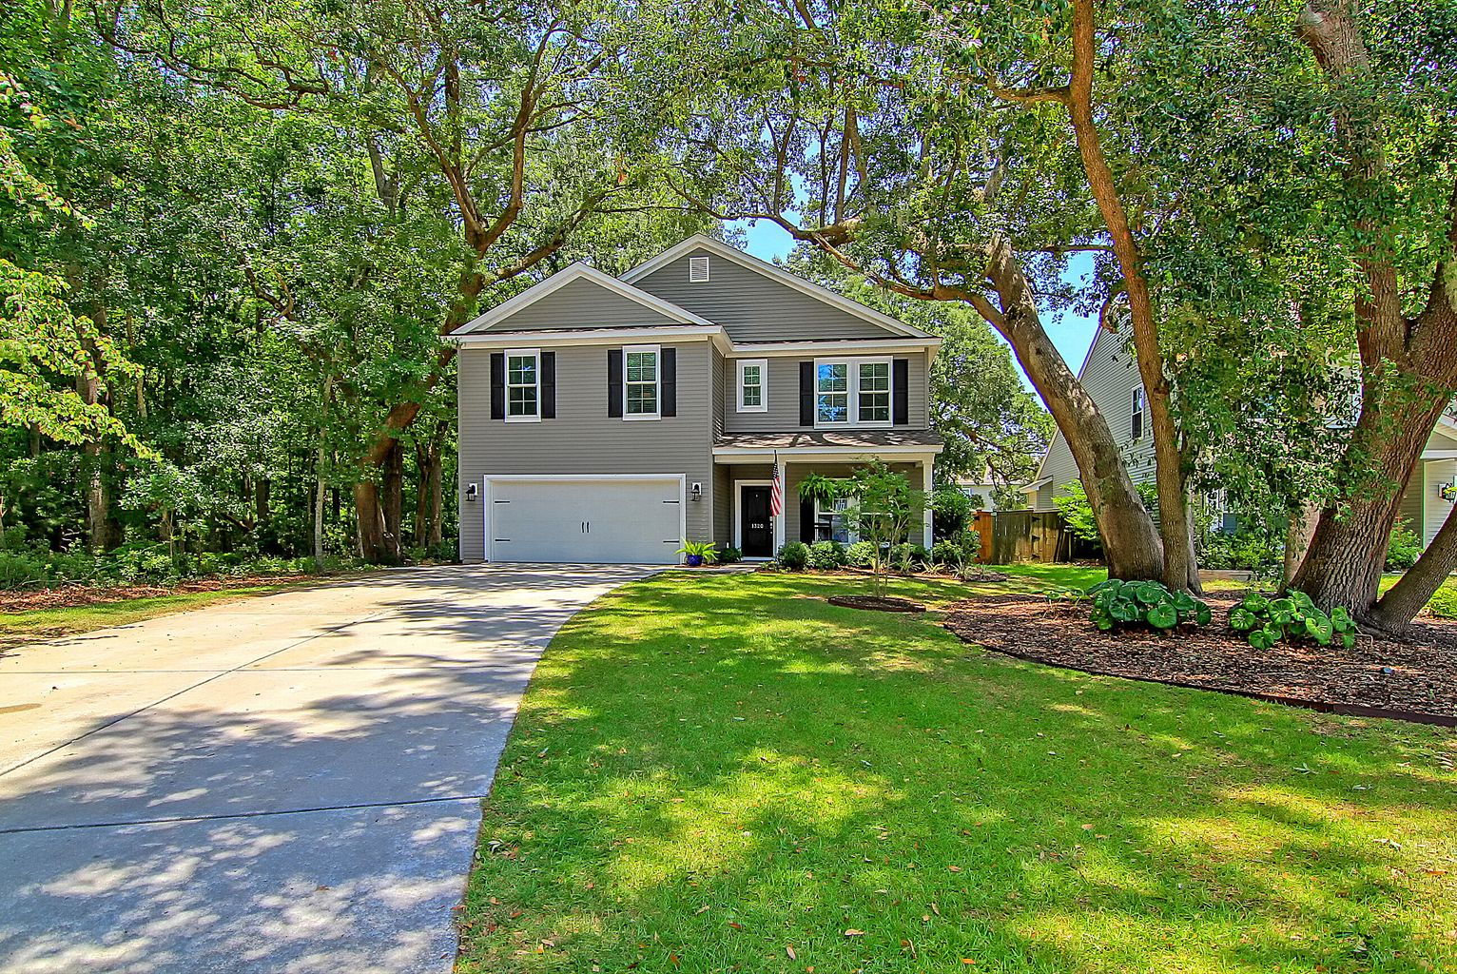
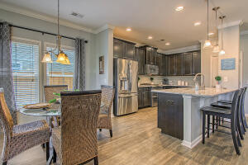
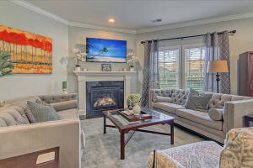
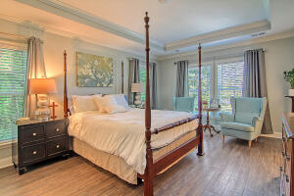
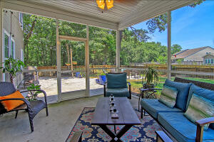
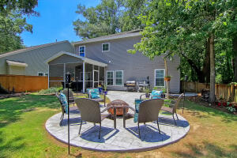


1320 Belgian Draft Drive
Carolina Park | Mount Pleasant, SC 29429 | MLS# 22017301 | $710,000
NEW PRICE
Gorgeous, upgraded, and private this 5bd/3bth Tupelo home is tucked away on a quiet cul-de-sac lot. This perfectly maintained home features an open floor plan ideal for entertaining, laminate flooring throughout, and first floor guest bedroom with full bath. The well appointed eat-in kitchen is highlighted by a large center island w/quartz countertops, ss appliances, a double oven, and beautiful custom tile backsplash. The spacious living room opens to the kitchen and features a corner gas log fireplace. Upstairs are three additional bedrooms including the master suite, and an oversized loft that can be used as flex space. The impressive master suite boasts a tray ceiling, walk-in closet, double vanity, garden tub and separate tile shower. Entire upstairs was freshly painted in 21' Laundry room is conveniently located on the second level. In back, enjoy a morning coffee on your screened in porch with custom stone patio and fire pit that overlooks a fully fenced backyard.
Additional features include:
-crown molding throughout
-surround sound
-extra attic storage
-natural conservation buffer on one side
-2 car garage with extended driveway & added garage door screen
-covered front porch
Tupelo amenities include neighborhood pool, play park, and hiking trails. The Tupelo subdivision is conveniently located off of Highway 17 and just minutes away from the Oakland shopping center and award winning Mount Pleasant schools. Enjoy lowcountry living at it's finest just 20 minutes to the beach and 30 minutes to downtown Charleston.
Erin Eisele
843-329-2273
erin.eisele@carolinaone.com
http://www.erineiselerealty.com/
Carolina One Real Estate
2713 Highway 17 North
Mt. Pleasant, SC 29466

