Slide 1
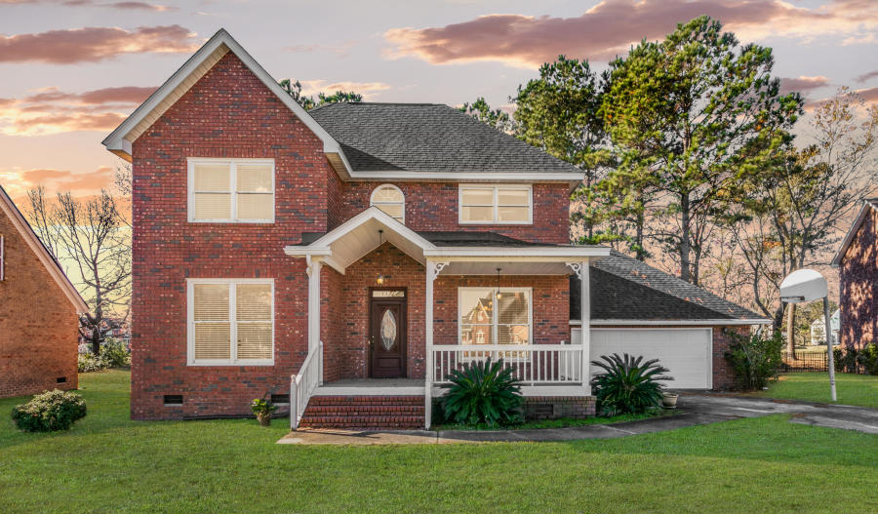
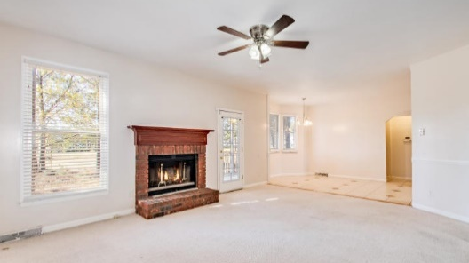
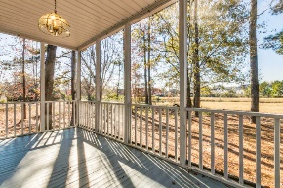
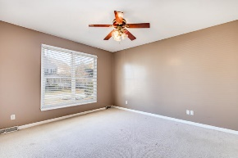
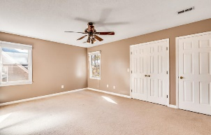
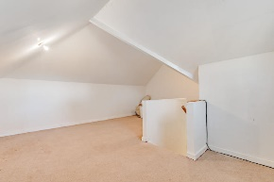
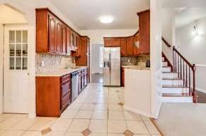
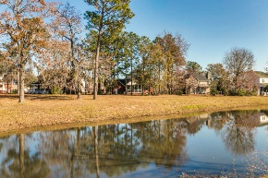


Rare Find in Eagle Landing!
1321 Kingfisher Circle
Eagle Landing ~ Hanahan, SC 29410 ~ MLS# 19033809 ~ $319,900
**Seller is offering a credit to sand, refinish, and restain
the hardwoods and to replace the carpet!**
This all brick home located in a private cul-de-sac offers 4 Bedrooms and 3 Full Bathrooms + 1 Half Bath! As you walk into this home, you enter the foyer with the large dining room on the right, perfect for holiday dinners. To the left is the large master bedroom with a separate garden tub and shower in the master bathroom. The living room contains a fireplace and connects to the additional breakfast dining area. The kitchen has tons of cabinetry and counterspace and comes with ALL APPLIANCES! Upstairs contains second Master and the additional bedrooms/bathrooms. Each of the bedrooms are huge and have plenty of closet space. Looking to host outdoor parties? The screened-in back porch with views of the pond is the icing on the cake! Roof was replaced in 2017. This home is just minutes from restaurants, groceries, gyms, and endless shopping with the Northwoods Mall right across the neighborhood entrance! Schedule your showing today!
Nick Mazzilli
(843) 640-5575
nick@nickmcharleston.com
www.nickmcharleston.com
Reside Real Estate LLC
155 Wingo Way Unit 421
Mt. Pleasant, SC 29464

