Slide 1
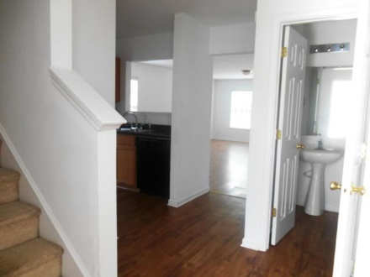
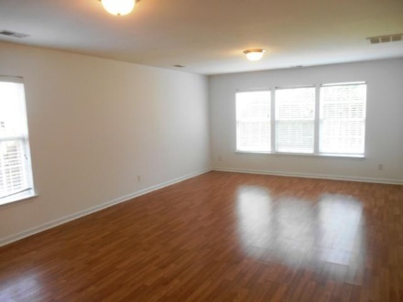
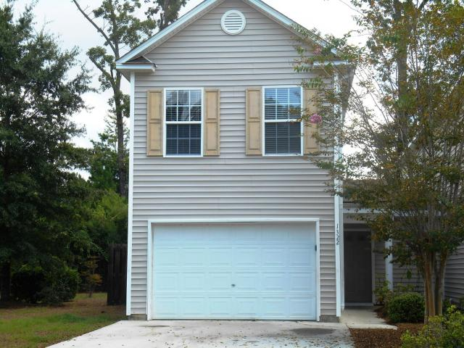
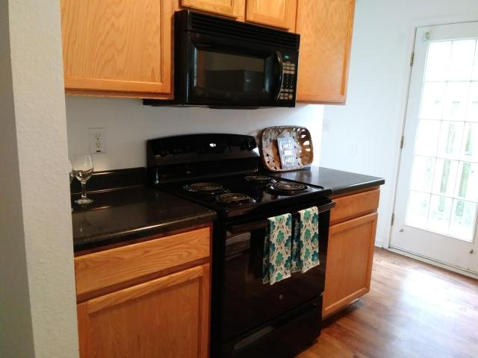
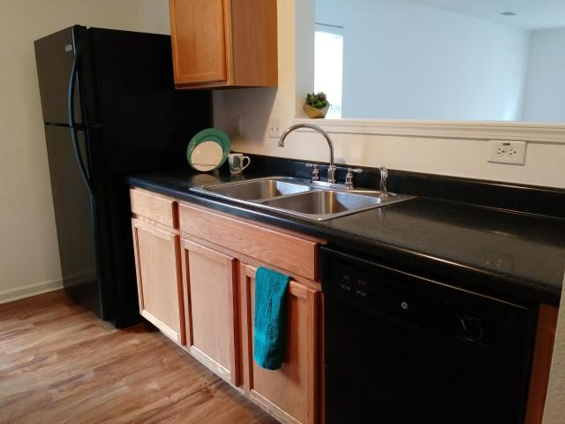
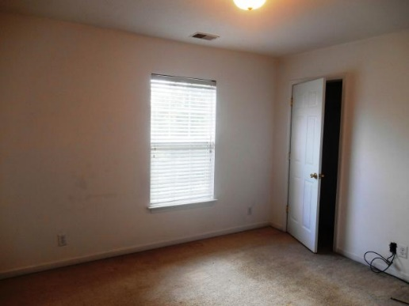
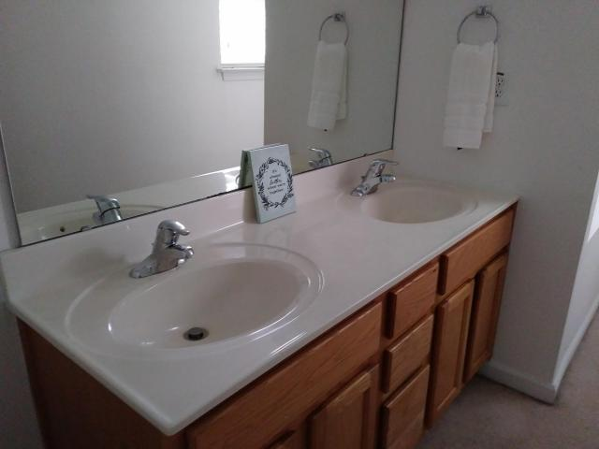
Open House ~ Sunday, August 19th ~ 1-4pm
1322 Garland Street
Vistiana
N Charleston, SC 29420
MLS# 18017026
$156,900
3 Bedroom ~ 2½ Baths
1,450 Square Feet
Great location for Investors or First Time Home Buyers in Dorchester 2 school district!
This 3BR, 2.5 bath townhouse is an end unit on a cul-de-sac street with a fenced in backyard. Downstairs living space has open concept from foyer to kitchen and great room. Upstairs you will find master bedroom ensuite, 2 spacious bedrooms with large closets and laundry area. Location is convenient to shopping, amenities, Joint Base Charleston, Boeing, Bosch and transportation routes.
Terri Wood
Real Estate Agent
Miler Properties
Office: (843) 821-1111
Cell: (843) 478-7020
terri@milerproperties.com www.milerproperties.com

