Slide 1
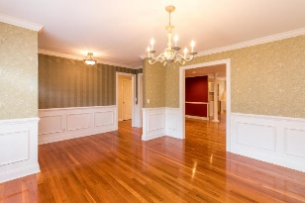
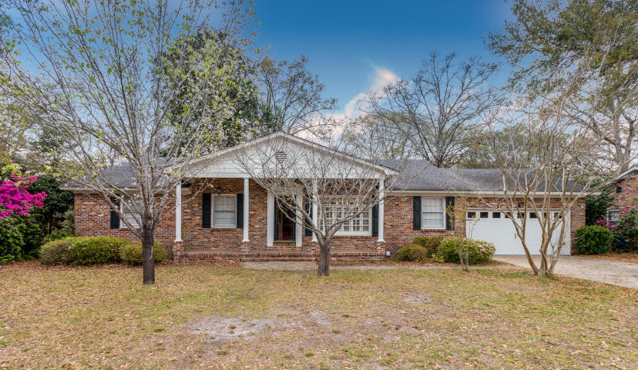
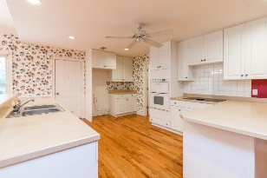
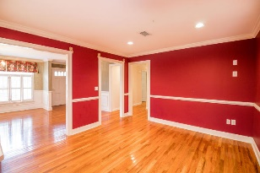
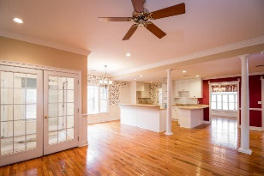
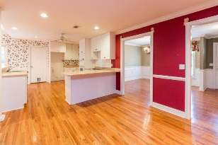
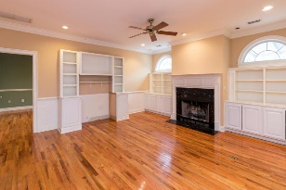
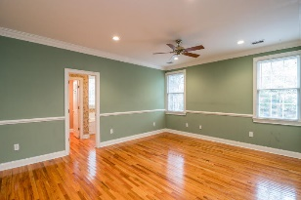
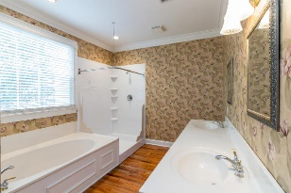
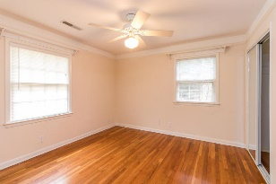
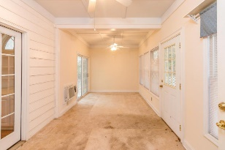
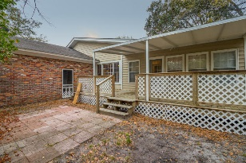
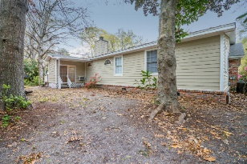


Beautiful Brick Home in Charlestowne Estates
1322 New Castle Street
Charlestowne Est ~ Charleston
MLS# 17003078 ~ $415,000
Beautiful brick one story home in well established neighborhood in central location. Close to everything. 4 bedrooms and 3 full bathrooms. Two master suites. Hardwood floors throughout. Formal living room, dining room, big eat in kitchen, family room, sunroom and big covered deck and patio. Two car garage, big front porch. Huge laundry room with . Breakfast bar, double convection oven. Camellia bushes adorn this entire property, also block solid fence around back yard. Lawn irrigation in the front yard. New Garage door. Smooth ceilings. Lots of recessed lights. Termite bond with Wilson's. Extra blown insulation in attic. Beautiful molding throughout the house. Built ins in family room and wood burning fireplace. Property currently does not require flood insurance Zone X and there is no HOA
Sherrie Lindberg, Realtor
843-532-2002
lindbergsherrie@gmail.com
www.erawilderrealty.com
ERA Wilder Realty, 125-F Wappoo Creek Dr, Charleston, SC 29412

